Slide 1


URUGUAY ROUND II
Milan 25th October
Exploration & Production
ANCAP
Notes:
Buenos días.
En primer lugar, quisiera agradecerle a las numerosas empresas petroleras y de servicios que están aquí presentes, su presencia es la que hace que este esfuerzo tenga sentido.
Good morning.
First of all, I would like to thank all the many oil and service companies that are here with us. Your presence is what make all the efforts worth.

Slide 2
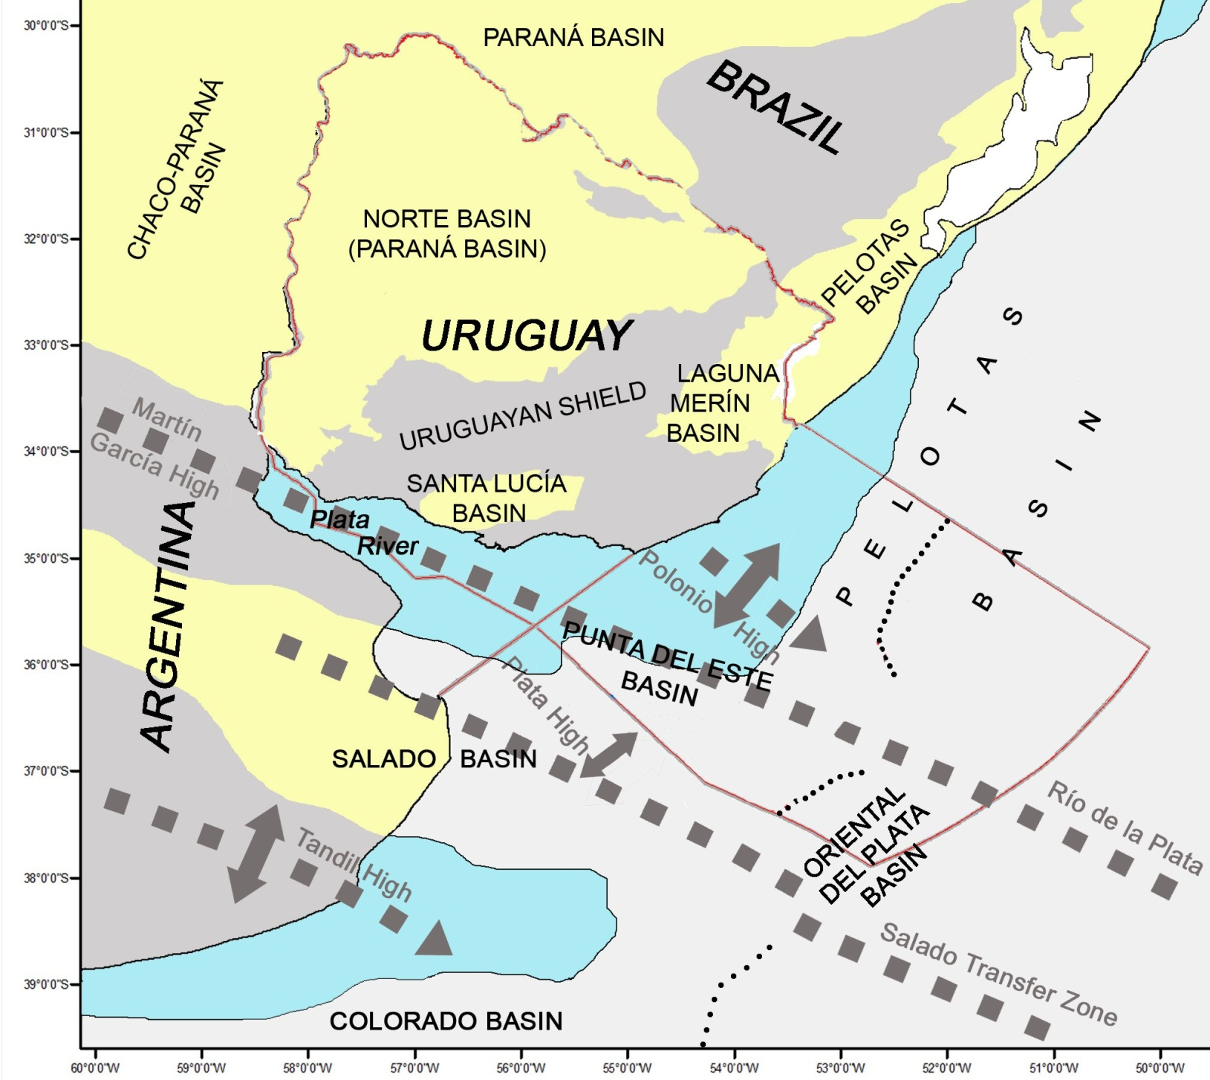

SEDIMENTARY BASINS OF URUGUAY
ARGENTINA
BASIN
Soto et al. 2011
Notes:
The geology of Uruguay is represented by a Precambrian shield, coloured in dark gray in the picture, and six sedimentary basins (three of them in the onshore and three in the offshore).
The Norte Basin, located in the north and central region of the country, is a Palaeozoic intracratonic basin, corresponding to the Uruguayan portion of the Chaco-Parana Basin, which extends to Brazil, Argentina, Paraguay and Uruguay.
Two Mesozoic basins are developed in the south of the country, called Santa Lucia and Laguna Merin. Both are related to the breakup of Gondwana and are part of a East-West – Northeast structural lineament.
In the offshore three basins are developed: Punta del Este, Pelotas and Oriental del Plata.
The Punta del Este basin presents a Northwest orientation. It is separated from the Salado basin in the offshore of Argentina to the west by the del Plata High and from the Pelotas basin in the offshore of Uruguay to the east by the Polonio High.
The Pelotas basin presents a Northeast orientation, it corresponds to the flexural border of a precursor synrift structure. This basin extends from the Polonio High up to the Florianópolis Fracture Zone in the offshore of Brazil, where the Santos basin starts.
The Oriental del Plata Basin develops in deep and ultra deep waters beyond the continental slope, over transitional and oceanic crust.

Slide 3
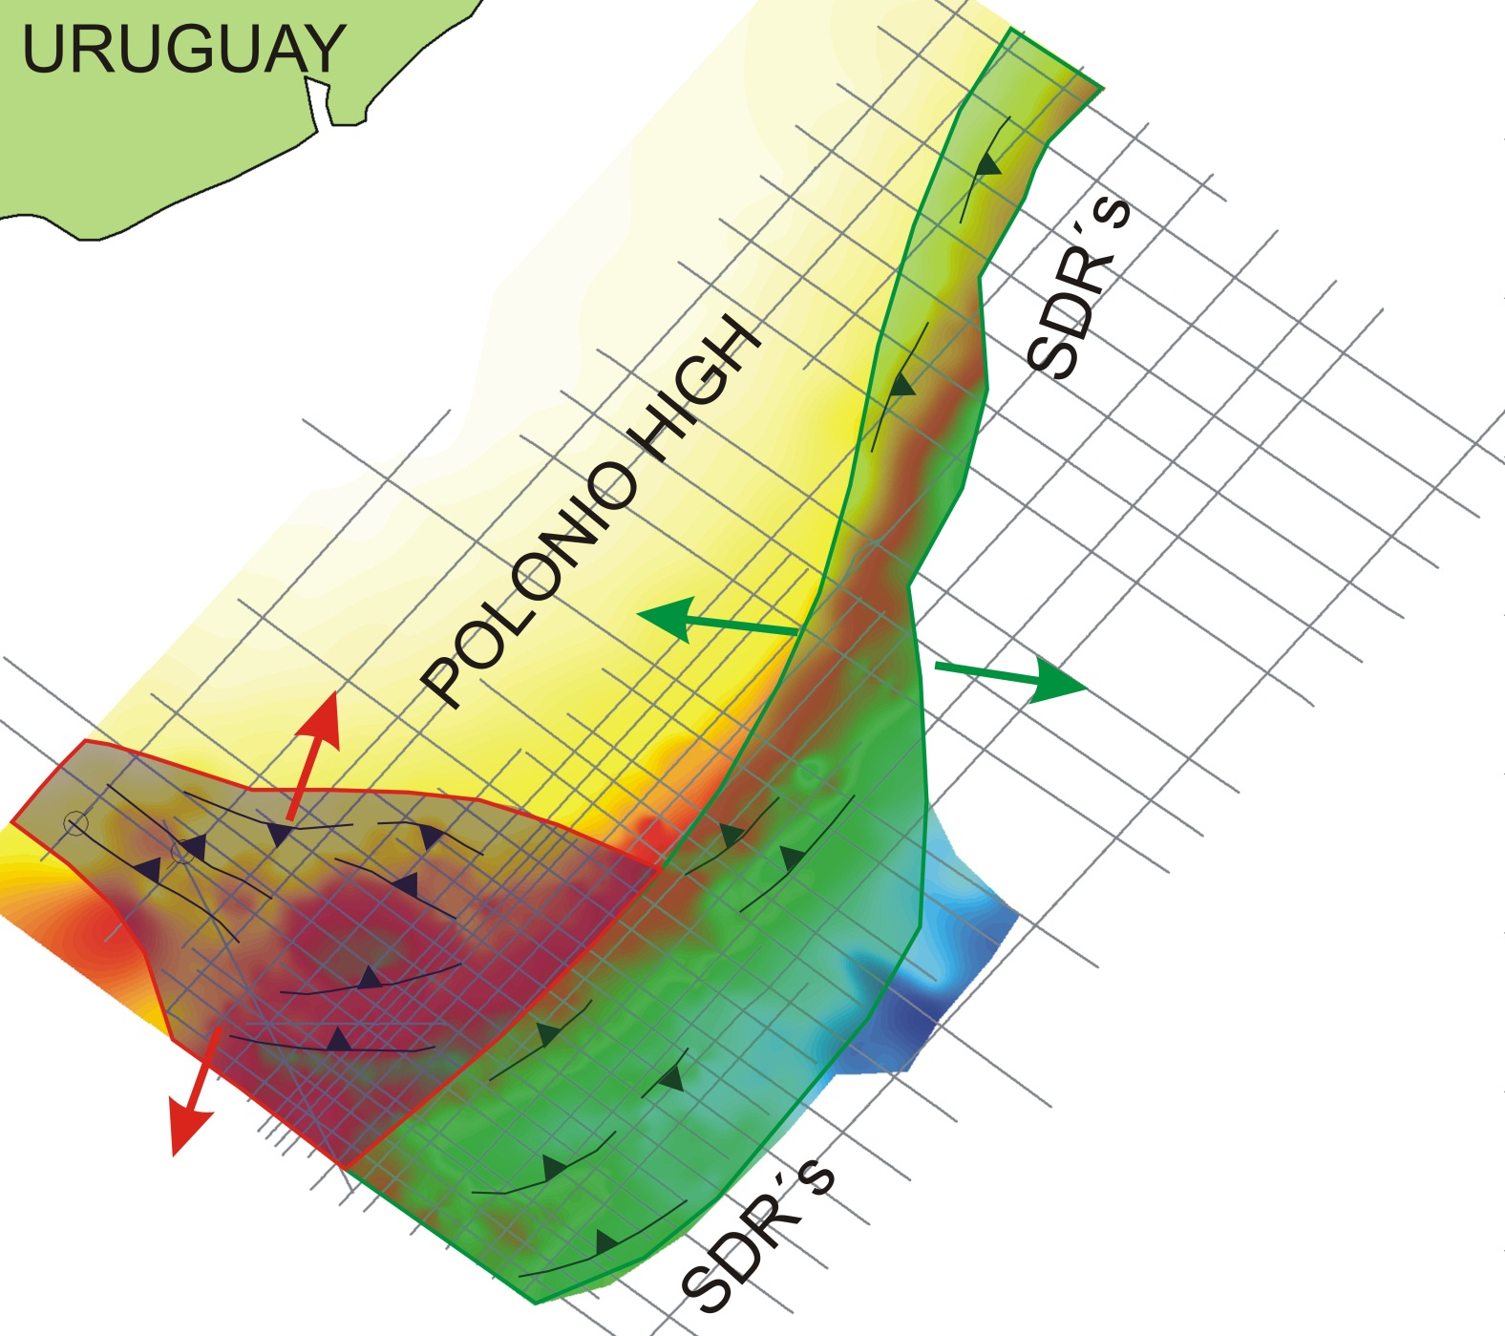

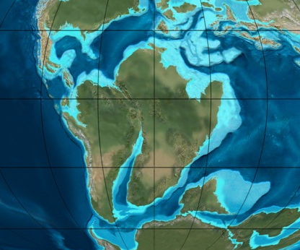
STRUCTURAL FRAMEWORK
Two main depocenter trends:
NW-SE
NE-SW
Late Jurassic (150 Ma)
PELOTAS BASIN
Early Cretaceous (120 Ma)
PUNTA DEL ESTE
BASIN
Base Rift TWT Map
R. Blakey
Notes:
This picture is a structural map of the base of the synrift sequence in the offshore of Uruguay, including the major faults associated with it. As you can see there are two structural trends related with the synrift phase. One of them has a northwest orientation and the other has an east-west-northeast orientation. The northwest orientation corresponds to the failed rift called Punta del Este basin, and these faults are associated with the initial rifting stage which started in the Jurassic times and subsequently aborted. On the other hand, the northeast trend is related to a second rifting stage of Early Cretaceous age, which generated fracturing parallel to the present continental margin.

Slide 4
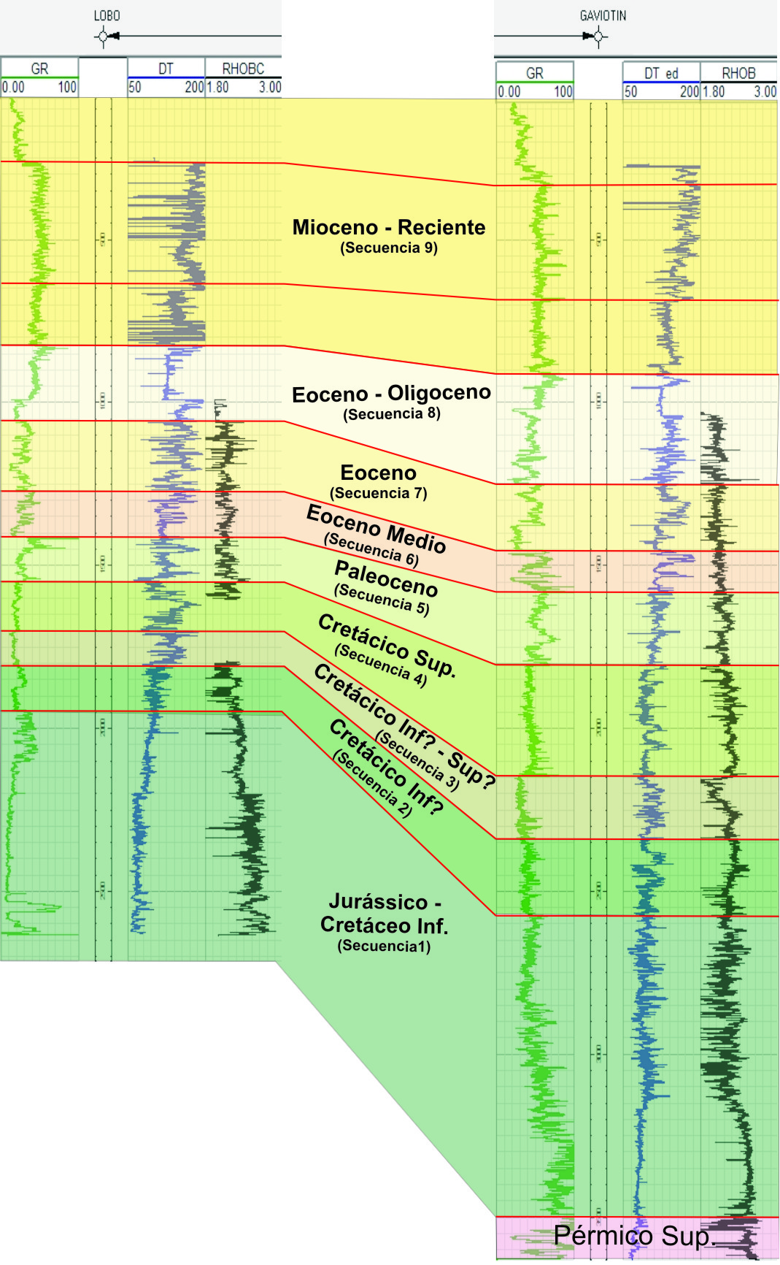
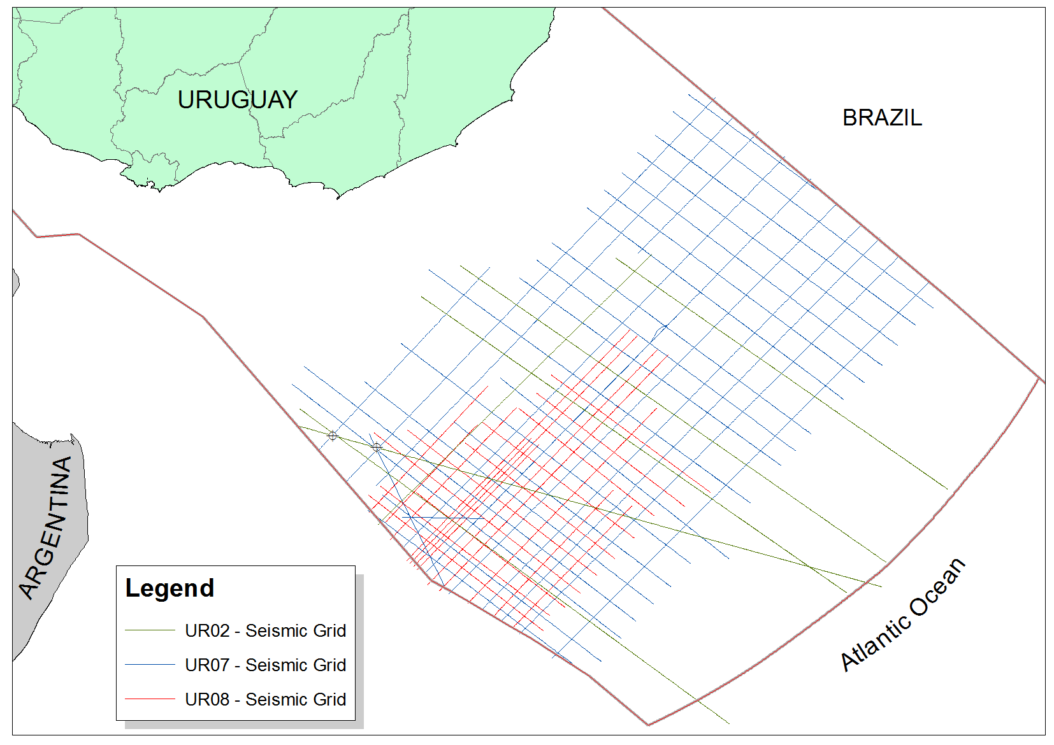
STRATIGRAPHIC FRAMEWORK
LOBO
GAVIOTIN
CORRELATION WELL TOPS
DRIFT
K/T
LOBO
TRANSITION
GAVIOTÍN
SYN-RIFT
PRERIFT
Notes:
With regard to the stratigraphy of the offshore basins of Uruguay, ten depositional sequences were defined on the wells according to the criteria established by the classic Sequence Stratigraphy. In both wells, biostratigraphic information is restricted from the Upper Maastrichtian to the Pleistocene, with the exception of the final section of the Gaviotín well, which has fossils of Permian age. In neither of the wells significant source rocks have been found, because they were placed in basement highs, and very close to the depositional and erosional basin limits. Four main tectonic-stratigraphic stages are recognized in the evolution of the Punta del Este basin. A prerift of Palaeozoic age, correlated with the Norte Basin. A Jurassic – Early Cretaceous synrift phase, which can be divided in a Sinrift I more volcanic, very well developed in the Lobo well, and a Sinrift II composed by alluvial and lacustrine sediments. A Barremian – Aptian transitional phase to open marine conditions and a Late Cretaceous-Cenozoic drift phase.

Slide 5
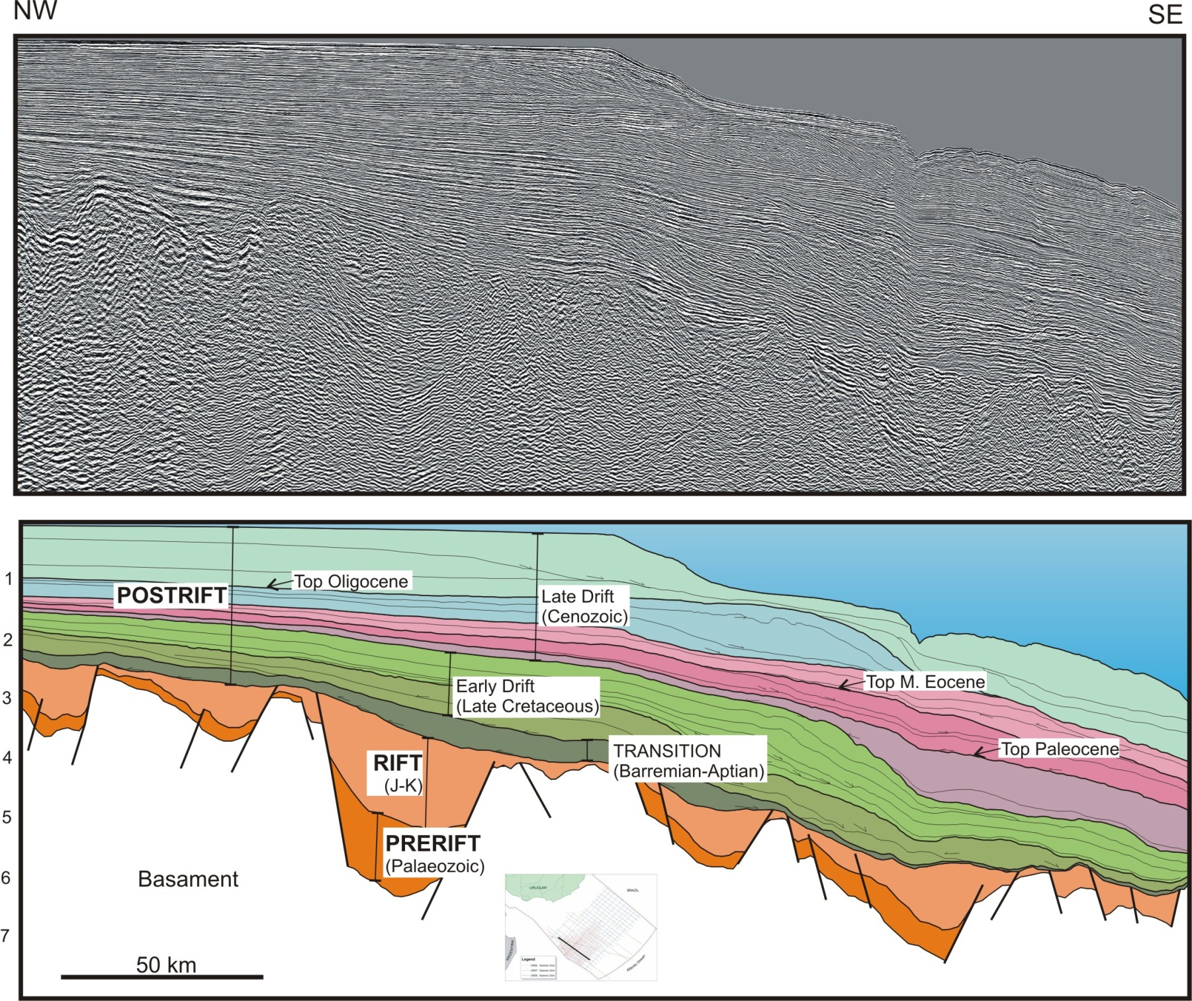
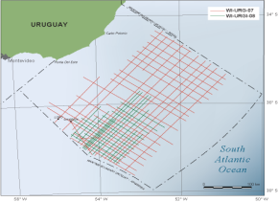
PUNTA DEL ESTE BASIN – STRATIGRAPHIC FRAMEWORK
Lobo
Gaviotín
Notes:
This is a dip seismic section along the Punta del Este Basin. The Punta del Este Basin is a failed rift, in which you can recognize grabens and half-grabens controlled by normal faults.
The prerift mega-sequence is represented by Palaeozoic sedimentary rocks drilled by the Gaviotín well, correlated with the geological units that outcrop in the Norte basin.
The synrift mega-sequence includes alluvial-fluvial and lacustrine deposits interbedded with volcanic and volcaniclastic deposits. It is remarkable that the prerift sequence is preserved spatially coincident with the development of synrift sequence, being partially eroded on highs.
The transitional sequence includes fluvial-deltaic deposits and distally marine deposits. It develops during a period of thermal subsidence after the end of the synrift phase. The base of the transitional sequence corresponds to an onlap surface, being the graben shoulders surpassed for the first time. Based on regional correlation; the age of this transitional sequence is probably Barremian-Aptian.
The drift mega-sequence can be divided in a Cretaceous early drift and a Cenozoic late drift. The Cretaceous early drift is coloured in green in the picture and it is composed by regressive deposits in a context of rising sea level. In the Cenozoic the sedimentation is controlled by the interplay of eustatic oscillations of sea level, regional subsidence and sediment supply.

Slide 6
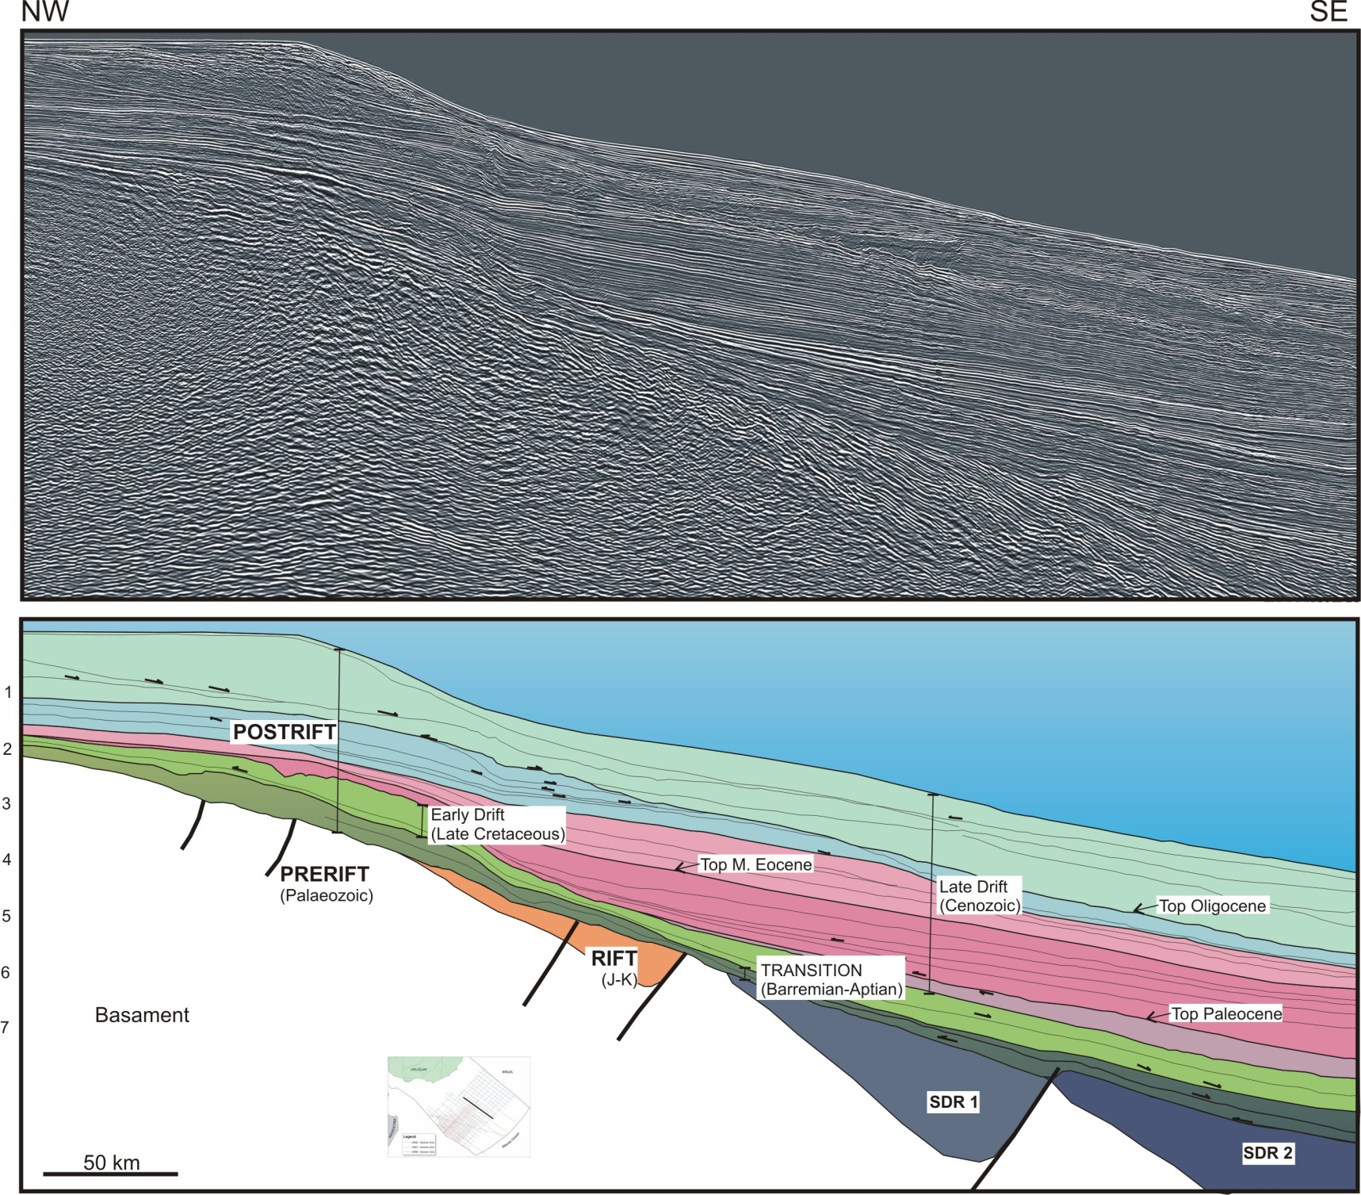
PELOTAS BASIN – STRATIGRAPHIC FRAMEWORK
Notes:
This is a seismic section along the Pelotas Basin. This is a flexural one, represented by an homoclinal ramp, with divergent reflectors, in which the sediments thicken toward the deepest part of the basin. The prerift mega-sequence is not mapped in this section because it appears masked by the quality of the seismic, but it has been drilled in the Brazilian portion of the Pelotas Basin. It corresponds to Palaeozoic and Mesozoic deposits of the Norte Basin. The rift mega-sequence in the Pelotas basin is represented by huge SDR wedges and small half-grabens with siliciclastic filling. The transitional sequence in this basin has the typical character of the Aptian transgression in all South Atlantic basins, with very clear onlap over the rift sequences.
The Cretaceous postrift mega-sequence, although present, is less thick than in the Punta del Este basin. The Cenozoic postrift mega-sequence is controlled by eustatic oscillations, sediment supply and specially by the high thermal and flexural subsidence, which determines that deep marine environments prevail in this basin.

Slide 7
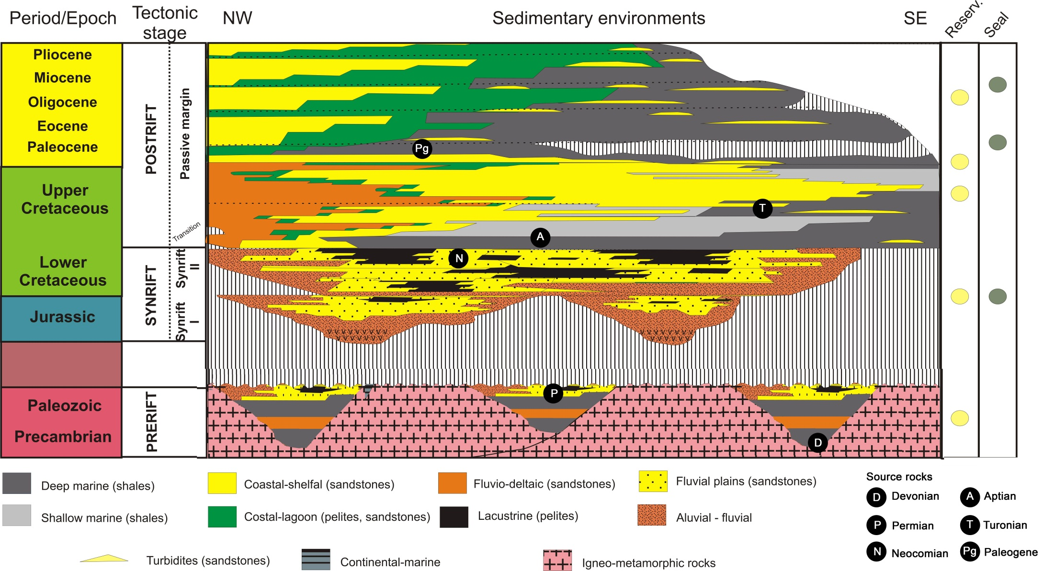
PETROLEUM SYSTEM MODEL
Notes:
This picture sums up the petroleum system model that we are proposing for the offshore basins of Uruguay. The main potential source rocks are associated with the marine shales of the prerift sequence, lacustrine shales of the synrift sequence, Aptian marine shales of the transitional sequence and Turonian marine shales of the drift sequence. The main reservoir rocks are associated with aeolian and fluvial deposits of the prerift sequence, fluvial sandstones of the synrift sequence and basin floor fans of the Paleocene, Eocene and Oligocene sequences. Seal rocks have local and regional development. Among the former there are synrift lacustrine shales as well as early drift distal marine shales, and among the latter, the most important ones are the marine shales of the Paleocene transgression.

Slide 8
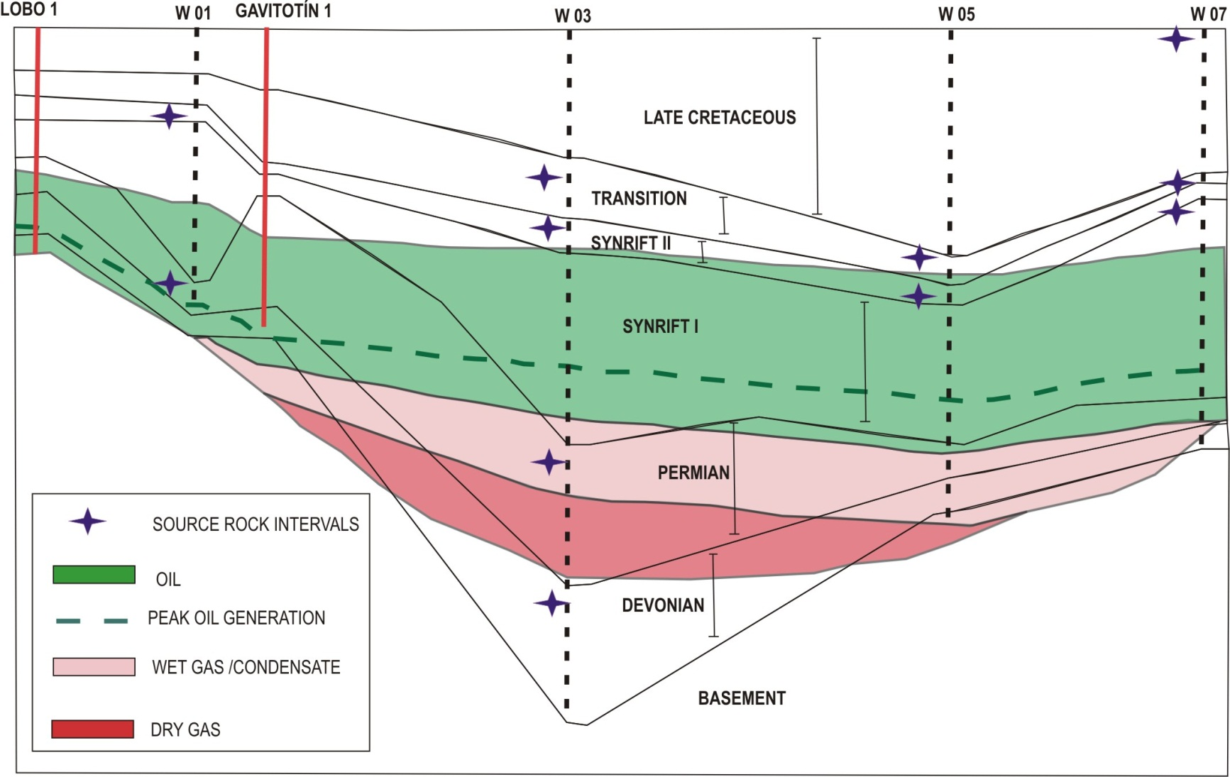

MATURITY MODEL 1D
Schematic section of thermal maturity (65 Ma)
Notes:
The maturity history can be analyzed in three stages. At the Late Cretaceous-Paleocene times the Palaeozoic source rocks were in the wet and dry gas windows, although they were in the oil window in the well number 1, while the Early Cretaceous source rocks were immature to incipiently mature in the well number five, and the Late Cretaceous and Palaeocene source rocks were still immature.

Slide 9
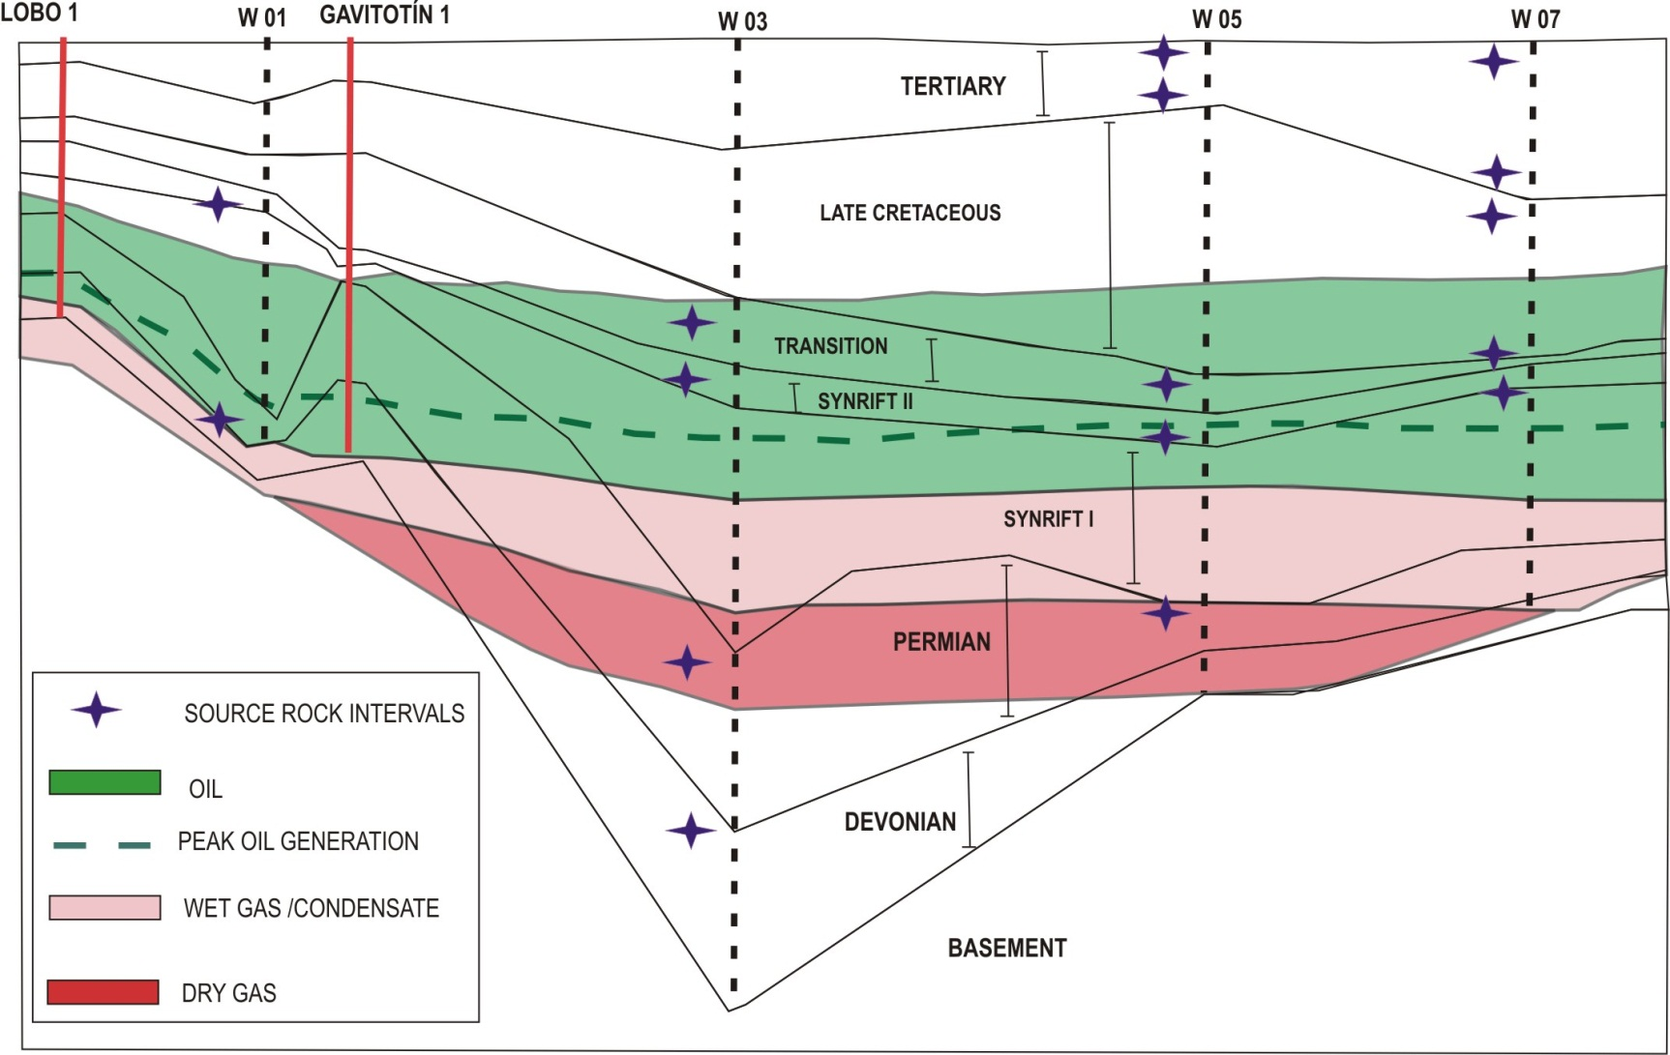
MATURITY MODEL 1D
Schematic section of thermal maturity (37,2 Ma)
Notes:
At the Eocene-Oligocene times the Palaeozoic source rocks are even more mature, while the Early Cretaceous source rocks were in the oil window, except in the well number one, where they are immature. The Late Cretaceous and Paleocene source rocks were still immature.

Slide 10
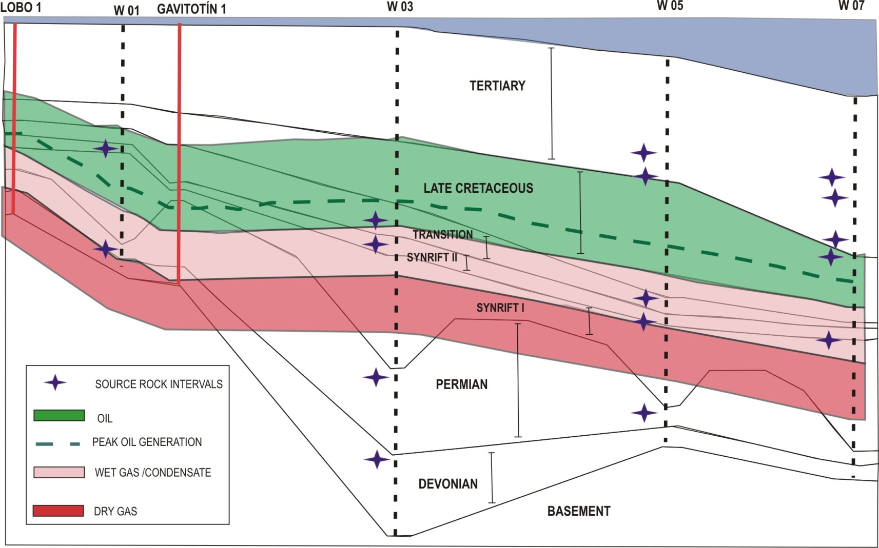
MATURITY MODEL 1D
Schematic section of thermal maturity (0 Ma)
Notes:
At present time all Palaeozoic source rocks are very mature (having generated and expelled all the hydrocarbons), while the Early Cretaceous source rocks are in the wet gas window, although they are still in the oil window in the wells number one and three, and the Late Cretaceous and Palaeocene source rocks enter the oil window only in the well located more distally.

Slide 11
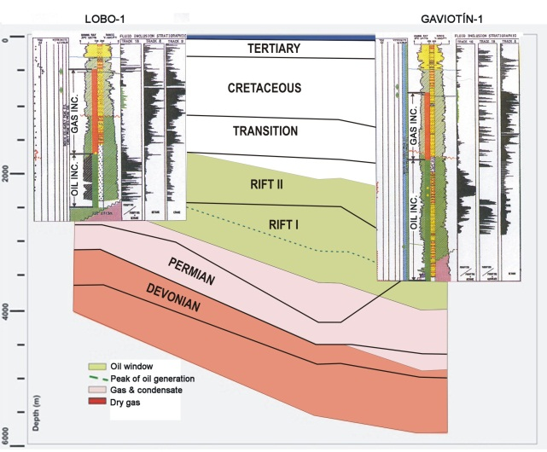
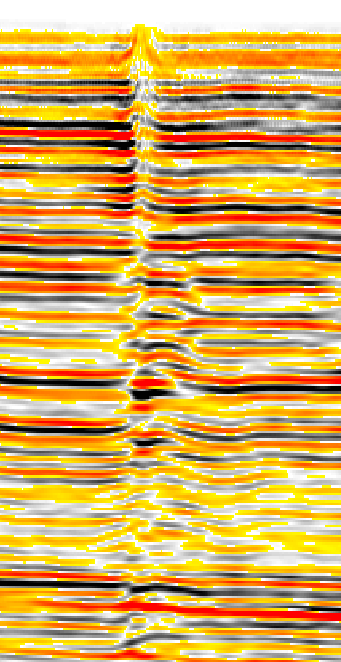
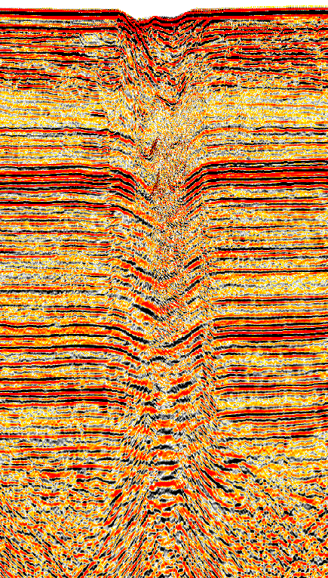
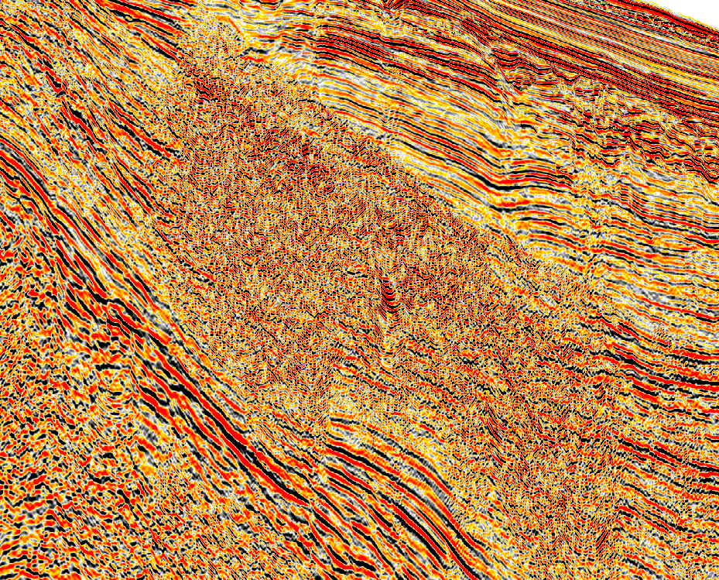
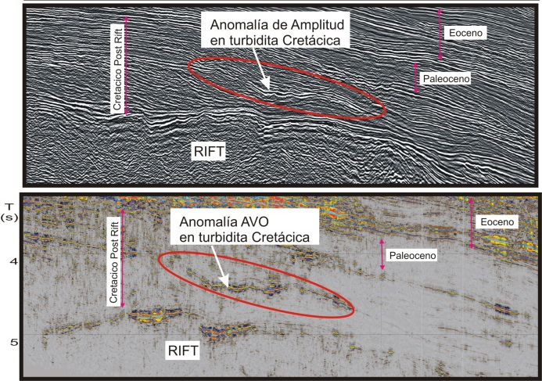
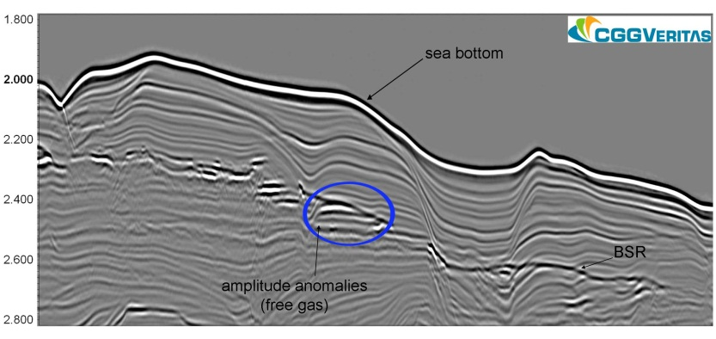
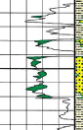
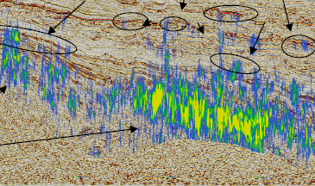
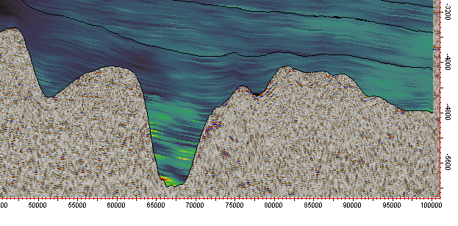
SUMMARY – HC EVIDENCES
Gaviotín Well
Notes:
This slide summarizes the set of evidence of hydrocarbons in the offshore of Uruguay. Oil and gas inclusions, gas chimneys, pull downs, loss of seismic signal, amplitude and AVO anomalies, gas hydrates, frequency anomalies that I have not presented today, but which we have carried out, velocity anomalies and crossing of the density-neutron logs at wells. This evidence gives strength to the petroleum system model developed for the offshore basins of Uruguay.

Slide 12
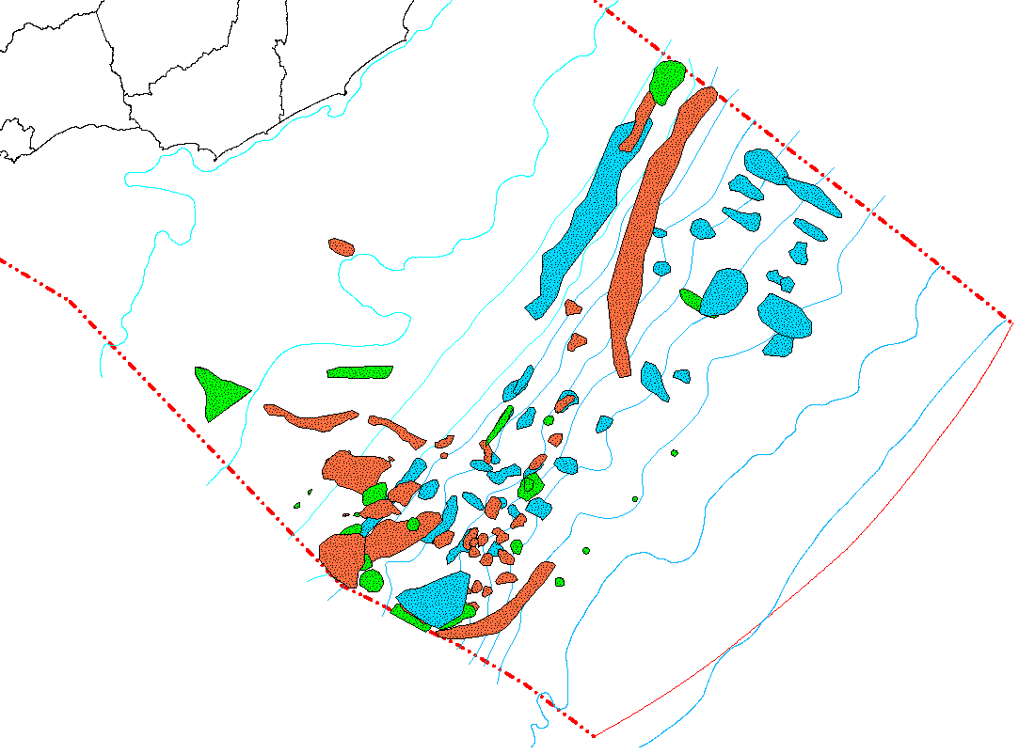
LEADS & PROSPECTS
20
50
100
200
500
1000
1500
2000
2500
3000
3500
4000
Prerift & Synrift
Cretaceous Post-rift
Cenozoic Post-rift
Notes:
A set of leads and prospects have been identified in the offshore basins of Uruguay. Those associated with prerift and synrift phases are coloured in orange. Those associated with the Cretaceous postrift sequences are coloured in green. And those associated with the Cenozoic postrift sequences are colored in blue. Next, I will try to explain to you the exploration plays in the context in which the leads and prospects were defined.

Slide 13
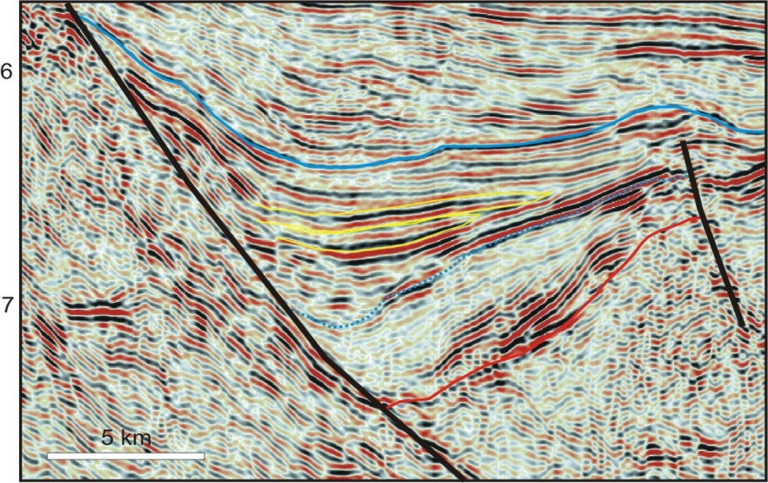
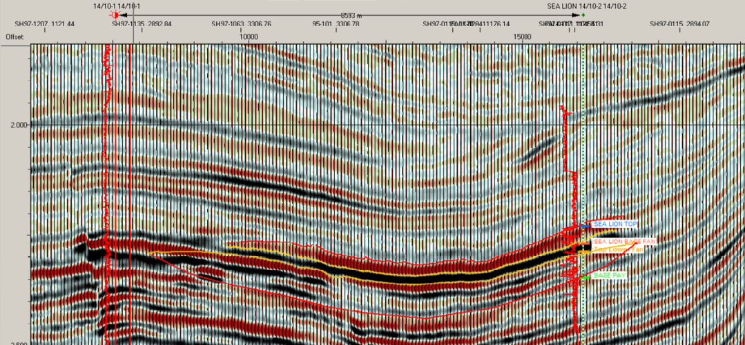
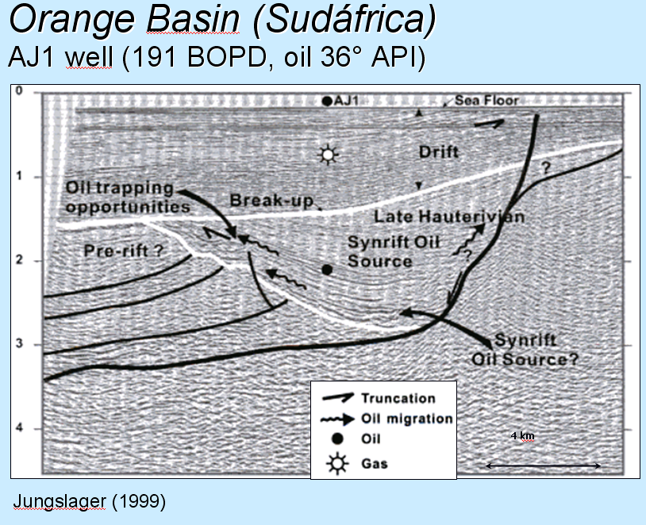
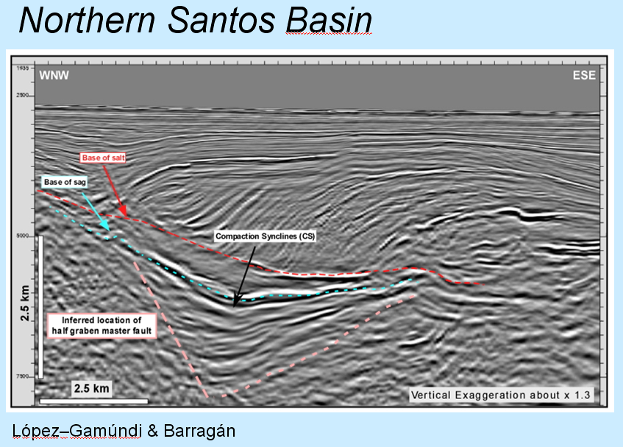
PLAY TYPE: COMPACTION SYNCLINES
Punta del Este Basin
North Falkland Basin
Inversor Energético Minero
Sea Lion - 5.508 bpd
Notes:
This slide shows how this play is a successful one in many productive basins of the Atlantic Ocean. All of them present the same tectonic and stratigraphic settings. In all cases the source rocks are lacustrine shales of the synrift sequences, which generate oil, then it migrates and is trapped in the alluvial bodies of the synrift sequences, or against the break-up unconformity.

Slide 14
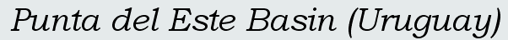
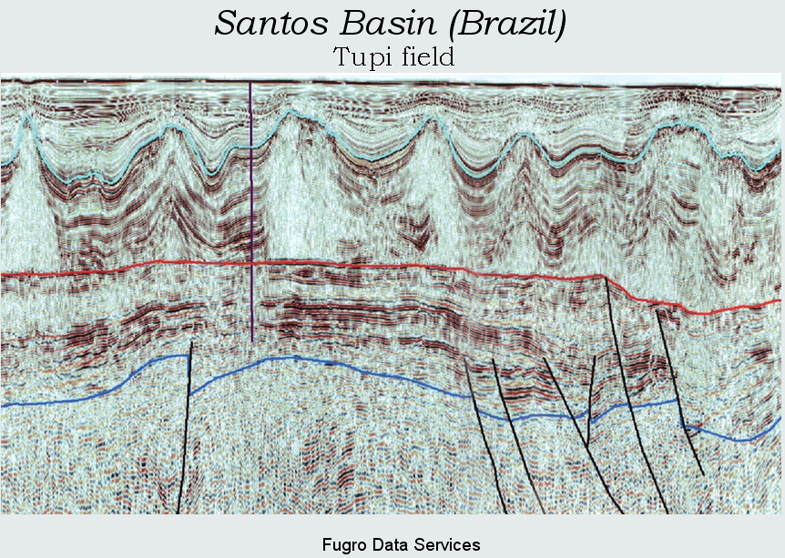
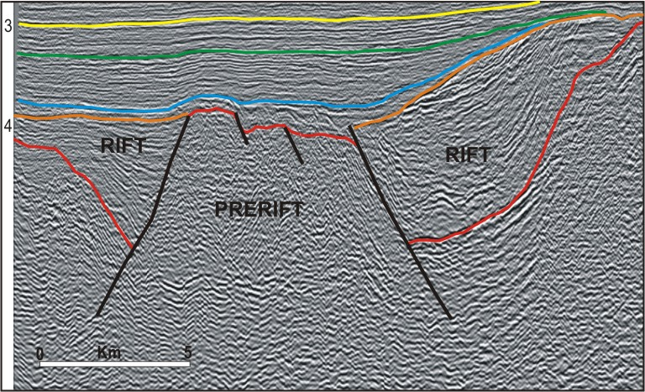
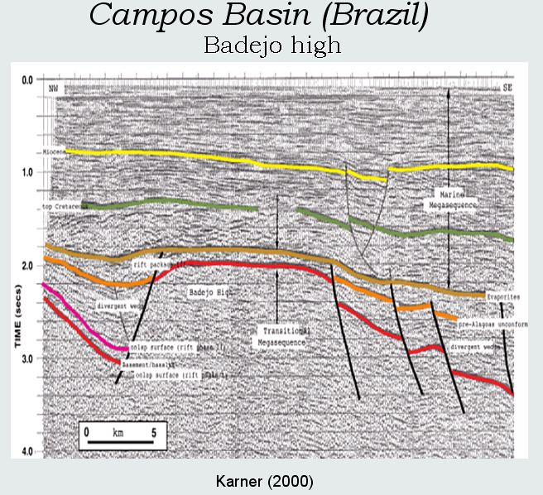
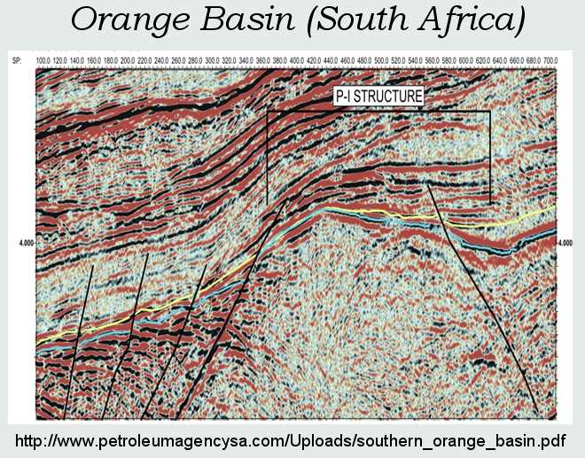
PLAY TYPE: ANTICLINE
Notes:
Again, this slide shows that this play is successful in several basins of the South Atlantic Ocean. The similarity between the Orange and Punta del Este basins is remarkable, because in both cases the sequences involved are siliciclastic. Regarding the similarity with the Santos Basin, despite the differences between the Santos and the Punta del Este reservoirs, the exploratory model remains the same. It includes generation from the synrift sequences and accumulations in anticline structures associated with basement highs.

Slide 15
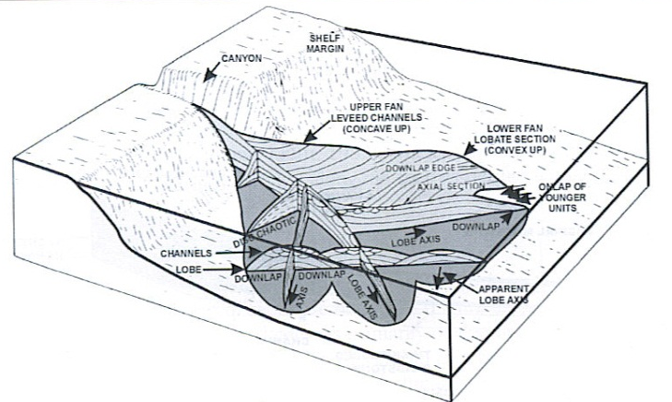
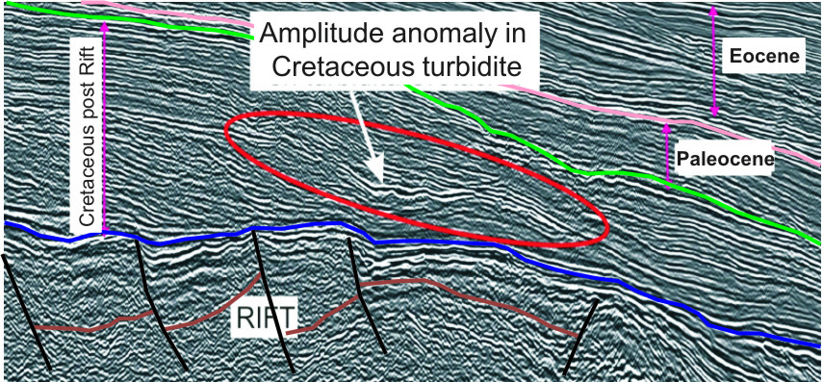
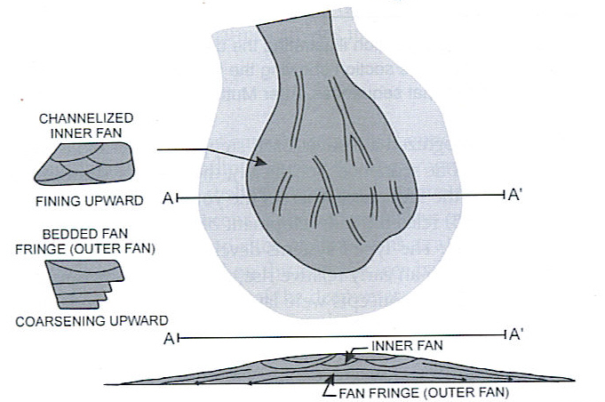
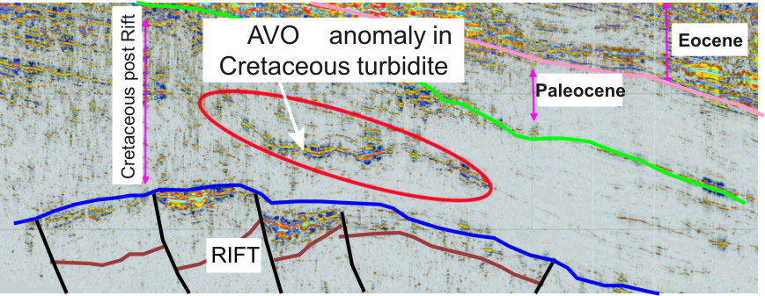
PLAY MODEL
Cretaceous Basin Floor Fans with Amplitude and AVO Anomalies.
Amplitude Anomaly in Basin Floor Fans
AVO Anomaly in Basin Floor Fans
PLAY TYPE:
Cretaceous Basin floor fans
(Forced Regressive Deposits)
Notes:
So, the play model is represented by basin floor fans belonging to forced regressive system tracts, which have proved its quality as reservoir rocks around the world. In this case the play is even more attractive because the basin floor fans present AVO and amplitude anomalies.

Slide 16
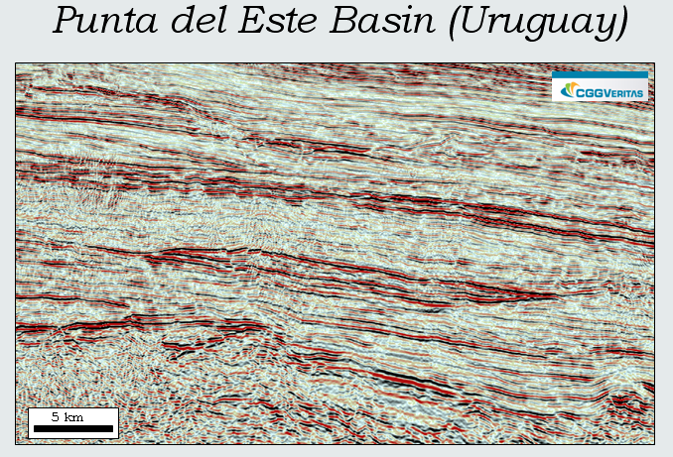
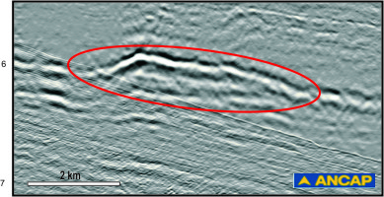
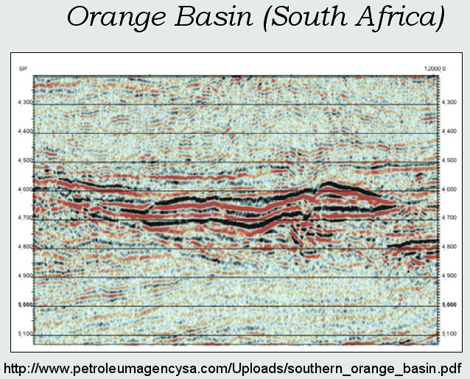
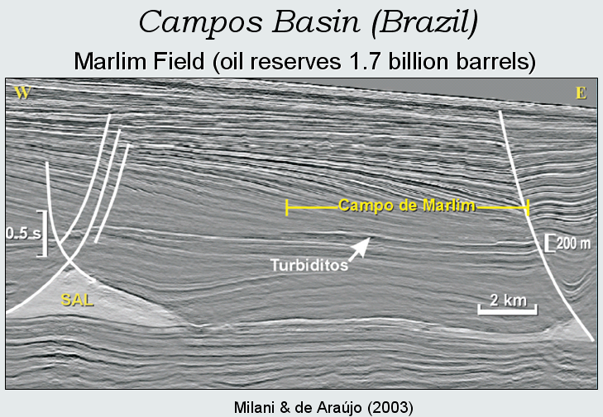
BASIN FLOOR FANS
Pelotas Basin (Uruguay)
PSTMIG BSTK
Notes:
Basin floor fans associated to forced regressive system tracts are widely distibuted in the offshore basins of Uruguay. They present the same siesmic features and are located in the same stratigraphic positions than basin floor fans in productive Atlactic basins, such as Paleocene Basin floor fans in the Punta del Este and Orange Basins and Oligocene basin floor fans in Pelotas and Campos basins.

Slide 17
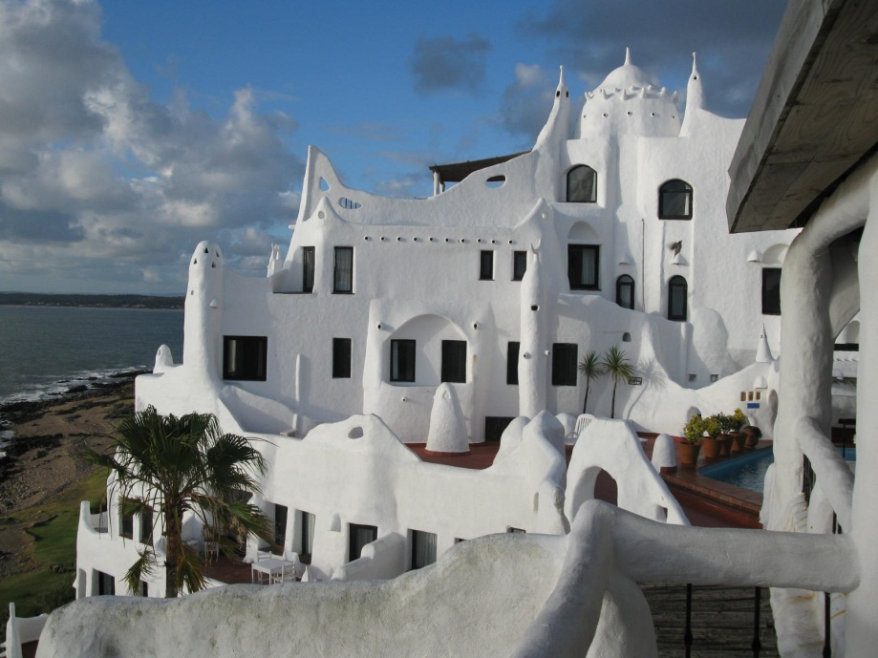
PURPOSE
ANCAP is calling Oil Companies interested in carrying out exploration and exploitation of Hydrocarbon activities in the República Oriental del Uruguay continental shelf, under Production Sharing Agreements.
Notes:
ANCAP está convocando a Empresas Petroleras interesadas en realizar actividades de exploración y explotación de hidrocarburos en la plataforma continental, bajo la modalidad de Contratos de Producción Compartida.
ANCAP is calling Oil Companies interested in carrying out exploration and exploitation of Hydrocarbon activities offshore Uruguay, under Production Sharing Agreements.

Slide 18
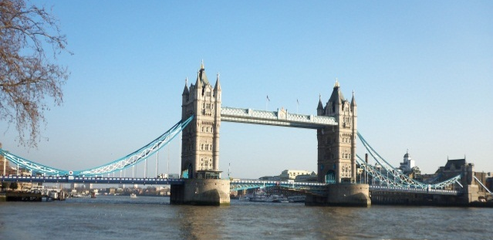

SCHEDULE
ACTIVITY | DATE
Official Announcement | September, 8th 2011
Submission of Intention Letter and documents for the Qualification of Oil Companies. | September, 8th 2011 to March, 1st 2012
Submission of proposals. | From March 22nd until March 29th, 2012 at 14:00, Local time.
Road Show London
7th – 8th
November 2011
Road Show
Rio de Janeiro
22nd – 23rd
November 2011
Notes:
Este es el cronograma oficial de la Ronda. A la fecha de hoy se considera oficialmente abierta. Las fechas a destacar son la de finalización del período de calificación de Empresas Petroleras, que comienza hoy y finaliza el 1º de marzo de 2012. La otra fecha a destacar es el 29 de marzo de 2012, momento en el cual finaliza el período para presentación de ofertas. Ese día a las 15 horas se realiza la apertura de las ofertas y en el momento, en caso de haber competencia puede saberse la propuesta de mayor puntaje por una determinada área.
This is the official schedule of Uruguay Round II. We announced it in Montevideo last September. The dates to be highlighted are the end of the qualification of Oil Companies period, which ends the 1st of March 2012. The other important date is march 29th 2012, when the period for submission of offers ends. That day the bids are open and in case there is competition for one or more areas, the highest score offer will be the one awarded the area. Is just that simple and clear, there is no negotiation.

Slide 19
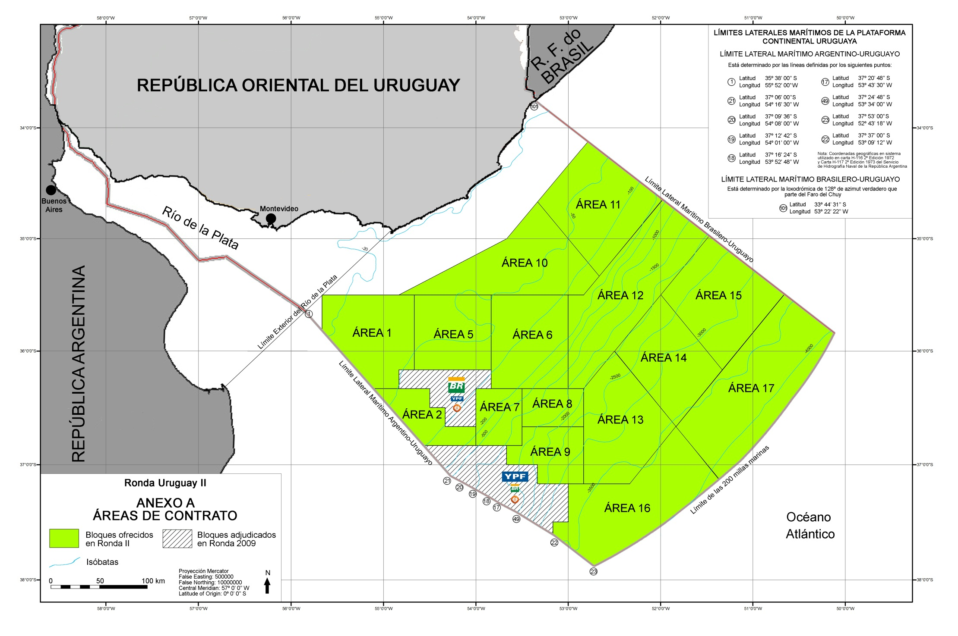

OFFERED AREAS
Notes:
Estas son las 15 áreas que estamos ofreciendo, son las que están pintadas de verde. Van desde aguas someras a ultraprofundas, cubriendo todas nuestras cuencas offshore. Las áreas más chicas son de unos 2.500Km² y las más grandes de más de 10.000Km².
Se muestran también en gris las áreas en las que tenemos contratos vigentes.
These are the 15 areas we are offering, the ones colored in green. They are from shallow to ultra deep waters, covering all our offshore basins. The smallest areas are about 2.500Km² and the biggest are about 10.000Km².
We are showing in grey the areas in which we have contacts in force.

Slide 20
QUALIFICATION OF INTERESTED OIL COMPANIES
LEGAL DOCUMENTS
TECHNICAL INFO
  Operations offshore
  Daily Production
Operator for all areas
Operator for shallow areas
Non operator
Not qualify
FINANCIAL INFO
  Equity > 600MMUS$ + 200MMUS$ per block
Top 100 companies would only have to submit the legal documents and they have the qualification as operator for all areas granted.
Notes:
As it is usual oil companies will be assessed regarding their technical and financial capacity and will have to submit some legal documents. As result of the qualification, companies may qualify as operators for all blocks, qualify as operators only for shallow waters, qualify as non operators or no qualify. Top 100 companies
of the Energy Intelligence annual ranking will only have to present these legal documents, they have the qualification granted.

Slide 21
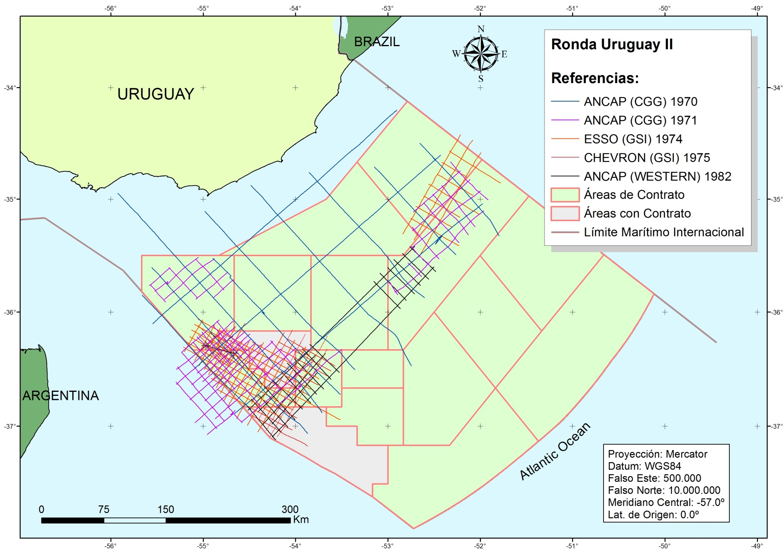
DATABASE: ANCAP’s “OLD” DATA
ANCAP’S VINTAGE DATA
From 1970 to 1982
2D SEISMIC: 12.123Km,
Well logs
Well reports
25.000US$
Notes:
ANCAP tiene a disposición de las empresas petroleras un paquete de datos de la información sísmica de los 70 al 82 y los registros y reportes de los 2 pozos perforados por Chevron en el 1976, la que llamamos información “vieja”. Este paquete se vende a 25.000US$.
ANCAP offers a data package of 2D seismic from the 70’s to 82 and the well logs and reports of the 2 wells drilled by chevron in 1976. This data package is sold at 25.000US$.

Slide 22
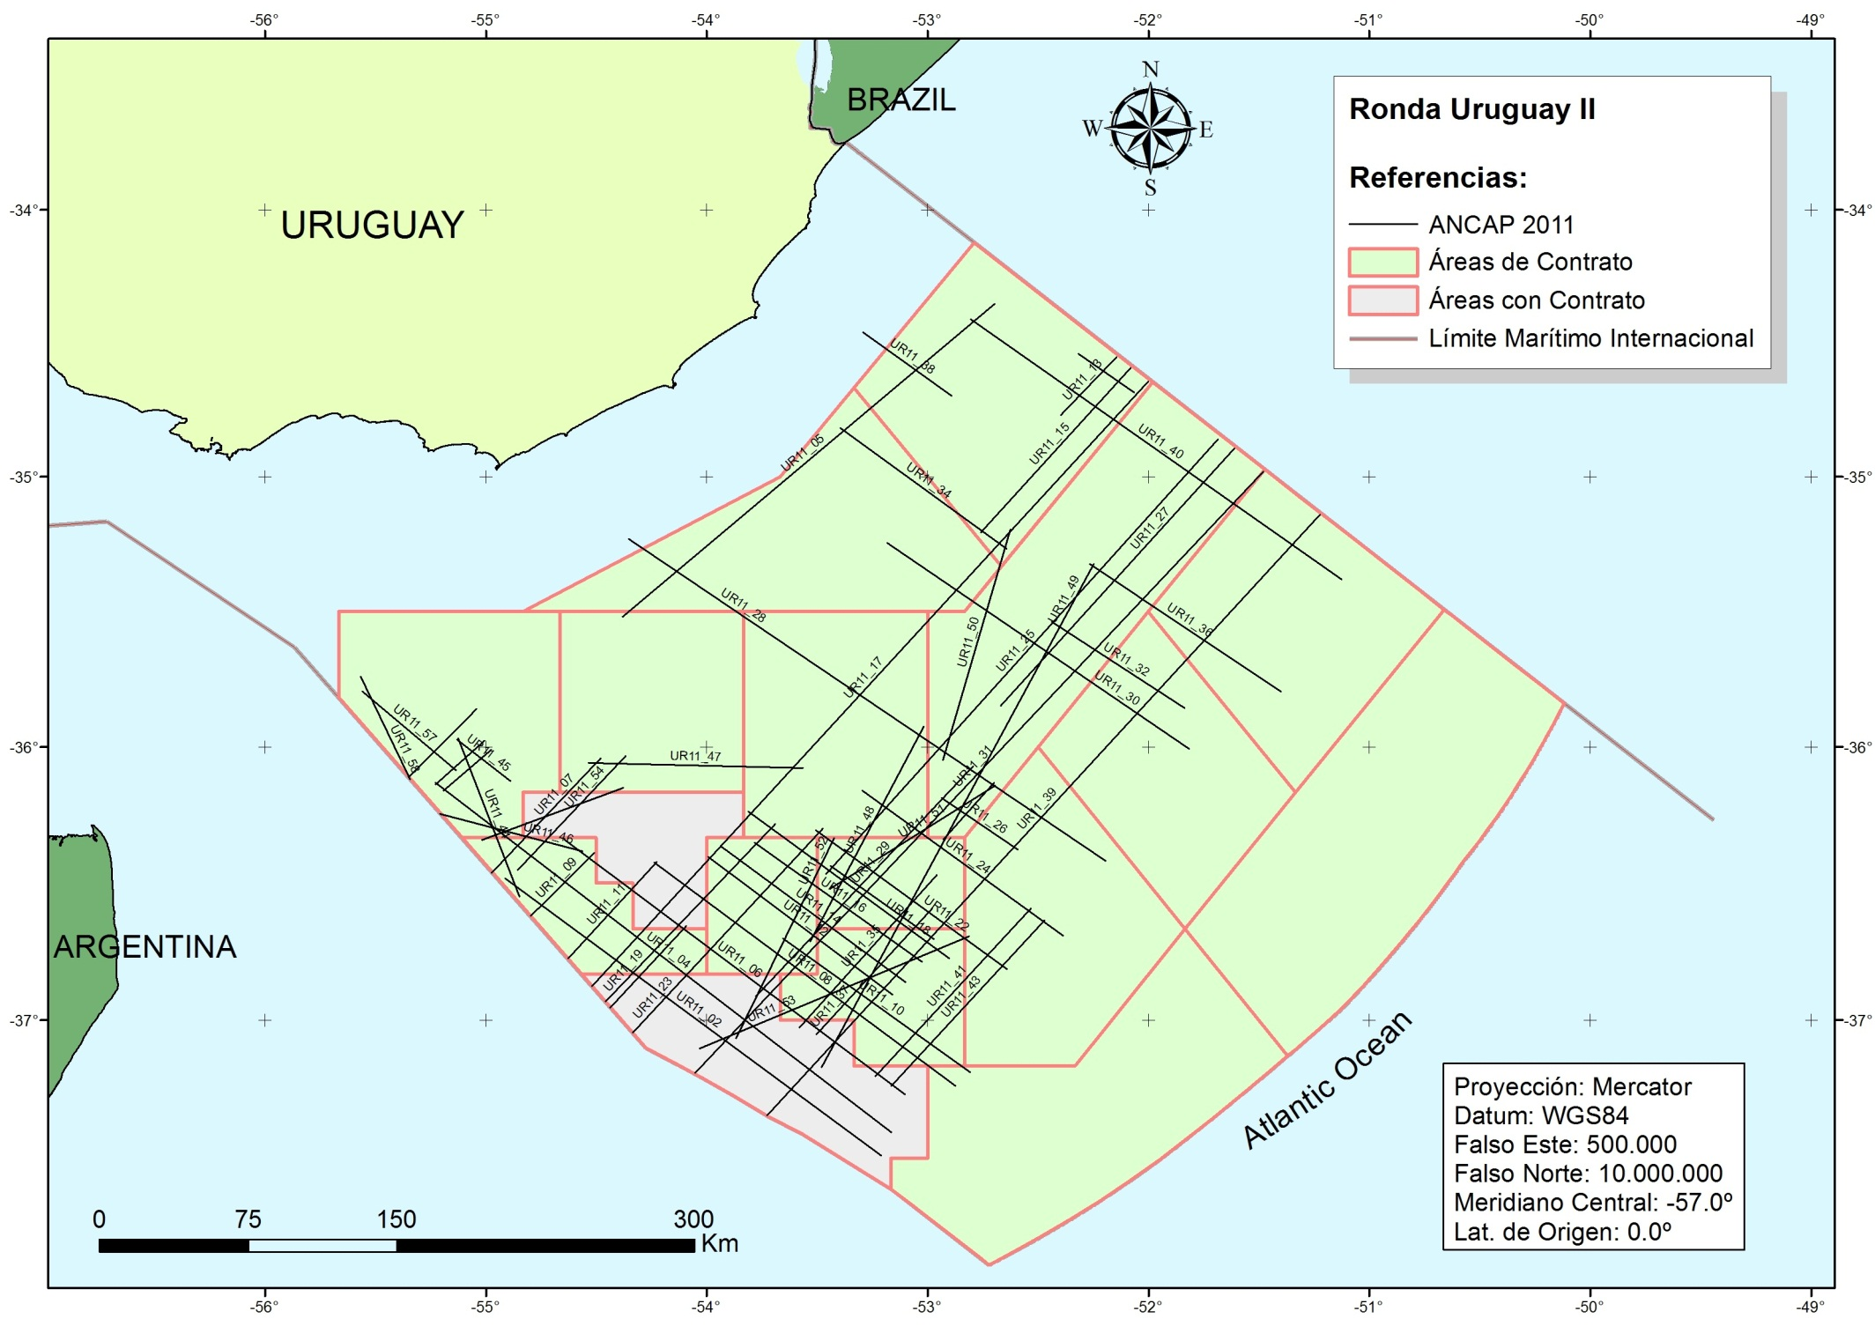

DATABASE: ANCAP’s PROPRIETARY DATA
Notes:
También tenemos disponible 6300Km de sísmica 2D, propiedad exclusiva de ANCAP, que fueron relevados en abril y mayo de este año, por Reflect Geophysical. Esta información está actualmente como datos de campo, con un procesamiento preliminar. En estos días estamos abriendo una licitación para su procesamiento.
We also have available 6300Km of 2D seismic, exclusive property of ANCAP, that were acquired in April and May 2011, by Reflect Geophysical. We have this data so far as field data, with a preliminary processing. We will be launching a tender for its processing soon.

Slide 23
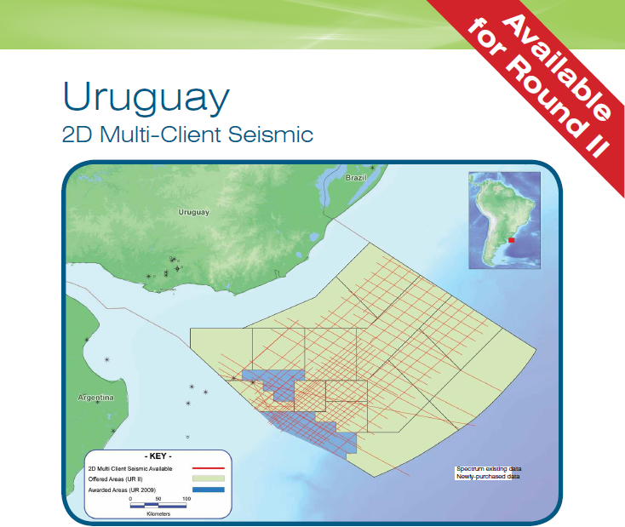

GEOPHYSICAL MULTICLIENT DATA
Notes:
Por último, en lo que refiere a base de datos, tenemos la información que comercializa CGGVeritas y Spectrum. Aquí están los representantes de estas empresas si desean contactarlos. Son aproximadamente 12000Km de sísmica 2D.
Finally, regarding available data, we have the information that CGGVeritas and Spectrum are marketing. They are approximately 12.000Km of 2D seismic acquired in 2002, 2007 and 2008.

Slide 24
OFFERS COMPARISON
For Oil ºAPI >25
For Oil ºAPI < 25
For Natural Gas
WEIGHING FACTOR OF OFFERS TERMS
TERM | WEIGHING FACTOR
Maximum Percentage of Association | 20%
Committed Exploratory Program | 40%
Increase of Profit Oil for the Uruguayan State | 40%
Notes:
Las ofertas por cada área tendrán un puntaje total, que surge de la suma de el puntaje 1 + el 2 + el 3. Ahora veremos detallados cada uno de los términos, que son el % de asociación de ANCAP, el programa exploratorio comprometido y el profit oil para el estado uruguayo. Esos son los términos que se deben ofrecer, para cada uno de los 3 casos correspondientes a petróleos livianos, petróleos “no tan livianos” y para gas natural.
The offers for each area will have a total score, which results by adding score 1 + 2 + 3. We will se every term in detail. The 3 terms are: A, the percentage of ANCAP’s association, UT (for the Spanish “Unidad de Trabajo”, which means Working Unit) that is an artifice to value the committed exploratory program and the profit oil for the Uruguayan state. These are the terms that have to be offered, for light oils, not so light oils and natural gas. In the table we are showing how much each of the 3 terms is weighted.

Slide 25
OFFERS COMPARISON
ANCAP’s Association: 20% - 40%
Exploratory Work: wells, 2D and 3D seismic, 2D and 3D electromagnetism, seabed sampling, processing ANCAP’s 2011 survey, licensing data.
  Minimum Exploratory Work requirement is different for each block.
X: increase of profit oil for the Uruguayan State, increasing according an R factor. R defined as ratio of total income over cost oil.
Notes:
Las ofertas por cada área tendrán un puntaje total, que surge de la suma de el puntaje 1 + el 2 + el 3. Ahora veremos detallados cada uno de los términos, que son el % de asociación de ANCAP, el programa exploratorio comprometido y el profit oil para el estado uruguayo. Esos son los términos que se deben ofrecer, para cada uno de los 3 casos correspondientes a petróleos livianos, petróleos “no tan livianos” y para gas natural.
The offers for each area will have a total score, which results by adding score 1 + 2 + 3. We will se every term in detail. The 3 terms are: A, the percentage of ANCAP’s association, UT (for the Spanish “Unidad de Trabajo”, which means Working Unit) that is an artifice to value the committed exploratory program and the profit oil for the Uruguayan state. These are the terms that have to be offered, for light oils, not so light oils and natural gas. In the table we are showing how much each of the 3 terms is weighted.

Slide 26
SOME REMARKS ABOUT THE BIDDING PROCESS
Only qualified companies may submit offers, with a maximum of 4 areas as operators.
The proposals are independent for each area
Offers in Spanish (except for technical documents and/or annual reports)
The Executive Branch has to authorize by Decree the signature of the Contract.
The awarding company has to register an Uruguayan company.
Notes:
El área se adjudicará a la propuesta válida de mayor puntaje y la firma del contrato se dará una vez sea autorizada por el Poder Ejecutivo.
Para participar de la ronda (calificar, ofertar) no es necesario que la empresa constituya una empresa uruguaya, si es que no la tiene, pero sí es requerimiento el formar una empresa uruguaya para firmar el contrato. En caso de que, como sucedió en la Ronda pasada, el área la gane un consorcio de empresas, existe ahora la posibilidad de que ANCAP firme el contrato con el Consorcio, constituido por empresas uruguayas.
The area will be awarded to the valid proposal of highest score and the contract signature will take place once is authorized by the Executive Branch.
To participate of the bidding round (qualifying, submitting offers) it is not necessary that the company opens an Uruguayan subsidiary, if it don’t have it, but it is a requirement to open an Uruguayan company to sign the contract. In case, as happened in the Uruguay Round 2009, that the area is awarded to a consortium of companies, now exists the possibility that ANCAP signs the contract with the consortium, but it has to be composed by Uruguayan companies.

Slide 27

CONTRACT
PSA: Production Sharing Agreements for which Contractor assumes all risks, costs and responsibilities of the activity.
  No royalties are applied
  No signature or production bonuses.
  No surface rentals
  No taxes paid to provinces or municipalities
  No Ring fencing inside the contract area
CONTRACT TERM
30 years which can be extended to 40 years
  EXPLORATION: maximum 9 years (3 + 2 + 2 + 1)
  EXPLOITATION: 25 years subject to maximum contract term.
Notes:
The contract model is a typical production sharing agreement, in which the contractor assumes all risks, costs and responsibilities of the activity. No royalties or bonus of any kind are applied. No surface rentals or municipal or province taxes are applied.
The contractor has the obligation to perform the oil operations in the contract area and ANCAP has the obligation to pay for that.

Slide 28
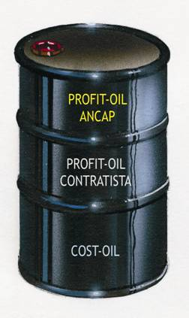
CONTRACTOR’S ECONOMY
Contractor’s compensation
  Cost oil
    Recovery limit 60% in case of oil production and 80% in case of natural gas production.
  Profit oil
    Variable according R factor. Profit oil split is biddable.
Contractor has the right to freely dispose hydrocarbons warranted from its compensations.
ANCAP has the preferential right to purchase such hydrocarbons for domestic demand only.
Hydrocarbons valued at international prices.
Notes:
The contractor is paid with the part of hydrocarbons produced corresponding to cost oil and its profit oil. There is a cost recovery limit of 60% of the oil production and 80% in case of natural gas. Costs are recovered quarterly and investments are recovered in 20 quarterly installments. As we have said, the % of profit oil for the government has to be bid. The contractor is entitled to freely dispose and export such oil, but ANCAP has the preferential right to totally or partially purchase the oil, for domestic consumption only. In any case, the oil or natural gas will be valued and paid at an international price of a hydrocarbon of the same quality.

Slide 29

TAXATION
Income Tax
  Corporate Income Tax (IRAE)
  Income Tax on Non Residents (IRNR)
Tax on Net Worth (IPAT)
Consumption Taxes
  Value Added Tax (IVA)
  Specific Consumption Tax (IMESI)
Custom Taxes
Social Security Contributions (CESS)
INVESTMENT PROMOTION REGIME
EXEMPTED
(Hydrocarbons Law)
Exemption from IRAE: Law 16.906 and Decree 455/2007.
Notes:
Regarding the fiscal regime, here we show a list of all taxes any company should pay in Uruguay. Net worth, consumption and custom taxes are exempted by hydrocarbons law, which declares the activity of national interest. For income tax, the oil company should submit its project under the governmental authority (COMAP), which regarding the investment promotion regime will give a score to the project and based on that score will obtain a % of exemption of income tax. A project of the size of the development of an oil field has a great chance of being completely exempted of income tax.

Slide 30
Concluding remarks
Uruguay can offer:
A strong political, economic and social stability. The Energy Strategy is agreed by all political parties. There is an optimal business environment for investments, marked by history of certainties, seriousness and security.
An interesting, unexplored and intriguing geology, with many analogies and correlations with exploratory and geological features of producing basins of the Atlantic margin, showing promising alternatives.
Sound and fair bidding round terms and contract model.
Notes:
To sum up, Uruguay is a country with political, economic and social stability, with great respect for institutions and a long tradition of fulfillment of its obligations. The energy strategy is something agreed by all political parties, so it is a State project. We believe that this opportunity combines an interesting and promising geology in frontier basins with attractive bidding round terms and a country with an ideal business environment.

Slide 31
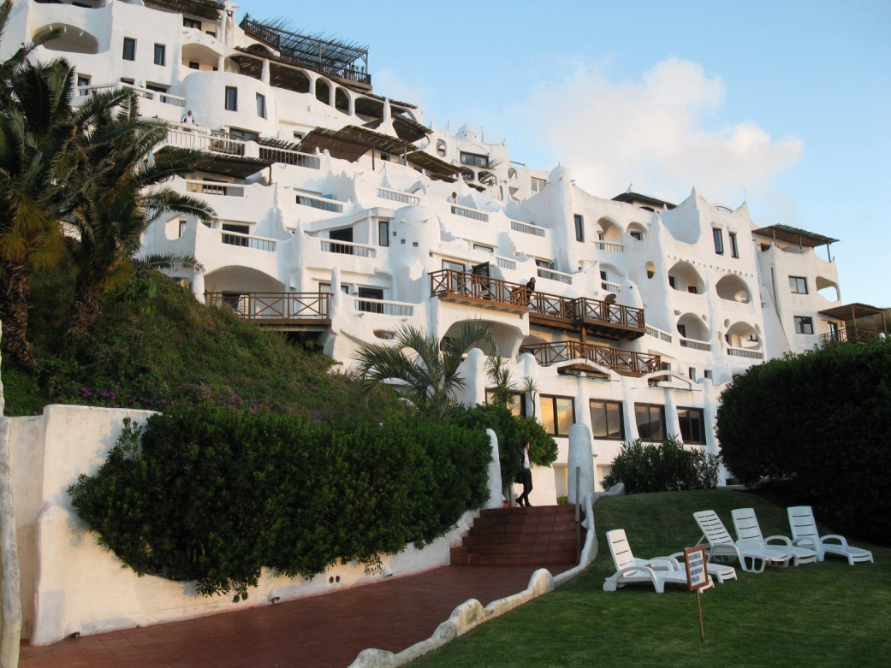
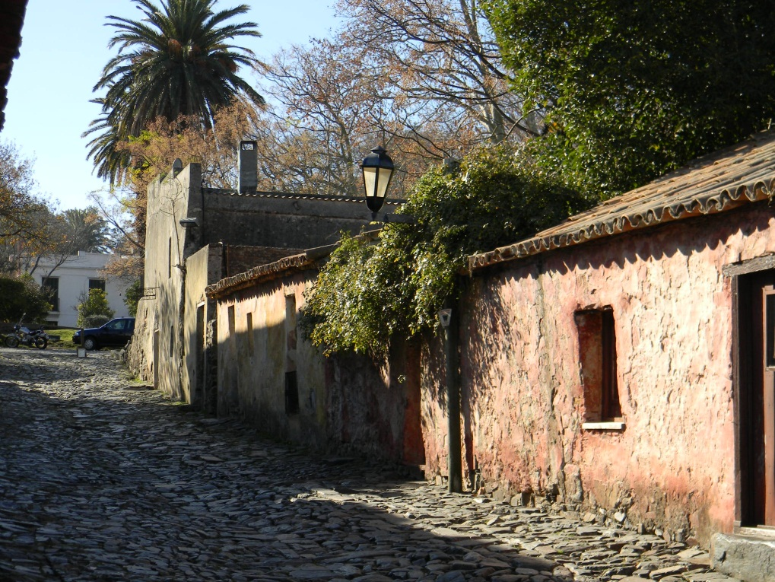

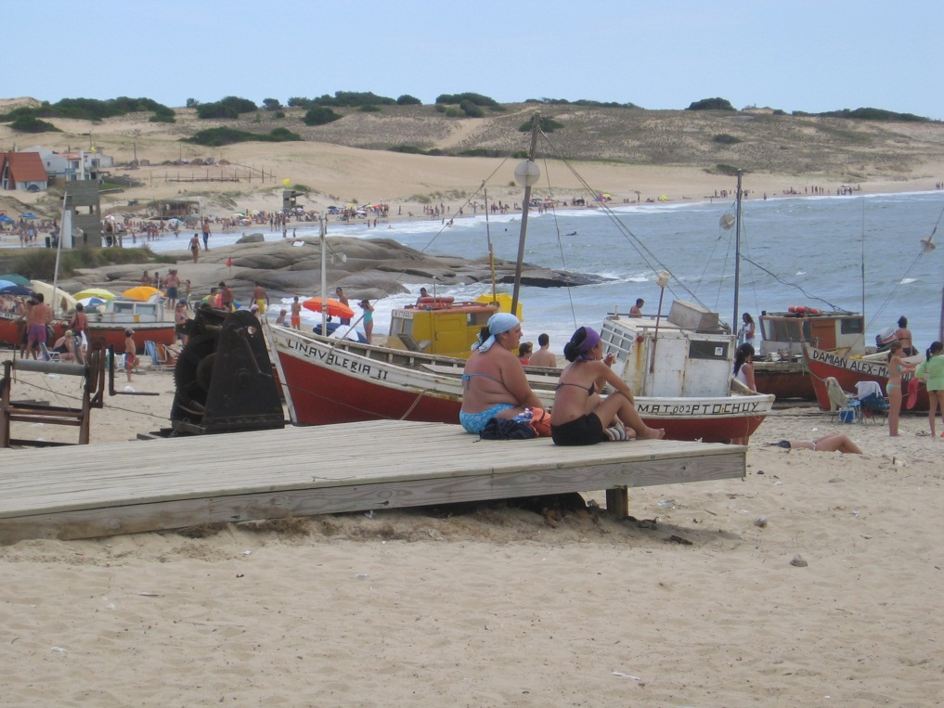
Notes:
Muchas gracias. Estoy a su disposición para evacuar cualquier consulta que pueda surgir.
Thank you very much. I will be available to answer any question you might have.

