Slide 1
Exploration Opportunities for Trinidad and Tobago Deep Atlantic Area (TTDAA)
The Ministry of
Energy and Energy Affairs
Resource Management
AAPG 2011 – Milan, Italy
http://energy.gov.tt/
Notes:
Brief Introduction including people involved from both Spectrum and MEEA e.g. Leo and Joe and Stephen / Lendyn
Also can expand in maybe a line or two about what is a “Spec” project – a symbiotic Multiclient or partnering type initiative usually between governments and contractors/companies at little or no cost to host

Slide 2
Overview
Introduction to Trinidad and Tobago
Introduction to TTDAA
What has changed?
Taxation and Fiscal regime
Speculative Model Chosen
Studies undertaken and planned
Analysis of Deep water Blocks
Notes:
Just a brief overview

Slide 3

Population - 1.3M
Labor Force - 0.5M
Literacy Rate - 88%
Gas utilisation began 50 yrs ago
Current Gas Production 4.2bcf/d
LOCATION
Northeast of Venezuela
Southernmost of Caribbean
Total Area – 1,864sq. miles
Commercial oil production began 102yrs ago
Current Production-91,000 bopd

Slide 4

About Us
Discovered by Christopher Columbus in 1498
Became a British Colony in 1802
Mixture of races - African, East Indian, Chinese, Syrian, Lebanese
Celebrates 13 Holidays including Christmas, Divali, Eid-ul-Fitr

Slide 5

About Us
Climate - wet and dry season
Temperatures from 70-93 degrees
Trinidad is more industrialized
While Tobago focuses on Tourism and other Service Industry
Fun-loving people
Strong focus on education

Slide 6
Government of Trinidad and Tobago’s Focus
Sustainable development of the energy industry
Provision of a competitive framework for investment
Provision of gas for expansion of downstream industries
Rebalance oil and gas production
Enabling greater participation of nationals and national enterprises in the energy sector

Slide 7
Country Objectives
Effective and optimal monetizing of the natural resources
Security of country’s energy supplies
Protection and preservation of the environment
Establishment of research initiative
Training and development of nationals

Slide 8
What does Trinidad offer?
Liberalised currency system
Well established legal traditional system
Equitable taxation system
Open and transparent decision making system
Stable democratic government
Competitive fiscal incentives

Slide 9
What does Trinidad Offer?
Substantial petroleum reserve base
Competitive gas pricing regime
Strategically located in the Atlantic Basin with strong markets close by
Highly skilled labor force
Well developed land and harbor infrastructure

Slide 10
TTDAA
The Trinidad and Tobago Deep water acreage encompasses an area 40,000 square kilometers , with water depths ranging between 1000 to 3500 metres. The area is divided into 36 blocks and has had limited exploration and was first offered by Competitive Bidding in 2006. The acreage is east of Trinidad’s currently producing oil and gas fields; though different play types are expected.

Slide 11
Birth of TTDAA 2D
Memorandum of understanding between Government of the Republic of Trinidad and Tobago (GORTT) and eleven (11) multinational energy companies with Petrotrin standing in as the 12th but acting as the Project Manager on behalf of MEEA (procurement / tendering / client representation)
Engaged in several years of prior industry interest and support especially after deepwater exploration campaign of the late 1990s. MOU finally secured in 2002 with Veritas having eventually won the tender to shoot with Robertson doing the processing
Cost of survey including final deliverable product was calculated at US$500,000 per participant with the mandate of putting out a “ultradeep water” Competitive Bid Round by 2006

Slide 12
Birth of TTDAA 2D
First attempt in conducting a full scale exploration and reconnaissance of the deep waters within the sovereign limits of Trinidad and Tobago marine acreage
Touted as the “final frontier” for the hopeful discovery of a new oil and gas province
Approximately 12,337 line km in length acquired in a 4 x 4 km grid including long regional lines

Slide 13
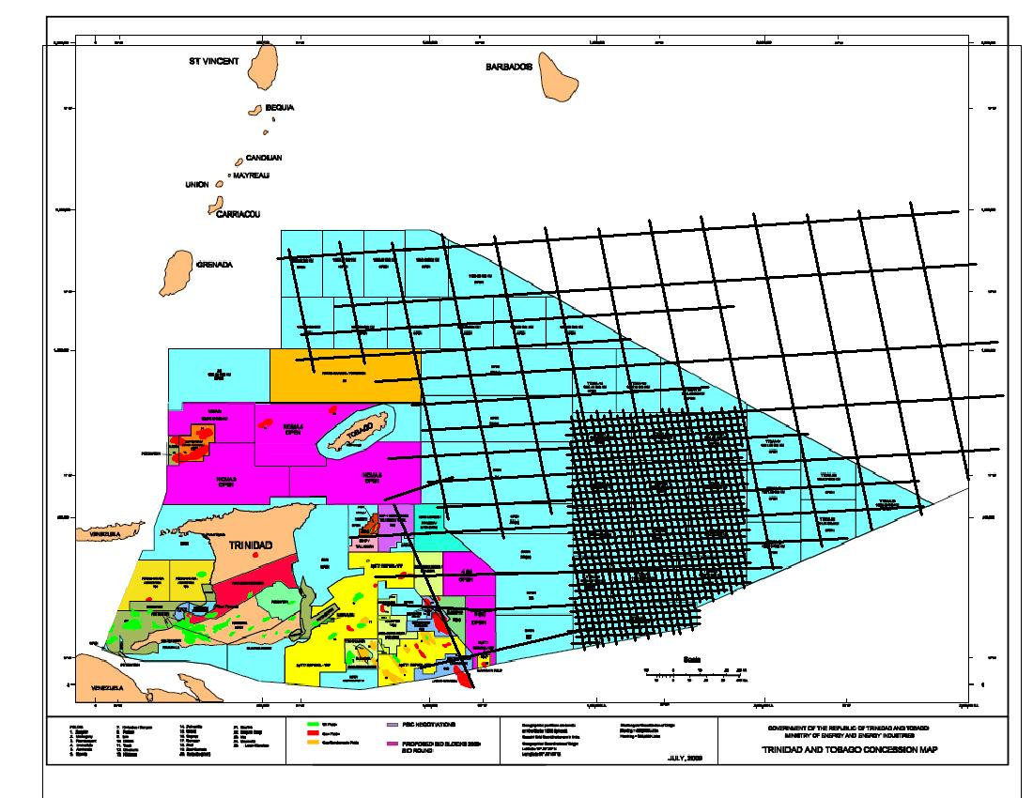
TTDAA 2002 2D Survey Outline (12300 line km aprox)
Concession Map Overlay
Notes:
Crudely overlain for the purpose of making a broucher with Spectrum

Slide 14
What has changed?
TTDAA 2006 -> 2010 -> 2011/12
Taxation
Technical
Reduced Taxation terms
Improved Fiscal regime
Optional Signature Bonus
No State carry-on participation
Streamlined Competitive Bid Process
Increased size of blocks (800 to 1000 sqkm)
Additional seismic survey (PGS 2D)
Reprocessing (Time and Depth) of 12,300 line km TTDAA 2D by Spectrum
Commissioned comprehensive Deepwater Study by DGA Consultants
New GXT reprocessing of Span Lines
New EMGS survey proposed
Increased Data Package Contents

Slide 15
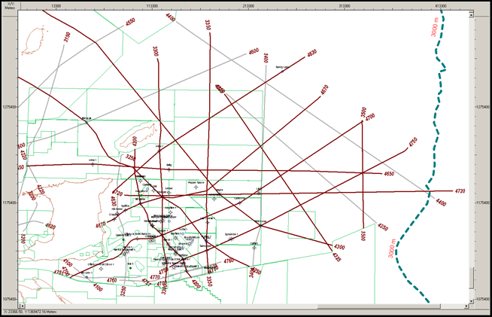
GXT Span 2D Lines 2004 (Depth Reprocessing in 2011 – Cretaceous Imaging)

Slide 16
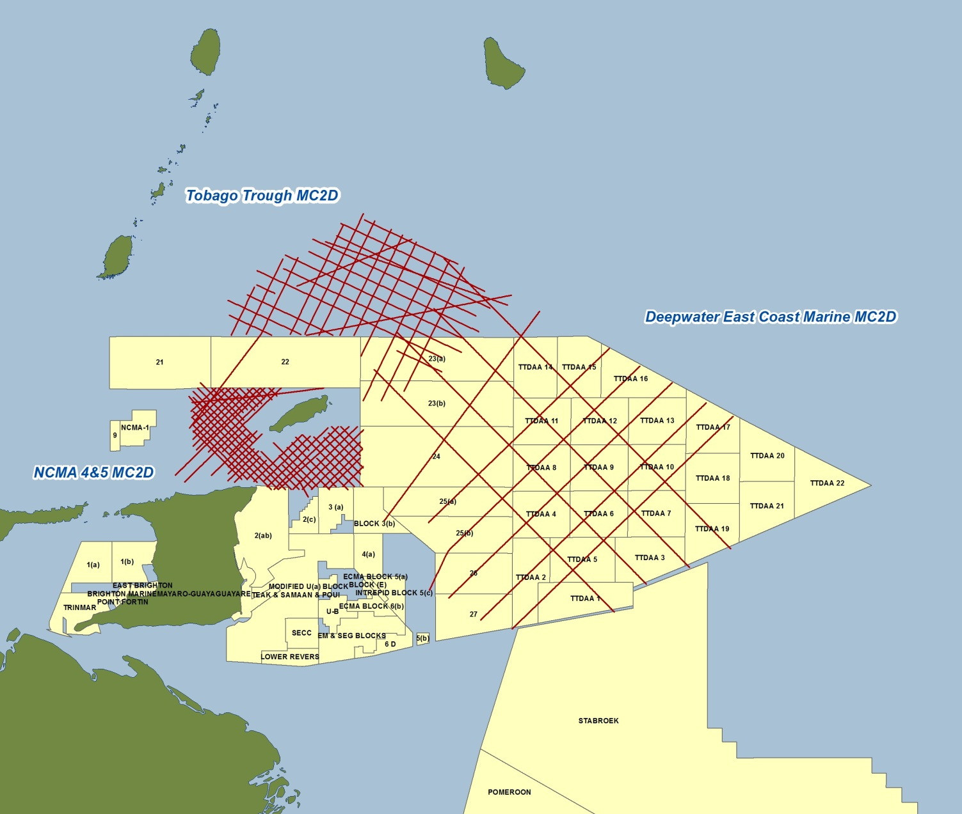

PGS 2008 MC2D – 6834 line km

Slide 17
BioSTRATIGAPHIC ASSOCIATES TRINIDAD LIMITED
The focus of this study is to provide an integrated biostratigraphic database on the Late Neogene sequences that can be utilised for sequence stratigraphic interpretation, shelf to deep water well correlation, and environmental modelling and tie to the deep water seismic grid

Slide 18

Planned EM Deep Water Survey

Slide 19


Dynamic Global Advisors
Trinidad Joint Study Team Phase I Report
A New Look at Eastern Deepwater Trinidad;
Seismic Interpretation & Exploration Potential
Available from DGA
Trinidad Joint Study Team Phase II Report
Basin to Leads – Risks and Reserves:
Exploration Potential of the Trinidad & Tobago Deep Atlantic Area
Available from MEEA

Slide 20

Dynamic Global Advisors
The results of the technical studies have established play concepts, analogues with other basins, identifying leads and potential hydrocarbon reserves
Used extensive Columbus Basin Wells
Seismic included GXT Span Lines and TTDAA 2D
Interpretation, Modeling, Volumetrics and Risking was done. All outputs and deliverables included

Slide 21
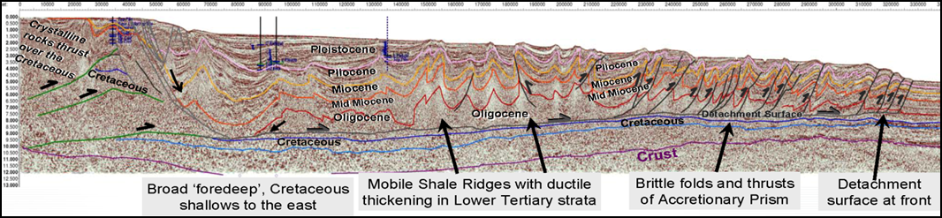
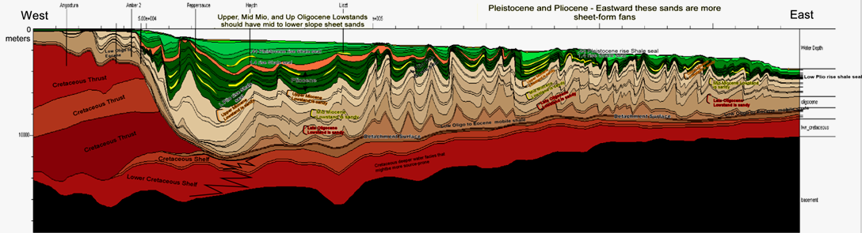
DGA Full Workflow and Results Provided

Slide 22

Spectrum TTDAA 2D Reprocessing 2010 - Why Reprocess?
To vastly improve the subsurface quality of the 2002 Trinidad and Tobago Deep Atlantic (TTDAA) 2D Survey data in the Deepwater Acreage
Further de-risking Trinidad and Tobago Deep Water potential with respect to the new 2010 Deep Water Competitive Bid Round
Represents the future of the energy industry
Encourage deepwater participation inclusive of the eleven companies of the original programme

Slide 23

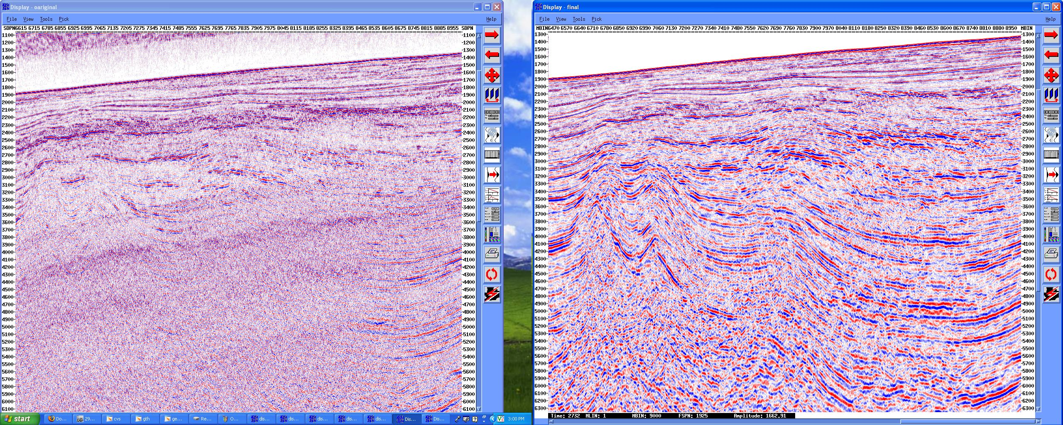
Original vs Final Migration

Slide 24
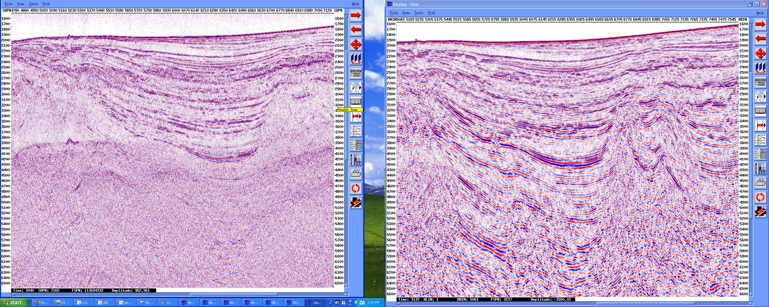
Original vs Final Migration

Slide 25
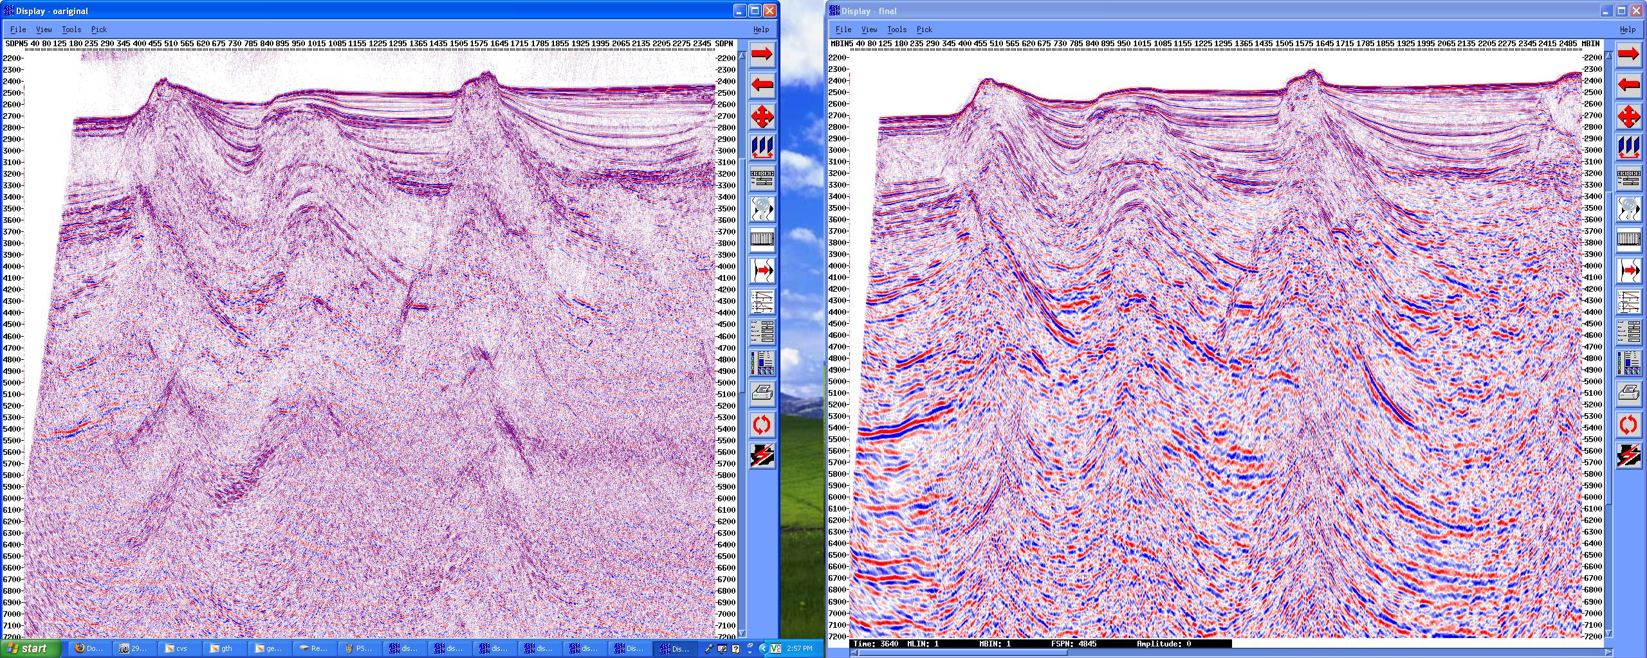
Original vs Final Migration

Slide 26
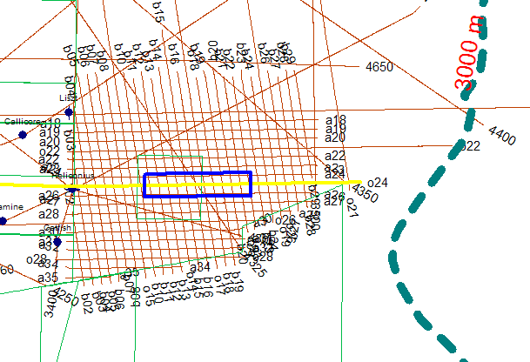
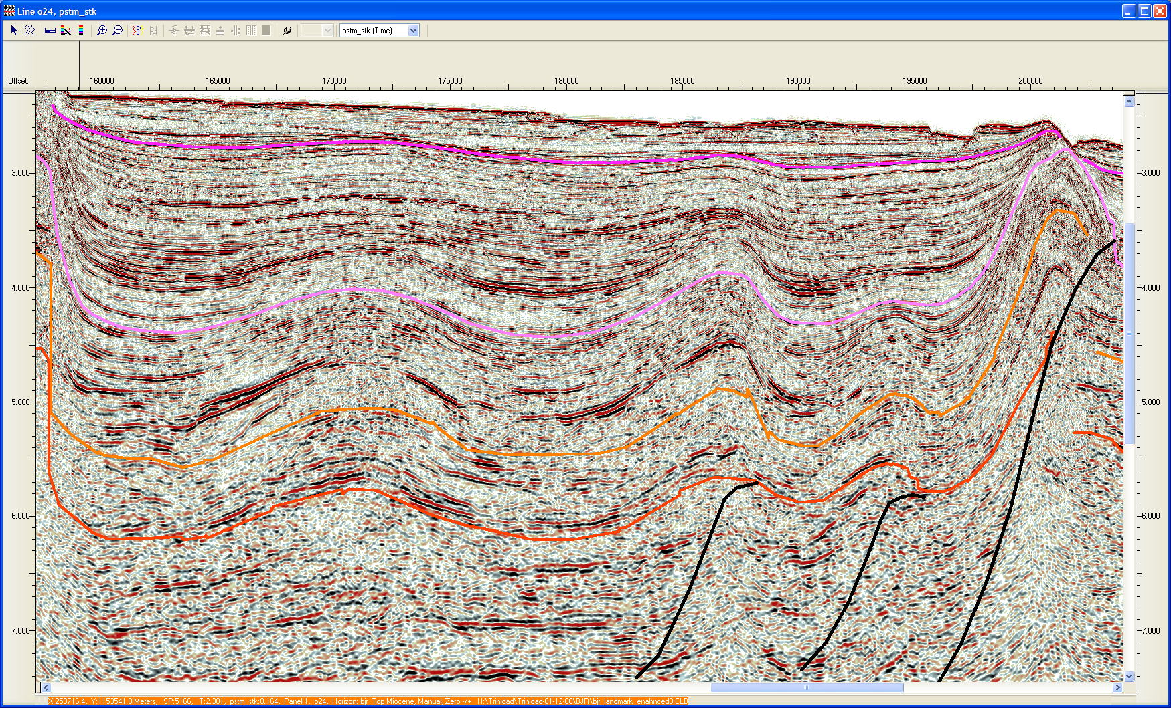
Sheet Fans Provide Multiple Reservoir/Seal Targets
Trinidad fans show excellent lateral extents
Block TDAA5
Open
5 km
Pleistocene
Pliocene
Miocene
Mid-Miocene
Sheet fans deposited at early lowstand time

Slide 27
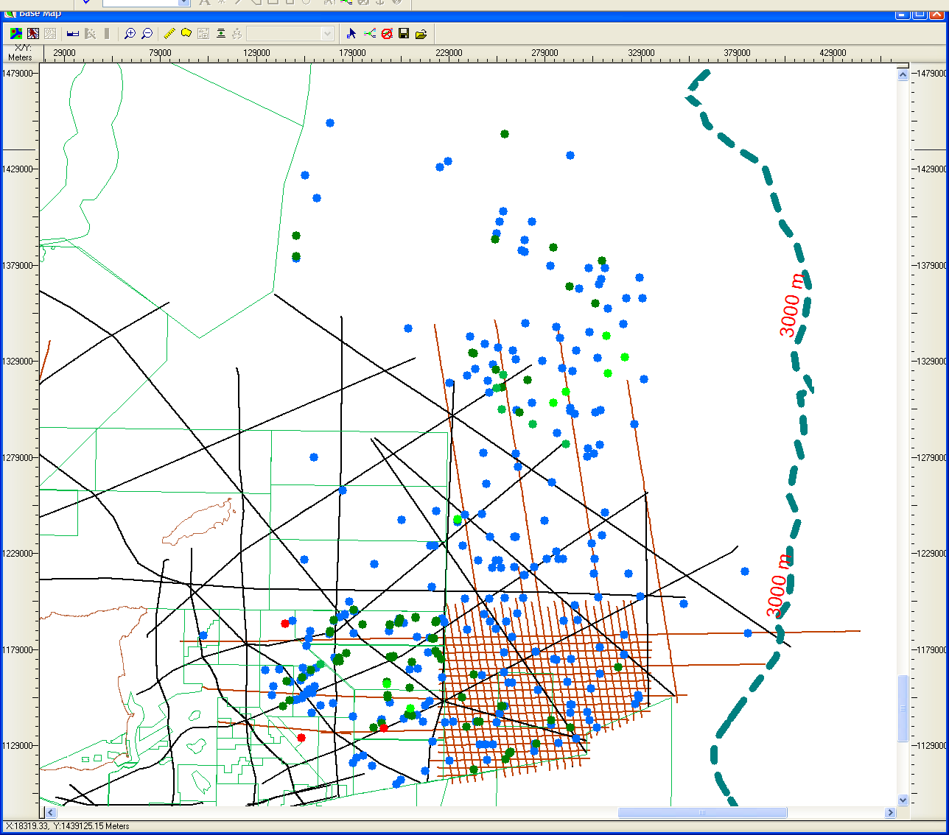
Trinidad Piston Cores Show Live Oil and an Active Hydrocarbon System
Total Piston Cores 449
Cores with Live Oil Shows 8
Cores with C15+ Heavies
GT 10000 units 7
Cores with C15+ Heavies
GT 1000-LT 10000 units 84
Cores with C15+ Heavies
LT 1000 units 260
The summary slide for the piston core surveys uses a straightforward scheme of total heavies of C₁₅₊ and divides the wells into groups denoted on the map by a color coded well symbols. The distribution shows an active hydrocarbon system operating throughout the area. The recent wet gas discovery in Victory 1 is noted.
50 km
Gas Shows / Discoveries 3
Pepper Sauce 1 Gas Show
Dynamine 1 30’ Gas Sand
Victory 1 Discovery
Tobago
Trinidad

Slide 28
Accretionary Prism Oil
Source
  Naparima Hill and Gautier fluids
  Need to be in upper to middle Miocene to avoid biodegradation
Seal
  Excellent seals exist in the Pliocene and Pleistocene
    No reason not to expect these seals further offshore
  Traps do not appear to be overpressured to fracture seals
Reservoir
  Proven reservoirs in Sandy Lane to Oligocene
Trap
  Look for early forming traps
    Recent movement on traps is risky but seals are ductile (high Poisson’s ratio)‏

Slide 29
Accretionary Prism Oil
Timing
  Timing is good for oil generation
  Movement of the Eocene/Oligocene mobile shale controls both seal and heating rate of source rocks
    Constraining this movement will have a strong impact on both seal and timing
  Petroleum system will be leaking
    All of Columbus basin is leaking
      Filling faster than it is leaking
    Late movement of faults affect seals
      Mitigated by ductile shales in Pliocene and Pleistocene
  Cool basin means any prospect can be tested between biodegradation limits and the source rock

Slide 30
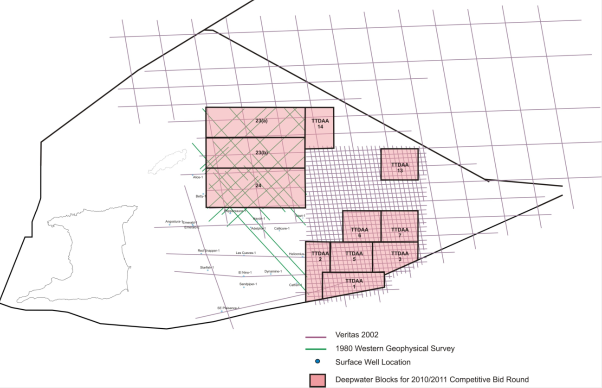
Comprehensive Data Package

Slide 31
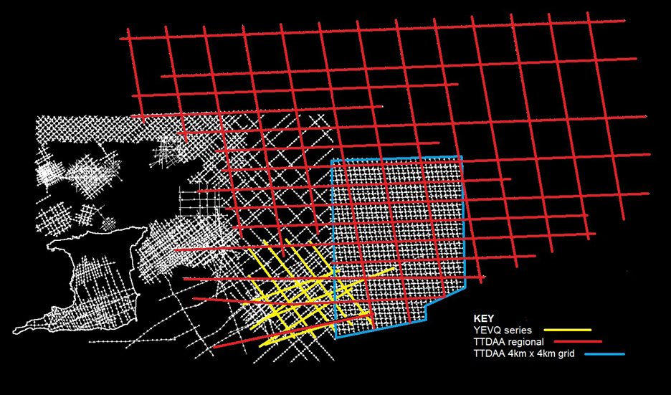
More data at reduced fee$

Slide 32
Competitive Bidding Process
Technical Review of Open Acreage
Nomination - companies can indicate blocks of interest
Blocks offered for competitive bidding-Competitive Bidding Order (CBO)
Bids evaluated and recommendations made
Technical Evaluation Committee Overview Committee, Cabinet
Blocks awarded;
Production Sharing Contract signed

Slide 33
Deep Water: Profit Share Matrices
Crude Oil
Price MBOPD | A | B | C | D
 | < $50.00 | $50.00 -$75.00 | $75.00 -$100.00 | > $100.00
 | %
< 75 | X | X | X | X
75 - 100 | X | X | X | X
100 - 150 | X | X | X | X
150 – 200 | X | X | X | X
> 200 | X | X | X | X
Natural Gas
Price MMCFD | A | B | C | D
 | < $4.00 | $4.00 - $6.50 | $6.50 -$9.00 | > $9.00
 | %
< 200 | X | X | X | X
200 - 350 | X | X | X | X
350 - 500 | X | X | X | X
500 - 750 | X | X | X | X
750 – 1,000 | X | X | X | X
> 1,000 | X | X | X | X
X represents the Governments Share of Profit Petroleum which is biddable
No carried participation
  Windfall Feature:
  BR + 70%*[(P – US$100.00) / P]*(1-BR)
  Where:
  BR is the base rate at Column D
  P is the market price
  Windfall Feature:
  BR + 70%*[(P – US$9.00) / P]*(1-BR)
  Where:
  BR is the base rate at Column D
  P is the market price
  Cost Recovery: 60%
Notes:
The technical terms have not yet been finalised for the deep water

Slide 34
Deep Water Exploration
Commercial Terms (re-emphasised)
  Conventional styled (non taxable) PSCs, with the following features:
    GORTT’s Share of Profit Petroleum are in lieu of taxes with exception of the payment of Withholding Taxes and Stamp Duty
    Ring-fenced – There will be no consolidation
    Profit Shares are biddable, matrices will be open with no constraints to bidding (Production is incremental)
    Financial Obligations are fixed in the Contract
    Cost Recovery Limit fixed at 60%
    No carried Participation
    Fair Market Value as defined in Petroleum Taxes Act is utilised for the pricing of gas

Slide 35
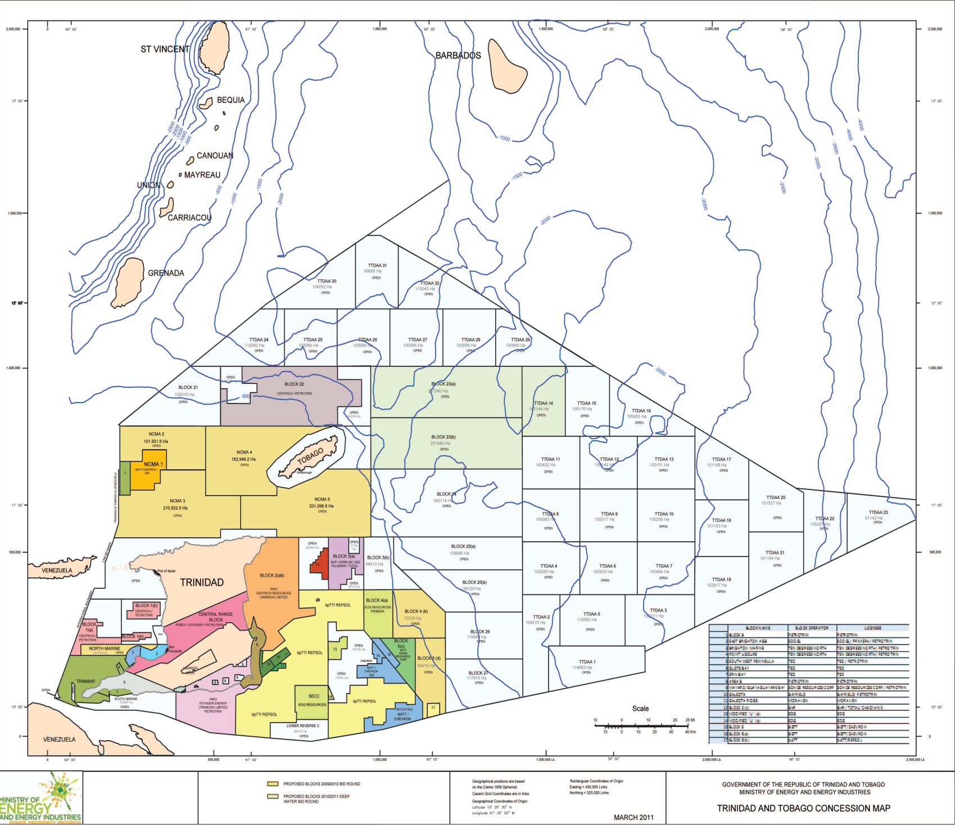
Competitive Bidding 2011/2012
Blocks for nomination are coloured light blue.
There are currently 36 deep water blocks available.
Companies are asked to nominate a maximum of five blocks

Slide 36
New 2011/12 Deep Water Round
The 2011/2012 bid Round
  Opening – November 30, 2011
  Closing – March 31, 2012
A maximum of six blocks will be offered – based mainly on your nomination
  Nominations close – October 31, 2011

Slide 37
Preliminary Terms and Conditions
Pre-bid fees
  Data which is licensed either before or after the publication of the Competitive Bidding Order be set off against the prebid fee up to a value of US$35,000.
  It is proposed that this 35,000 would be the fee for eligibility to bid on one block.

Slide 38
Preliminary Terms and Conditions
Pre-bid fees
Up to 2 blocks - US$15,000 in addition to the $35,000 already paid
Up to 3 blocks - US$25,000 in addition to the $35,000 already paid
Up to 4 blocks - US$35,000 in addition to the $35,000 already paid
Up to 5 blocks - US$40,000 in addition to the $35,000 already paid
Up to 6 blocks - US$45,000 in addition to the $35,000 already paid

Slide 39
Data Viewing Room
The Data Room is located at Level 23 of the offices of the Ministry of Energy and Energy Industries, International Waterfront Centre, Tower C, Port of Spain and viewing can be arranged between 8am to 4pm by appointment (see contacts below).
The Data Room can comfortably accommodate about four individuals, although there is no restriction on the numbers at any one time. It is equipped with a dual monitor workstation running Landmark’s Seisworks and Stratworks software and this can be used to examine available well and seismic surveys. The quantity and quality of data will vary by acreage and is determined by several factors including past exploration, proximity to producing blocks and legal data requirements. Every effort will be made to ensure that a representative and current dataset is available for viewing.

Slide 40
Contacts
Ministry of Energy and Energy Affairs
PBX 623-6708
Email: bidround@energy.gov.tt
Mrs. Penelope Bradshaw-Niles
Senior Petroleum Engineer
pbradshaw-niles@energy.gov.tt
PBX ext. 2360
Mr. Stephen Jagdeo
Senior Geophysicist
sjagdeo@energy.gov.tt
PBX ext. 2363

Slide 41
END

