Slide 1
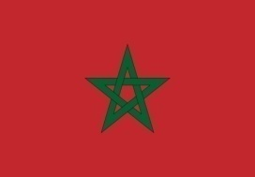
Kingdom of
Morocco
Exploration Opportunities
in Morocco
A. BENARCHID
ONHYM
AAPG International Conference & Exhibition, Milan October 2011

Slide 2
ONHYM Perspectives
Opening of new frontier areas for exploration;
Use of new technology tools in the exploration
phase (onshore and offshore);
Exploration and development of new resources
(Oil Shales, Shale Gas & Shale Oil).

Slide 3
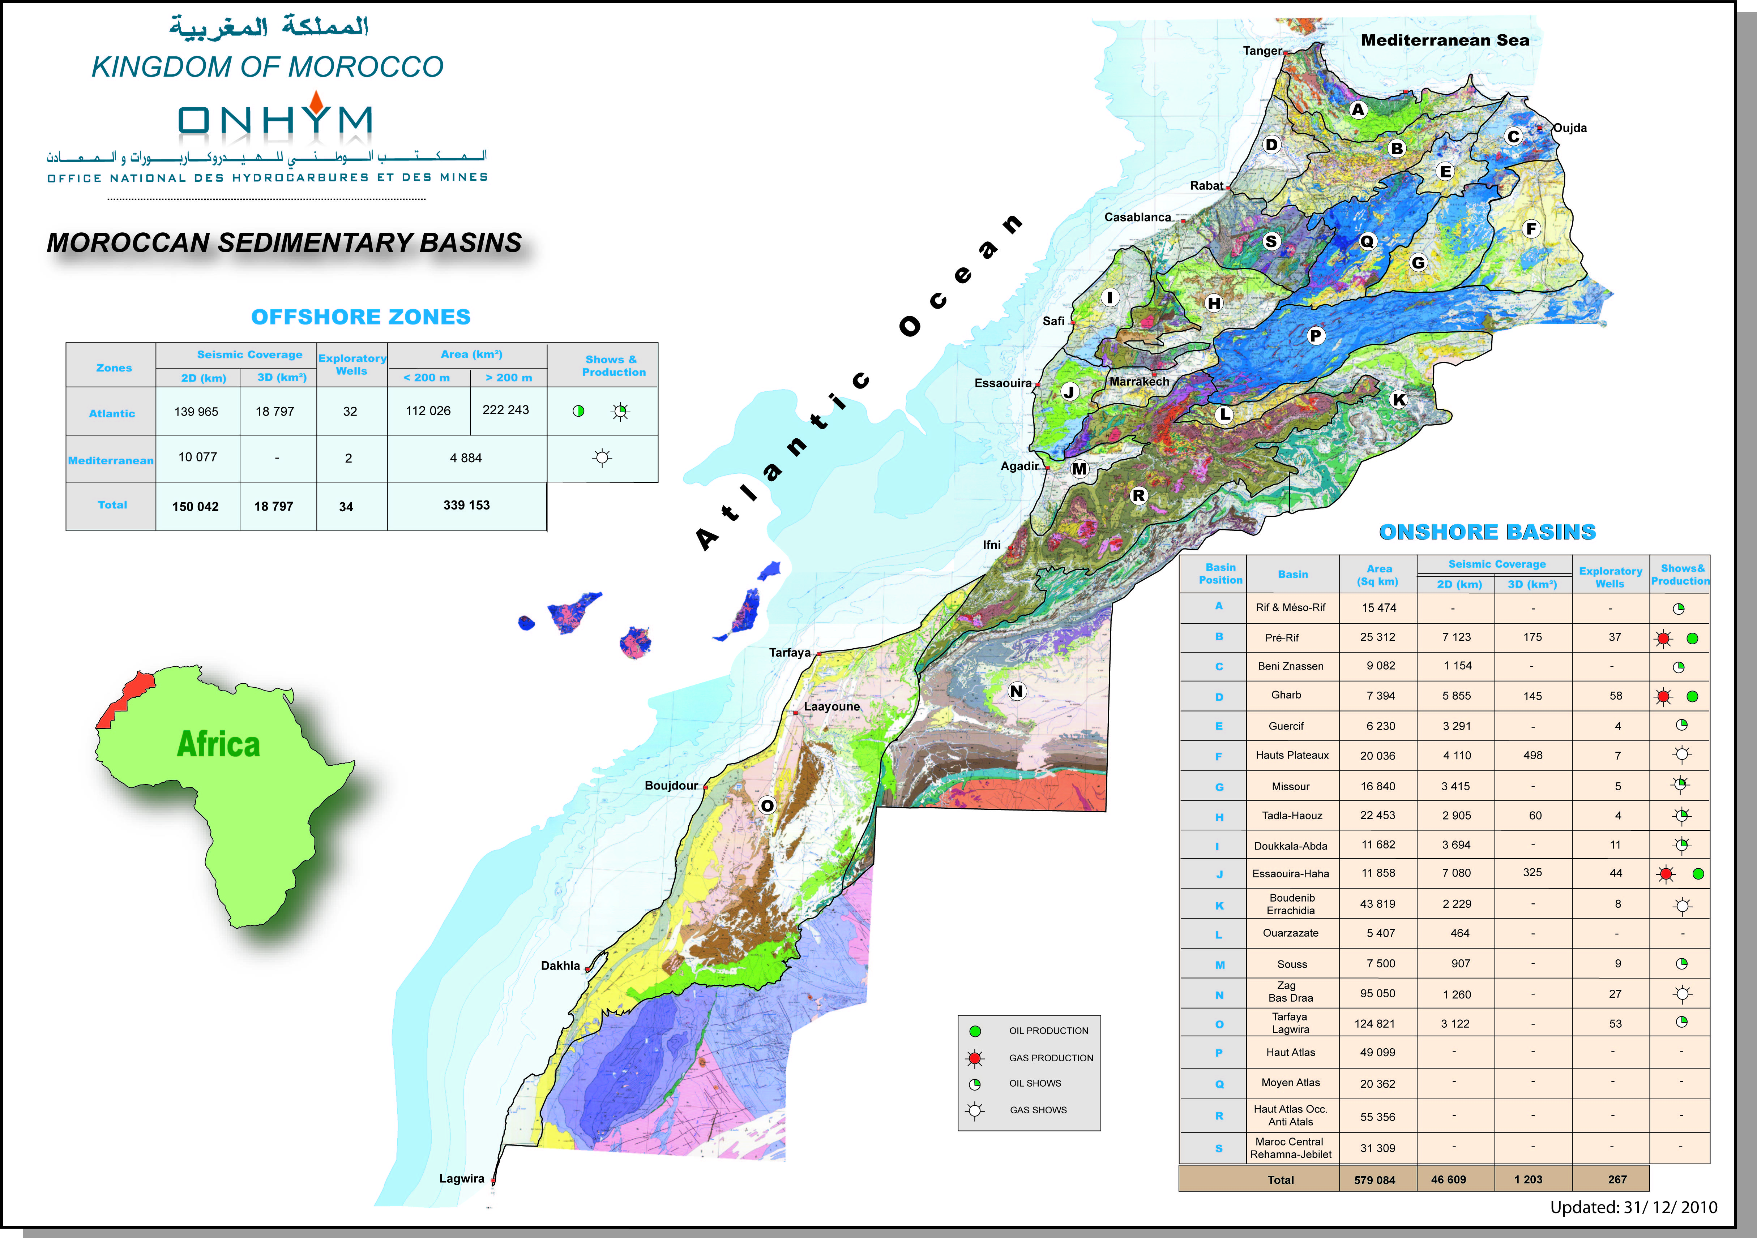
Geological Snapshot : Onshore
Paleozoic :
Zag (N), Boudenib (K), Ouarzazate (L), and Tadla (H)
Triassic :
Essaouira (J),Souss (M), Guercif (E), High Plateaux (F) and Missour (G)
Jurassic :
Laayoune (O), Tarfaya (O), Essaouira (J), Prerif (B)
Cretaceous :
Tarfaya (O), Boujdour (O)
Tertiary:
Gharb (D)
Atlantic basins

Slide 4
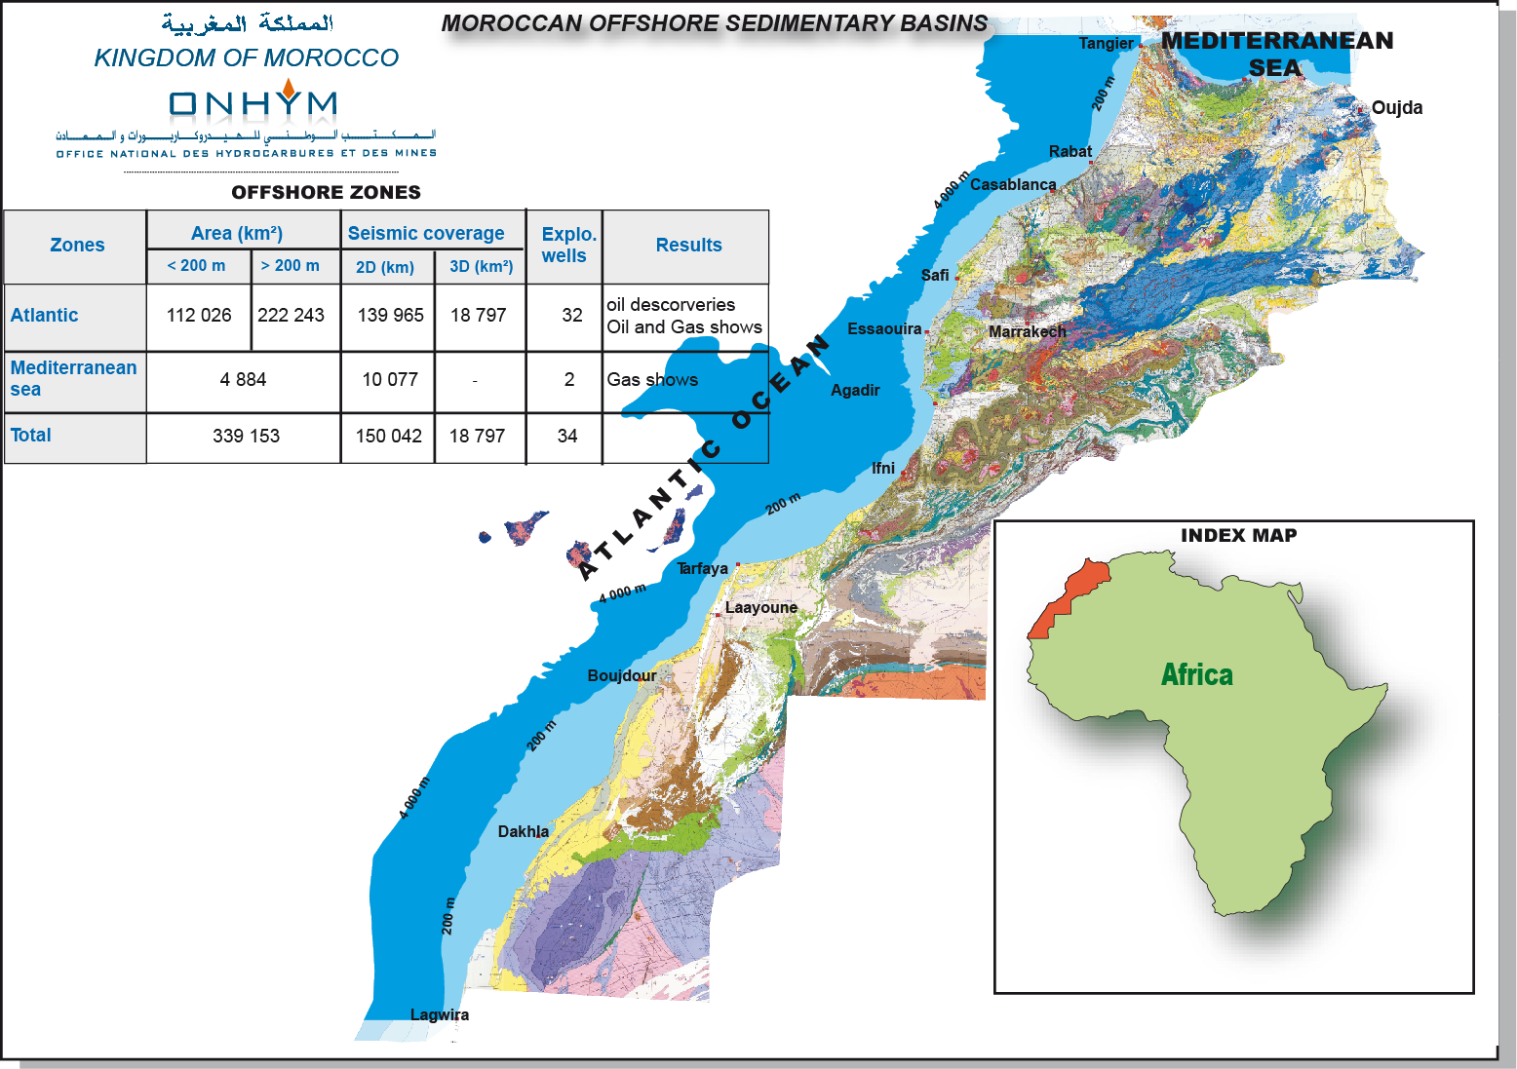
Geological Snapshot : Offshore
20 000
34
20 000
36
Offshore Atlantic: Jurassic, Cretaceous and Tertiary basins
Mediterranee: Tertiary basin

Slide 5
Exploration History
Exploration Drilling Density (well/ 100 Km²)
1,0
Onshore
Shallow Offshore
0,8
Deep Offshore
0,6
Wells per 100 Km²
0,4
0,2
0
Gharb
Prerif
Souss
Guercif
Tadla
Essaouira
Doukkala
Missour
Boudnib
Ouarzazate
Zag-Tindouf
Méditerranée
Hauts -Plateaux
Tarfaya-Laayoune
Shallow
Agadir-Ifni Shllow
Ifni-Tarfaya Shallow
Essaouira Shallow
Laayoune-Lagwira
onshore
Rabat-SafiShallow
Offshore profond Sud
Tanger-Rabat Shallow
Offshore profond Nord
Moroccan Sedimentary Basins

Slide 6
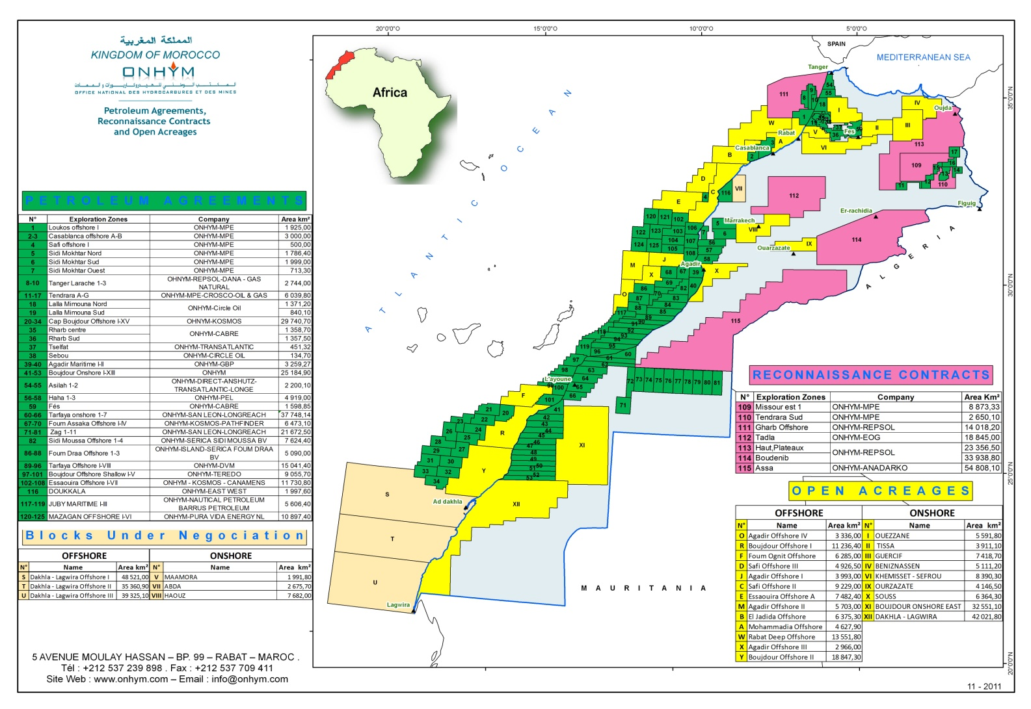
Exploration Status
Open acreage, permits and reconnaissance licences map
Open acreage | PA & RL
13 Blocs offshore 09 blocs onshore 06 blocs under negotiation | 31 Petroleum Agreements offshore & onshore 07 Reconnaissance Licences (6 onshore and 1 offshore)

Slide 7
Exploration Status
Available Data base
196 000 Km of 2D seismic data;
20 000 Km² of 3D seismic data;
300 of Exploratory wells (Final well reports,
logs, post mortem studies…).

Slide 8
Petroleum System Summary
The Essential elements to a working Hydrocarbon systems are all
present in most Moroccan sedimentary basins both Onshore and
Offshore;
Evidence from hydrocarbon occurrences (discoveries and shows),
outcrops, and seismic;
Source rocks : Silurian, Toarcian, Oxfordian, Apto-Albian,
Cenomano-Turonian, Eocene-Miocene;
Reservoir rocks: Devonian, Triassic, Jurassic, Lower Cretaceous,
Coniacian, Miocene, Oligocene.

Slide 9
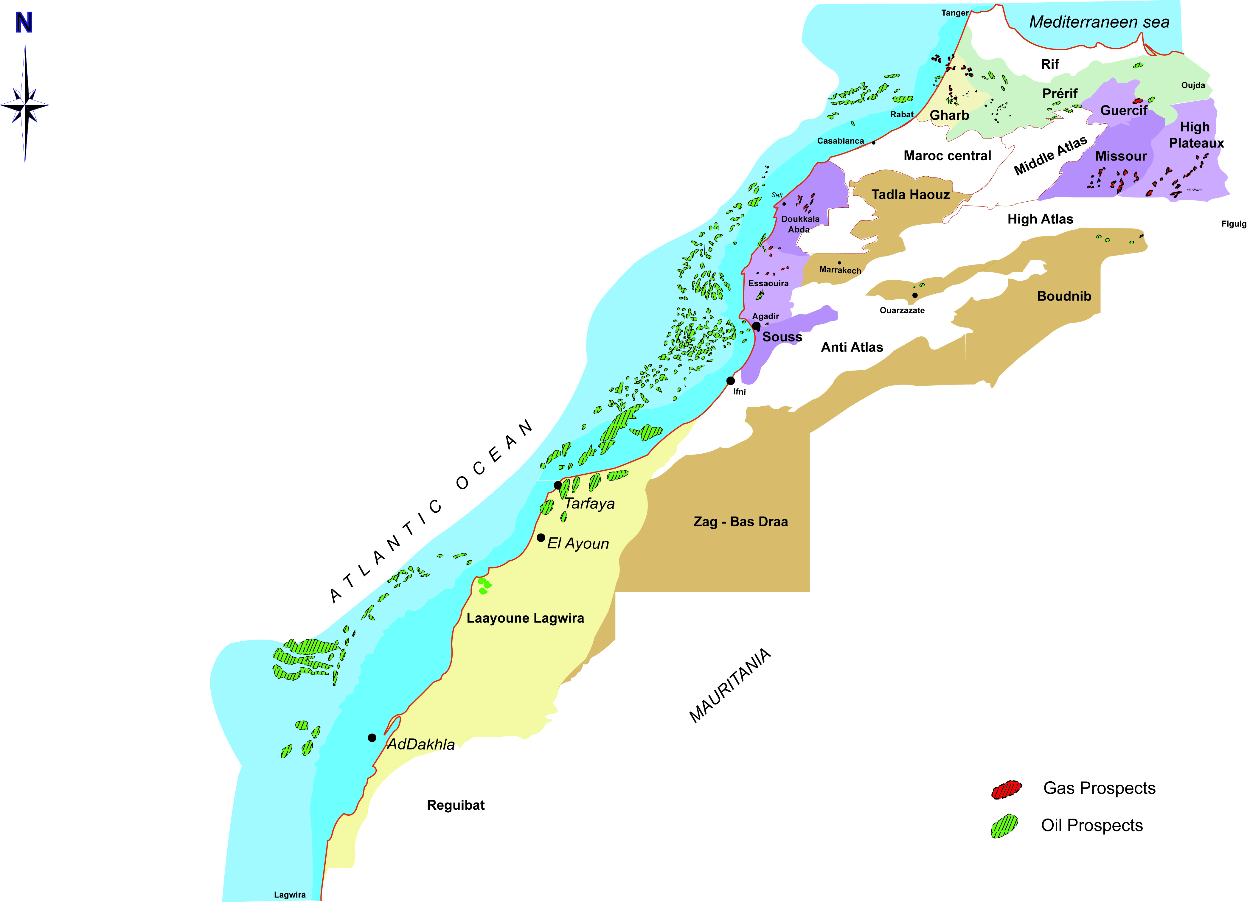
Prospects&Leads
300 Prospects & Leads in onshore and offshore Moroccan basins
Offshore Resources :
11 – 1 140 MMbblsO and up to 11 TCF of Gas

Slide 10
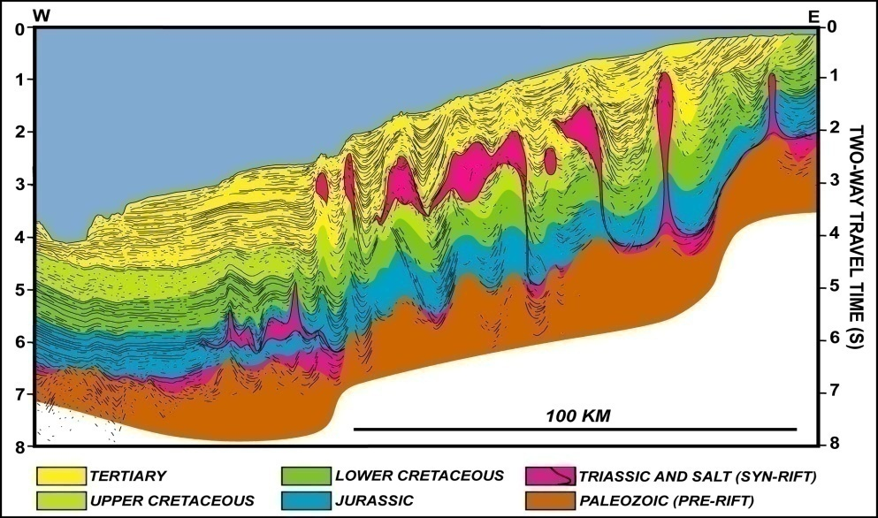
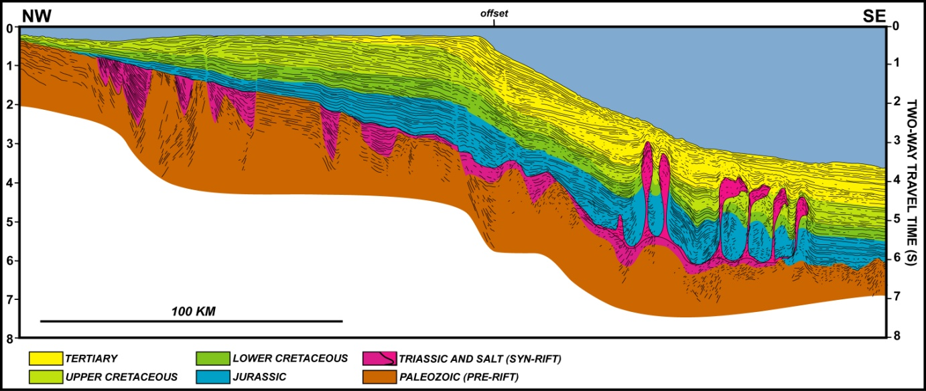
Analogs
Tafelney Plateau, Morocco
Lahavre Plateau,
Nova Scotia

Slide 11
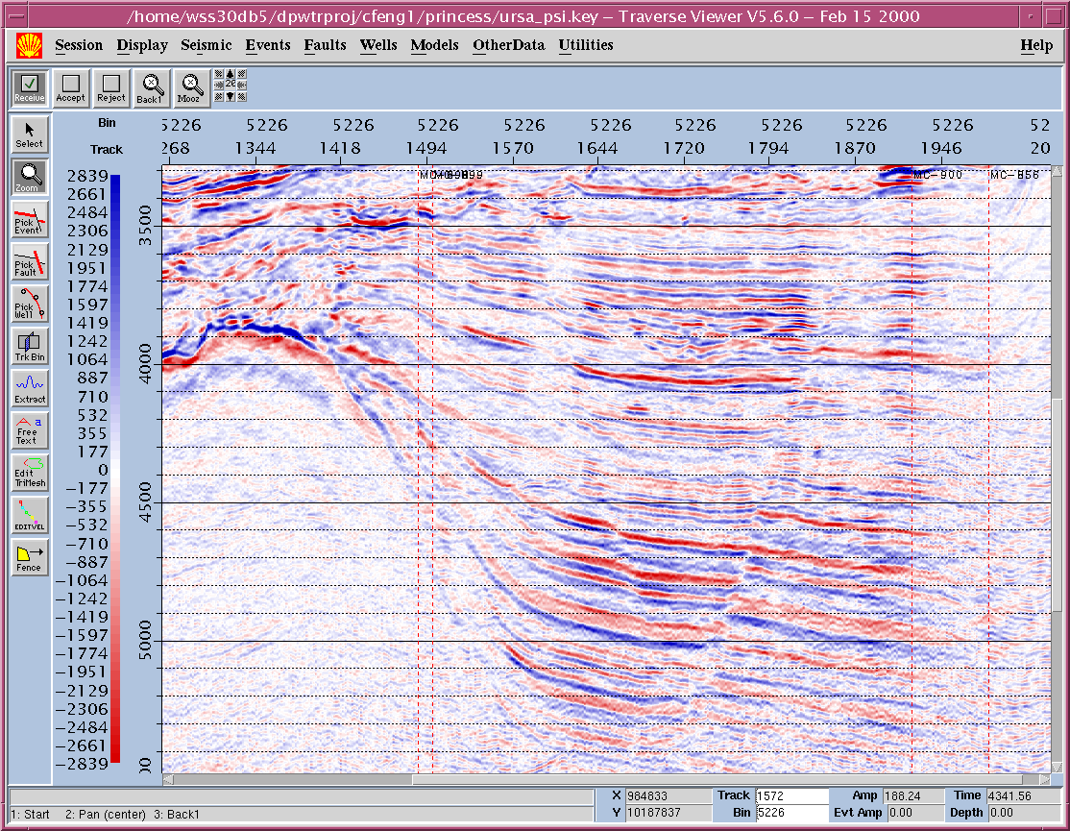
Analogs
Salt induced play
Moroccan Atlantic
Offshore
Ursa field Gulf of Mexico

Slide 12
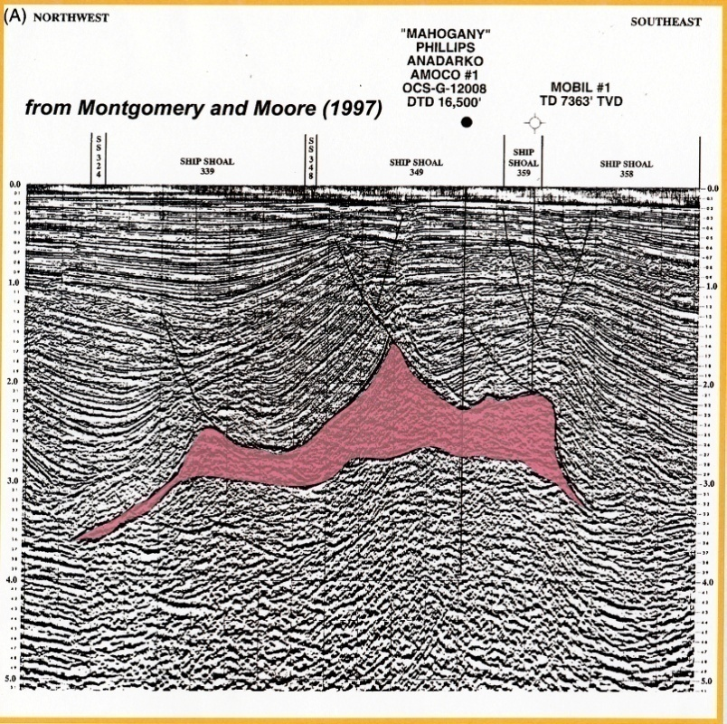
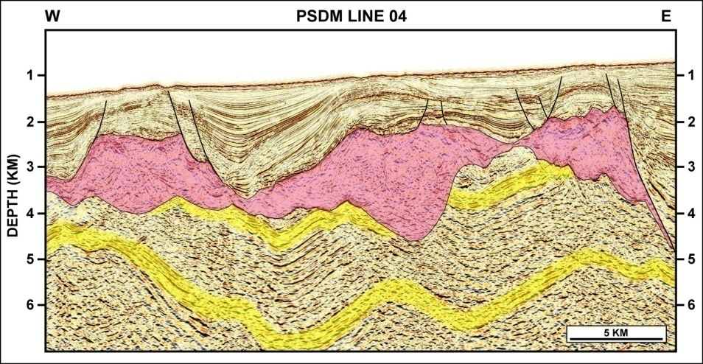
Analogs
Subsalt play
Mahogany Field
Gulf of Mexico (USA)
Moroccan Atlantic
Offshore

Slide 13
Example of play concepts
Offshore Atlantic
AAPG International Conference & Exhibition, Milan October 2011

Slide 14
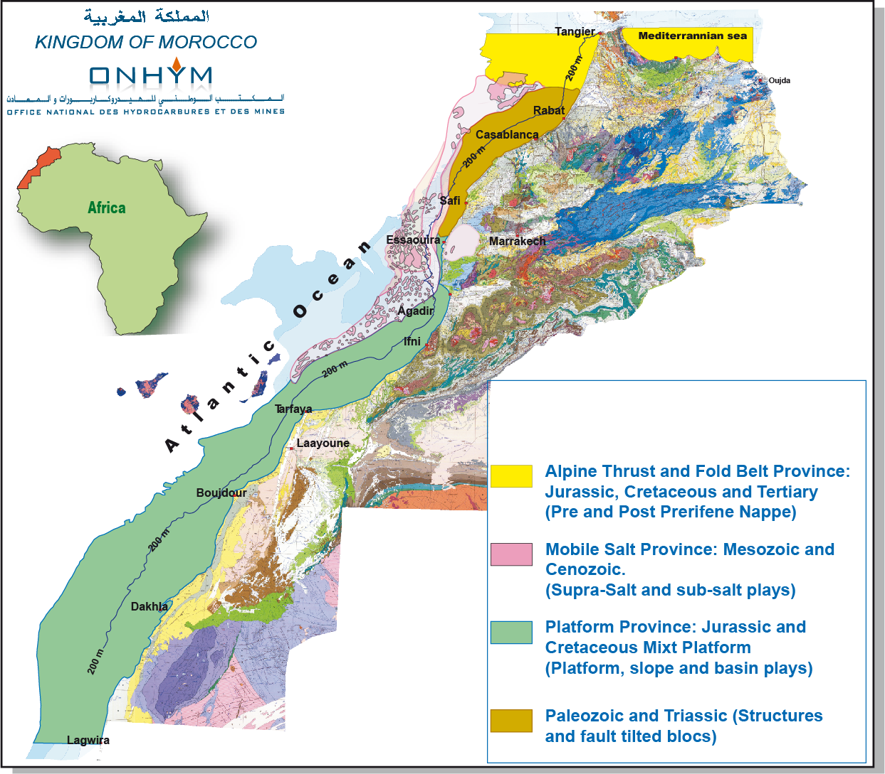
Offshore Atlantic
MAIN OFFSHORE PROVINCES

Slide 15
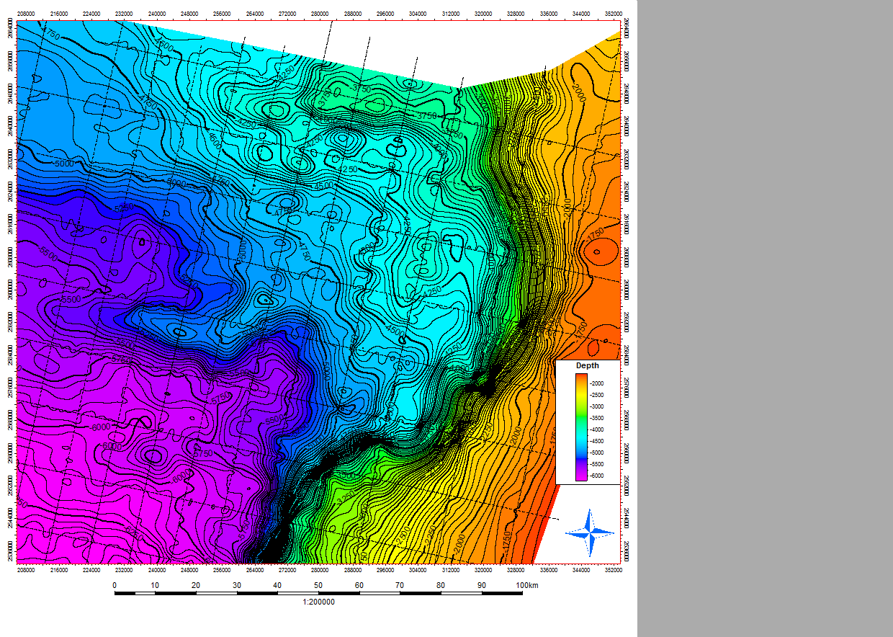
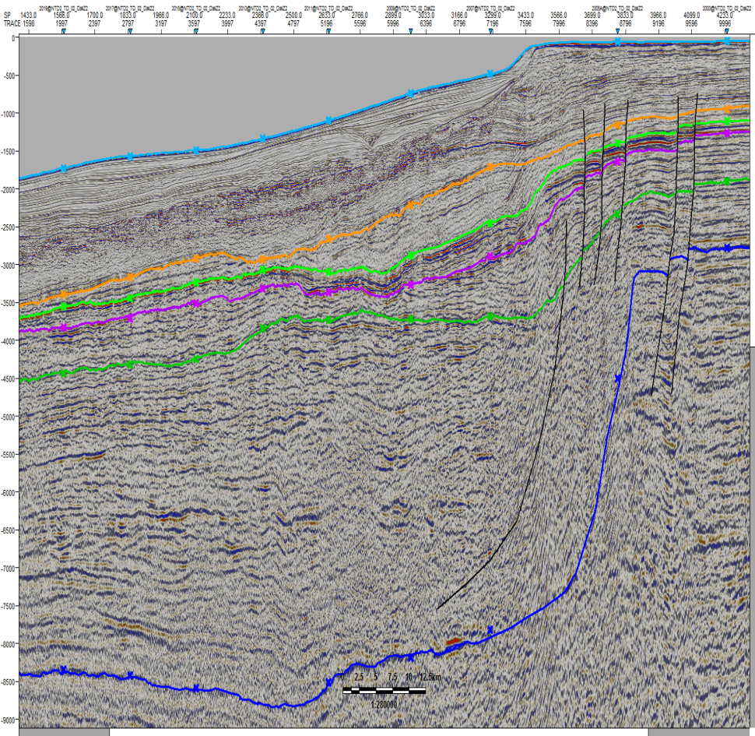
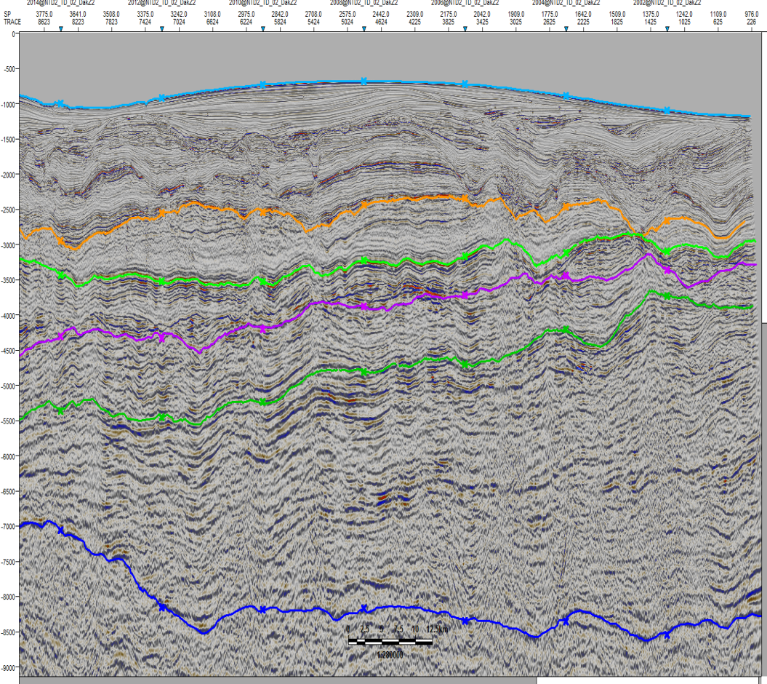
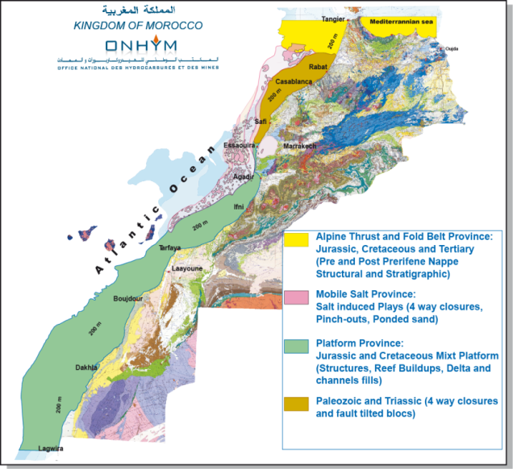
Dakhla –Lagwira Offshore
Albian Lead
Maximum closure: 140 Km²
W
E
Line TD02-2002
Sea Bed
Base Coniacian
Top Santonian
Base Tertiary
Mid Albian
Depth map at Mid-Albian (CI= 50m)
Top Jurassic
S
Line TD02-2011
N
Traps : Structural
four way closure
(Rollovers)
Reservoirs: Albian
sandstones
Source rocks: Aptian
and Jurassic
Seals: Upper
Cretaceous marls
Sea Bed
Base Tertiary
Top Santonian
Base Coniacian
Mid Albian
Top Jurassic

Slide 16
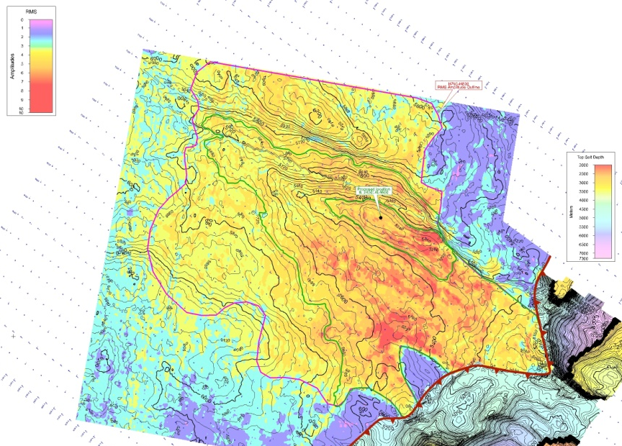
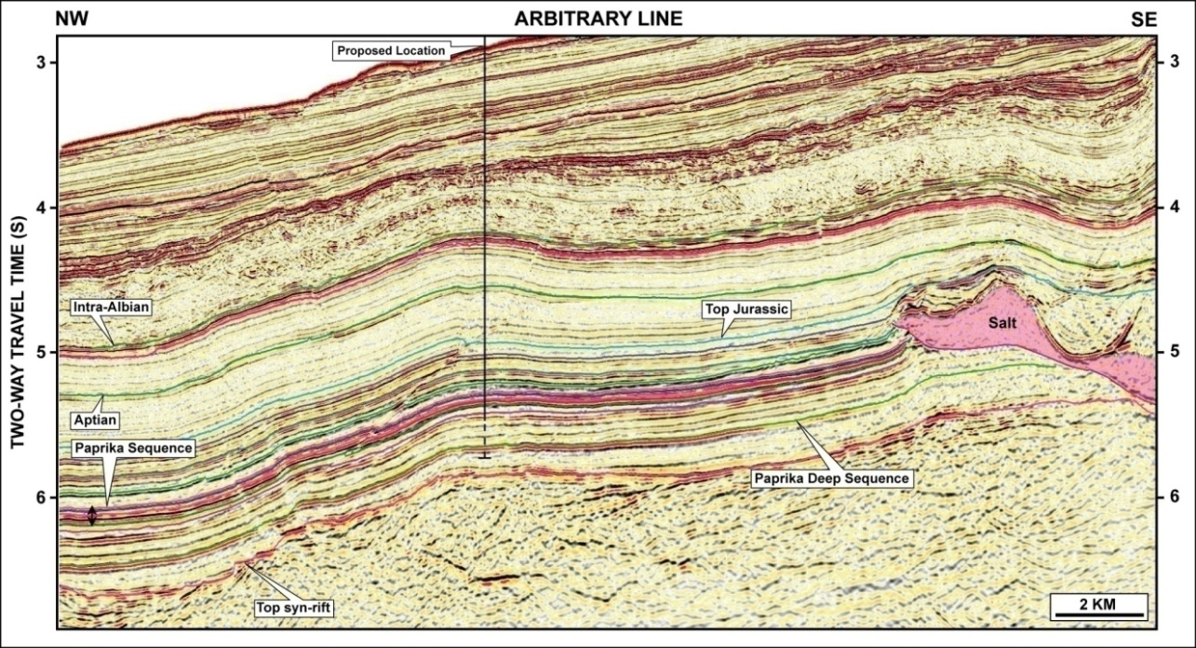
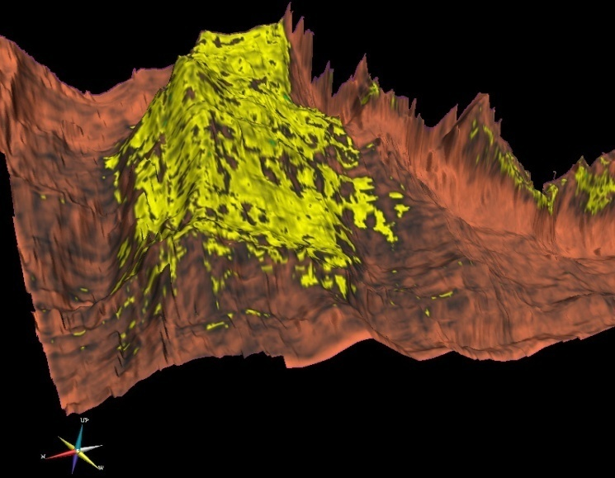
Middle Jurassic Depth Structure and RMS Amplitudes
Essaouira Offshore
Jurassic Lead
4 way closure
RMS Amplitude
Traps:
- Structural four way closure
- Stratigraphic widespread amplitude
distribution (turbidite lobes)
Reservoirs:
Likely Middle Jurassic sandstone
turbidites
Source rocks:
Lower Jurassic (Toarcian)
Seals:
- adjacent salt
- Upper Jurassic marls & shales
3 D view Amplitude extraction

Slide 17
Example of play concepts
Onshore
AAPG International Conference & Exhibition, Milan October 2011

Slide 18
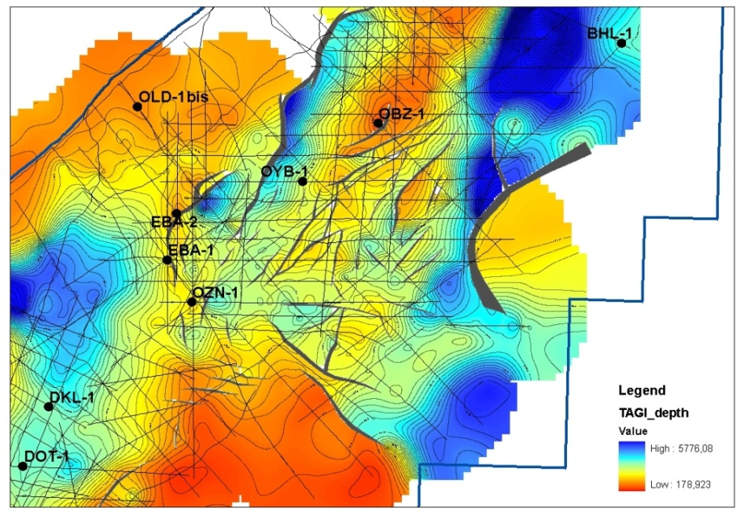
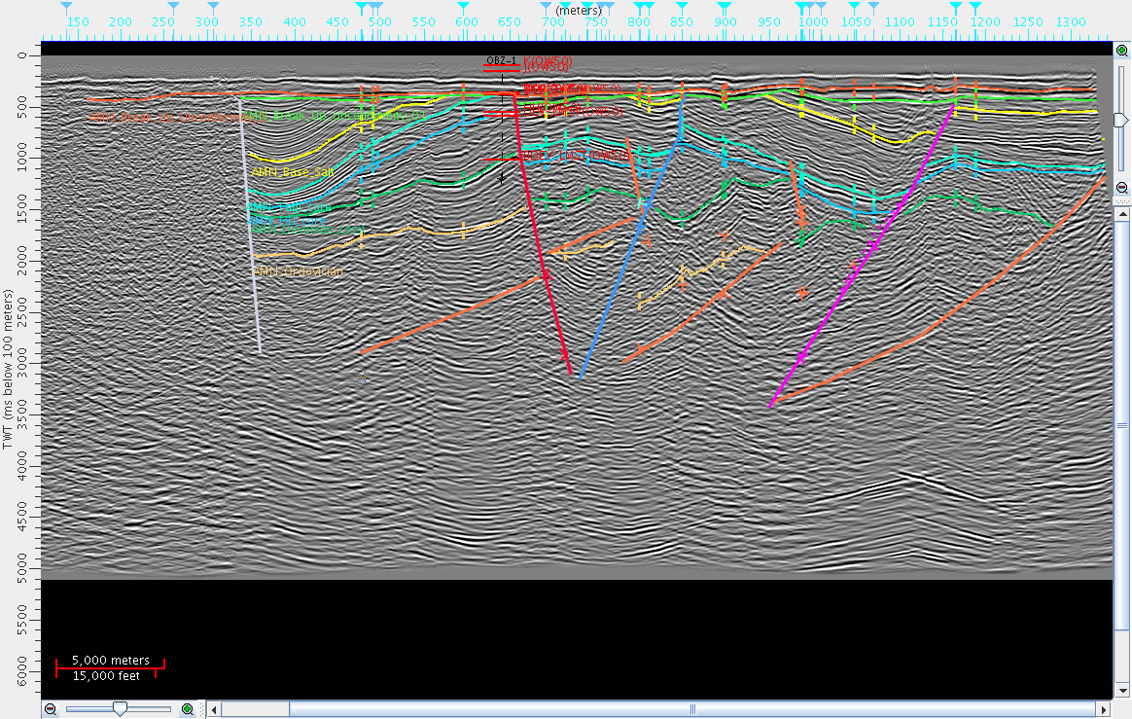
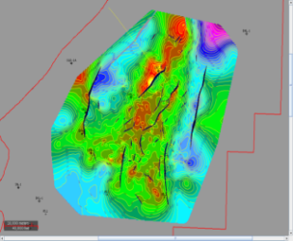
Abda-Doukkala basin
Triassic Prospect
DA-5
NW
Prospect D1
SE
Well OBZ-1
D2
D1
BKU
Base Salt
EAST WEST
BLOCK
D4
Top Tagi
D3
Hercynian Unc
Base Dev. Lmst
Ordovician
Depth map of Upper Triassic
Line DA-05, through the OBZ-1 Well to the D1 Structure
Traps : Faulted block
Reservoirs: TAGI sandstones
Seals: Triassic and liassic interbedded shale & salt
Source rocks:
- Silurian graptolic hot shales
- Frasnian shales
Prospect D1:
Areal closure : 16 Km²
Gas Reserves : 245 Bcf
Condensates Reserves: 15 Mbbls

Slide 19
Non conventional hydrocarbon
AAPG International Conference & Exhibition, Milan October 2011

Slide 20
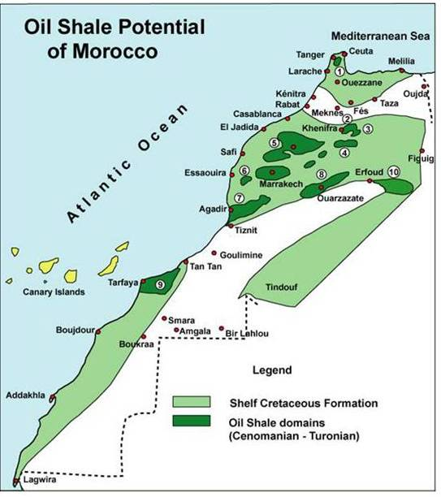
Oil shales potential in Morocco
The efforts of research started
during the Eighties. They are
resumed by national and foreign
partners in concordance with the
Moroccan global strategy.
Morocco has important oil reserves
contained in the oil shales
(approximately 50 billion barrels,
Timahdit &Tarfaya).
Timahdit

Slide 21
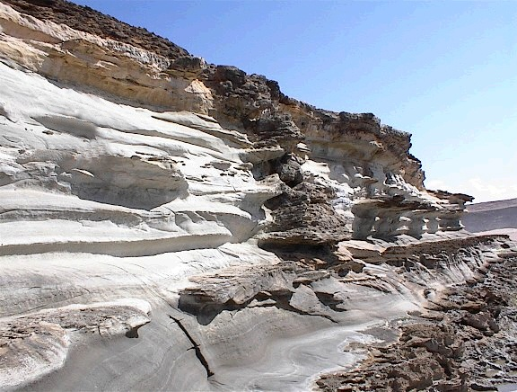
Oil shales potential in Morocco
Tarfaya onshore
TOC (Wt%)
0
10
20
30
Cenomano-Turonian Tarfaya oil shale: The source rock interval is 50 m thick, with a TOC of 2-19%

Slide 22
Oil shales potential in Morocco
Timahdit section
Upper Cretaceous Timahdit oil shale: maximum thickness 250m extended in an area of 900Km²

Slide 23
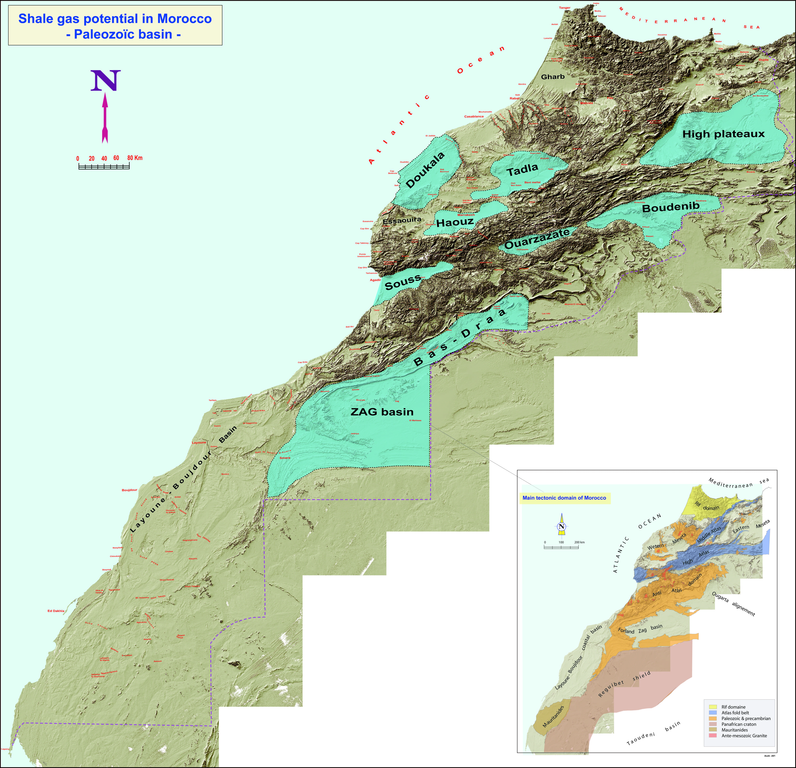
Shale gas potential in Morocco
Paleozoic system
First geological appraisal of
Paleozoic depositional system;
Other basins worth a deep
exploration work;
The Mesozoic and Tertiary sediments
have a good potential and should be
considered for shale gas
development plans.

Slide 24
Shale gas potential in Morocco
Paleozoic system
BASIN | AREA (Km²) | FORMATION | TOC (%)
Boudenib | 34 000 | Carboniferous | 1 – 1.45
 |  | Devonian | 1 – 1.3
 |  | Silurian | 1 – 3
Tadla | 10 000 | Carboniferous | 1 – 2
 |  | Devonian | 1 – 5.3
 |  | Silurian | 1 – 12
Doukkala | 8 000 | Carboniferous | 1 – 2
 |  | Devonian | 1 – 2.48
 |  | Silurian | 1 – 2.1
Zag | 65 000 | Devonian | 1 – 2
 |  | Silurian | 1 – 2
High Plateaux | 23 437 | Carboniferous | 1 – 1.6

Slide 25
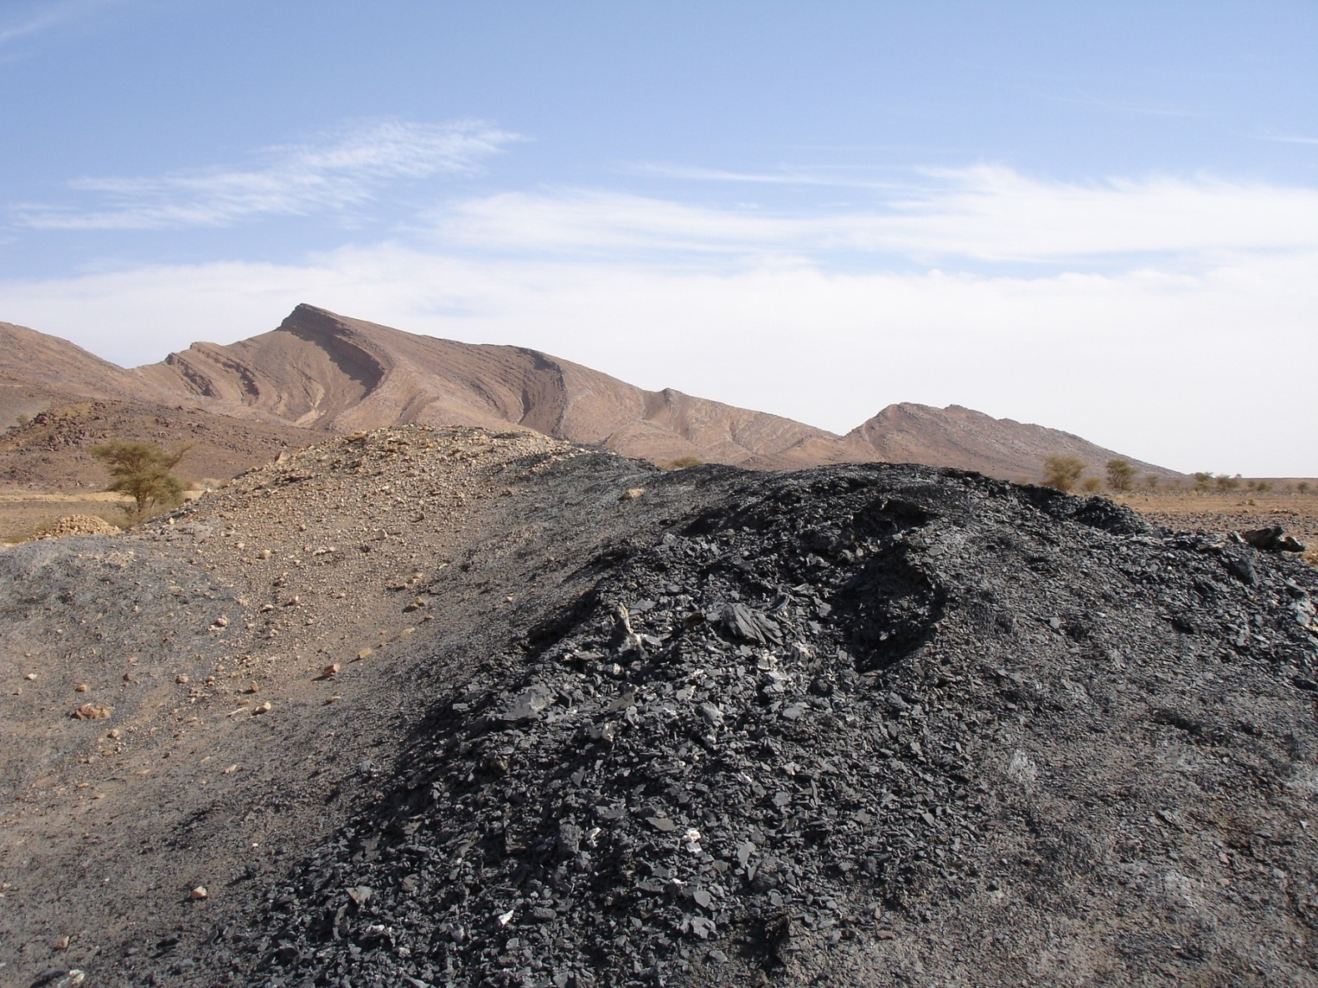
Shale gas potential in Morocco
Eastern Anti-Atlas
Ordovician Sandstone
Silurian shales

Slide 26
Conclusions
Moroccan sedimentary basins, both onshore and offshore, are still
under-explored ;
Exploration drilling activity, although limited, and outcrops demonstrated
the presence of viable petroleum systems;
New 3D seismic data have permitted to increase the rate of success and
to delineate new prospects;
Developed play concepts are ranging in age from Paleozoic to Tertiary,
and are of different types;
In term of non conventional hydrocarbon, Moroccan basins have a good
potential and worth a deep exploration work.

Slide 27
Conclusions
What could be next?
Resumption of intensive exploration of the untested plays, both onshore
and offshore, with new ideas;
Reevaluation and upgrade of the previously indentified prospects and
leads to go ahead for drilling;
Acquisition of high quality seismic data and using of new reprocessing
techniques and modeling to accurately assess and test the delineated
plays and prospects;
Intensive exploration programs to prove the non conventional
hydrocarbon potential of the Moroccan basins.

Slide 28
Kingdom of
Morocco
THANK YOU
ONHYM / MOROCCO
AAPG
Booth # 313
AAPG International Conference & Exhibition, Milan October 2011

