Slide 1

Morocco: Conventional and Non Conventional Hydrocarbon Development
Mohamed HSSAIN
ONHYM MOROCOO
Houston, April 2011

Slide 2
Outline
Morocco’s energy landscape
and strategy
Exploration status
Perspectives & Conclusions

Slide 3
Energy sector in Morocco
National policy
Ensure the effective security of supply at lower cost
Ensure the generalization of the access to energy
Diversify source of energy
Protect the environment and reinforce the technical safety
Establish and reinforce the Energy efficiency
Encourage Hydrocarbon Exploration
Notes:
Taking into account the current energy situation, Morocco has to meet the following challenges:
To ensure the control of the effective security of supply and with lower cost.
It is a question of being ensured of coherence of the energy system as a whole:
- Guaranteed public utility, adaptation supply / demand, taxation compatibility with the social choices (decentralization, regionalization)
- To proceed to the programming of the projects and to make sure that the investments necessary (8 to 11 billion DH / year) are timely carried out.
- To set up the institutions and structures required by retained options
To develop the local resources and to encourage exploration
To ensure the generalization of the access to energy

Slide 4
Petroleum Exploration Activities in Morocco
New dynamics
Favourable Geology and under - explored sedimentary
basins
Sustained studies of Petroleum Evaluation carried out
by ONHYM and it’s partners
Actions of proactive promotion
Technical progress (3D seismic data and Offshore
drillings)
Promulgation of a new more incentive code of
hydrocarbons in 2000
Notes:
Oil and gas exploration in Morocco gained a renewed interests from the international oil companies. The revival of Oil and Gas exploration in our country is due mainly to the following factors:
Prospectivity of our sedimentary basins,
Studies undertaken to identify and evaluate the oil potential of the Moroccan sedimentary basins,
The sustained actions of promotion deployed by the ONHYM,
The development of new technologies of drilling deep offshore,
The attractivity of our amended HC law:
This will be addressed later in more details by Mrs Wafae BENHAMMOU
The creation of the ONHYM in 2003 will allow the consolidation and the capitalization of the assets of the exploration both for Hydrocarbon and Mining as well as the reinforcement of the already launched proactive strategy

Slide 5
Petroleum Exploration Activities in Morocco
ONHYM Strategy
Give fresh impulse and a new dimension to the
mineral and hydrocarbon exploration in the country
Reinforce the dynamics of opening and partnership
Guarantee ONHYM a national identity at the
international level
Found a culture of performance within all the
components of the new organization
Notes:
Oil and gas exploration in Morocco gained a renewed interests from the international oil companies. The revival of Oil and Gas exploration in our country is due mainly to the following factors:
Prospectivity of our sedimentary basins,
Studies undertaken to identify and evaluate the oil potential of the Moroccan sedimentary basins,
The sustained actions of promotion deployed by the ONHYM,
The development of new technologies of drilling deep offshore,
The attractivity of our amended HC law:
This will be addressed later in more details by Mrs Wafae BENHAMMOU
The creation of the ONHYM in 2003 will allow the consolidation and the capitalization of the assets of the exploration both for Hydrocarbon and Mining as well as the reinforcement of the already launched proactive strategy

Slide 6
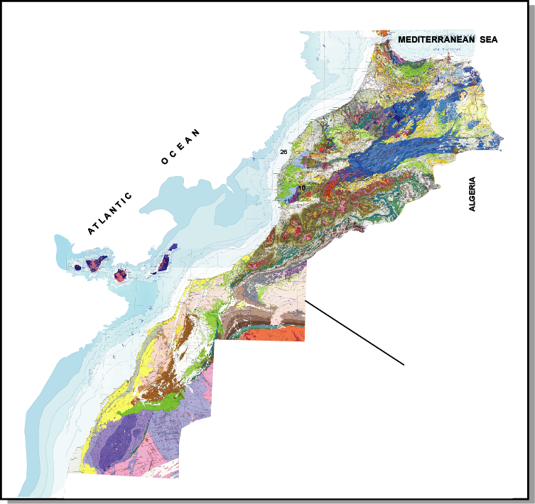
Exploration Status
Variety of thick Sedimentary
Basins (S.B)
Under- explored S.B onshore
& offshore
3 500 Km of Coast line
Recent discovery in northern
offshore Morocoo
Adequate data base acquired
in some S.B.
Play concepts defined

Slide 7
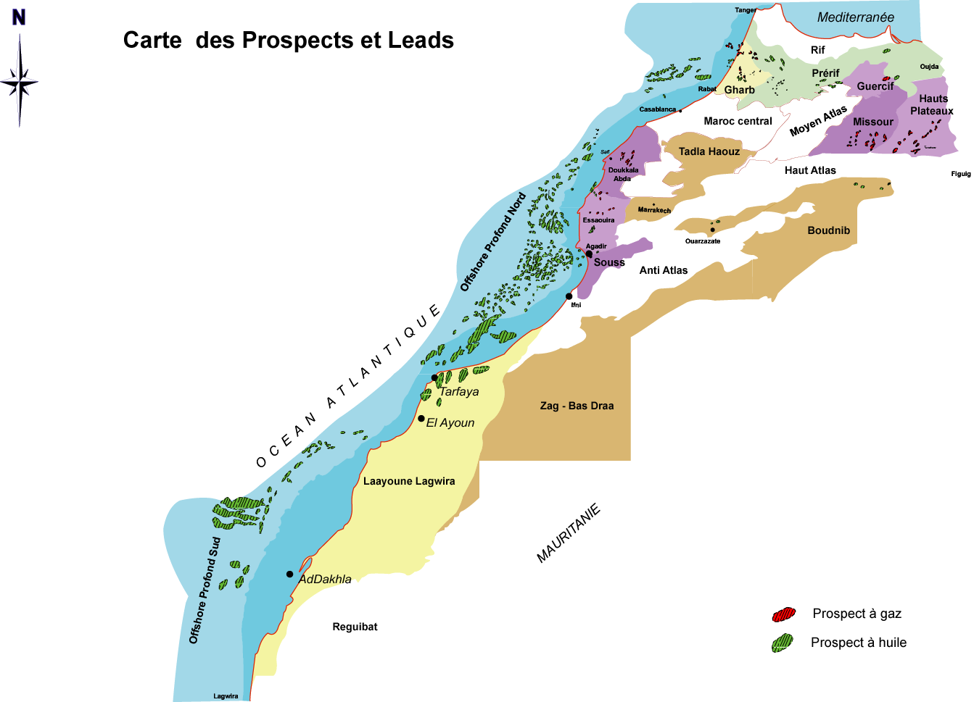
Exploration Status
.
Offshore Prospects and leads map
Amber 1

Slide 8
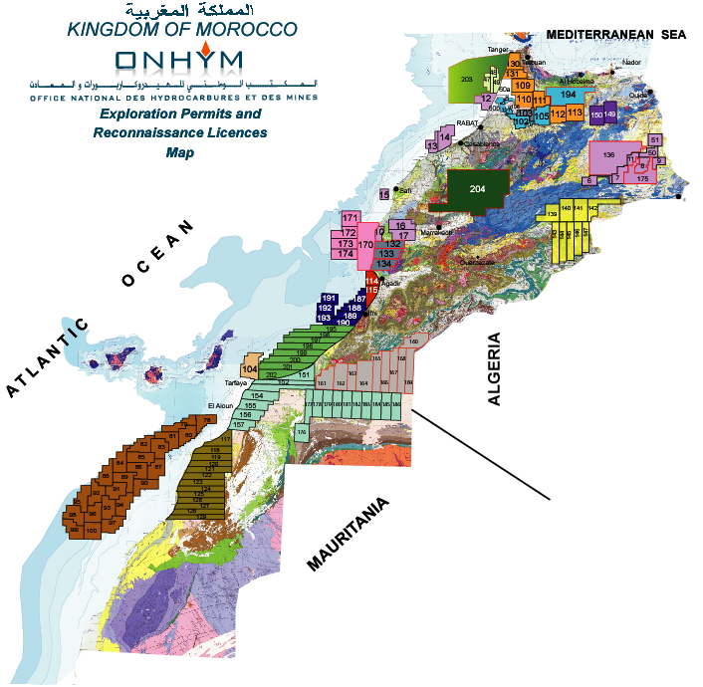
Exploration Status
Permits and Reconnaissance Zones acreage: end 2010
131 permits
28 societies
 | Onshore Permits | Offshore Permits | Reconnaissance Zones
Acreage | 135 764,45 Km² | 91 980,57 Km² | 53 967,63 Km²
Total | 79 | 52 | 6
13 concessions: 127,37 Km²
2010

Slide 9
Exploration Status
Petroleum Agreement Evolution: 1997-2010
Petroleum Agreement
2010
Years
Notes:
Une nette croissance enregistrée en 2000 en terme d’accords pétroliers et une progression continue de 2000 à 2007.
D’autres accords seront finalisés et viendront renforcer notre domaine minier

Slide 10
Exploration Status
Adequate data base acquired
 | Onshore | offshore | 2000-2010 | Total
2D Seismic Data (Km) | 5 148 | 66 471 | 71 619 | 196 000
3D Seismic Data (Km²) | 1 203 | 18 797 | 20 000 | 20 000
Wells | 36 | 6 | 42 | 300

Slide 11
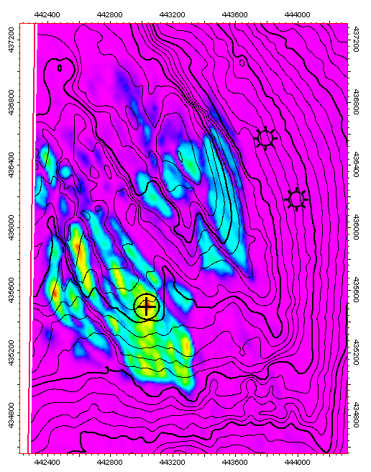
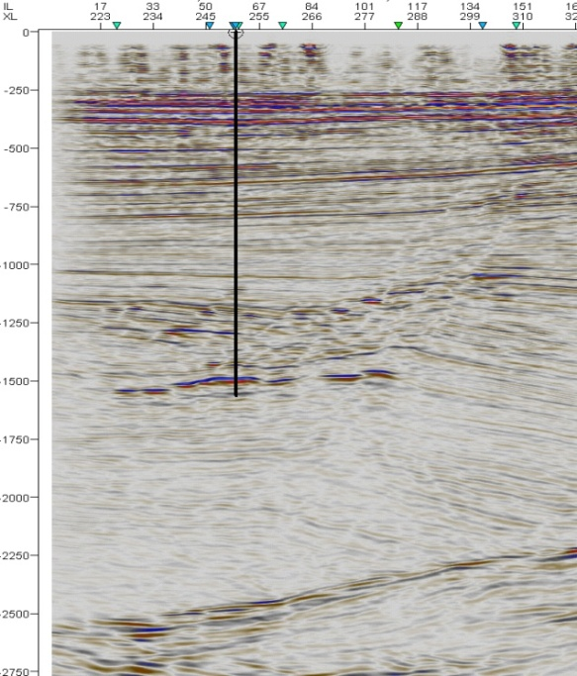



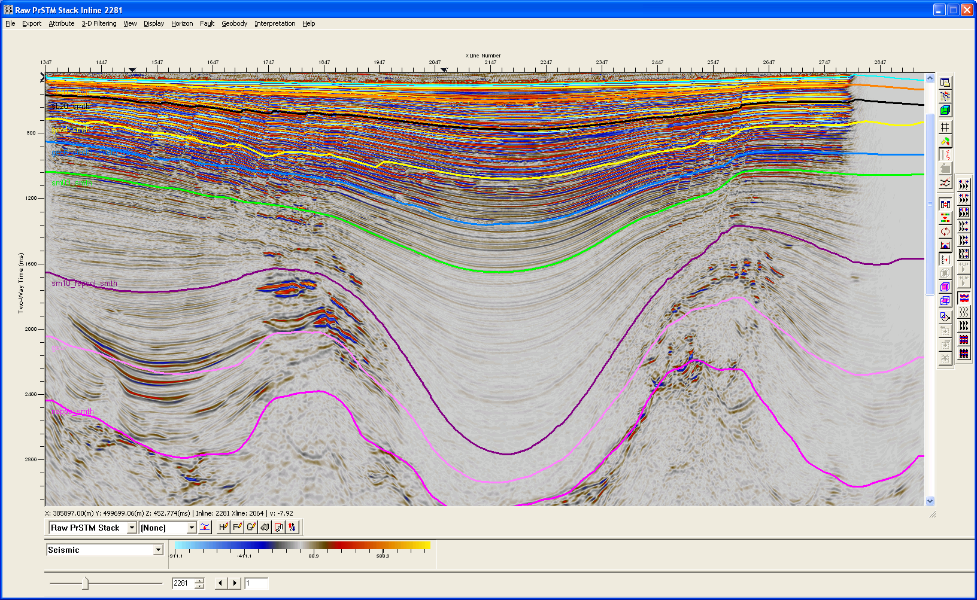
Amplitude Energy Extraction Map
Exemples: 3D Seismic, Shallow objectives
Seismic Line
SW
NE
KSR
-
3
1600
’
KSR
-
5
Onshore Gharb
1450
1500
1500
1500
1550
1550
1600
Seismic Line
0
1000m
Offshore Gharb

Slide 12
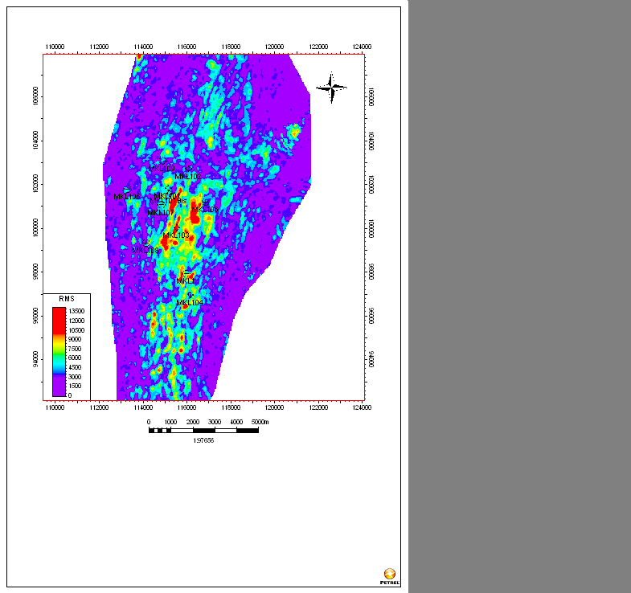
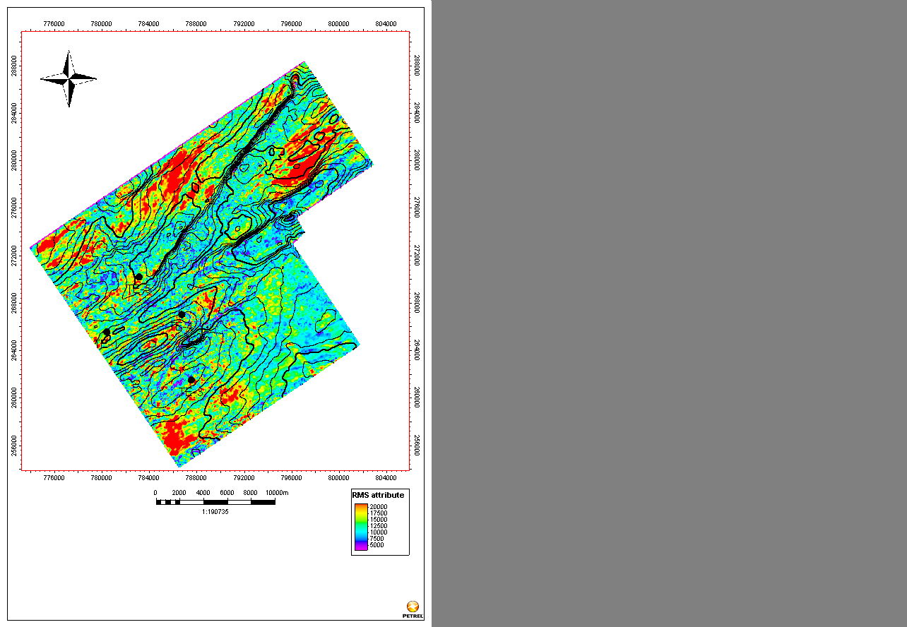
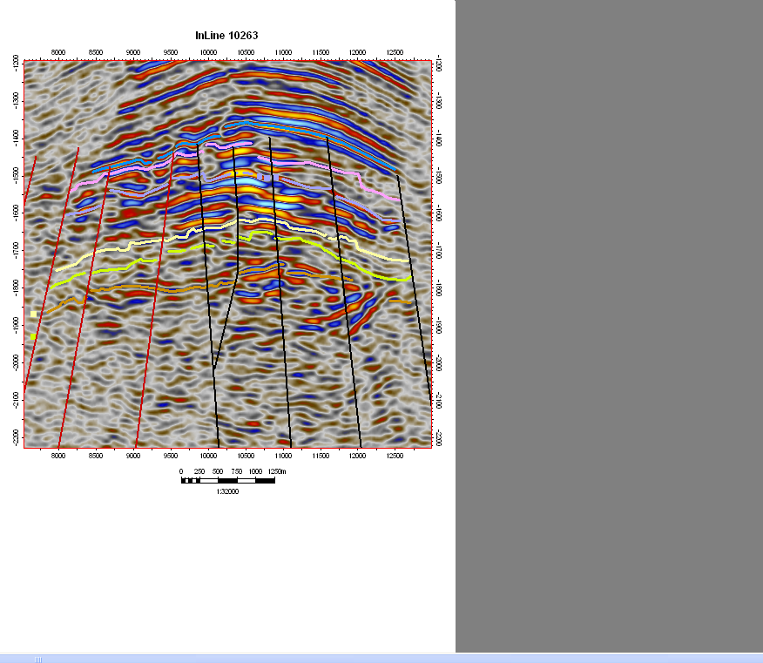
Exemples: Onshore 3D Seismic, Deep objectives
Meskala Subsalt
Tendrara Subsalt
RMS Attributs
RMS Attributs

Slide 13
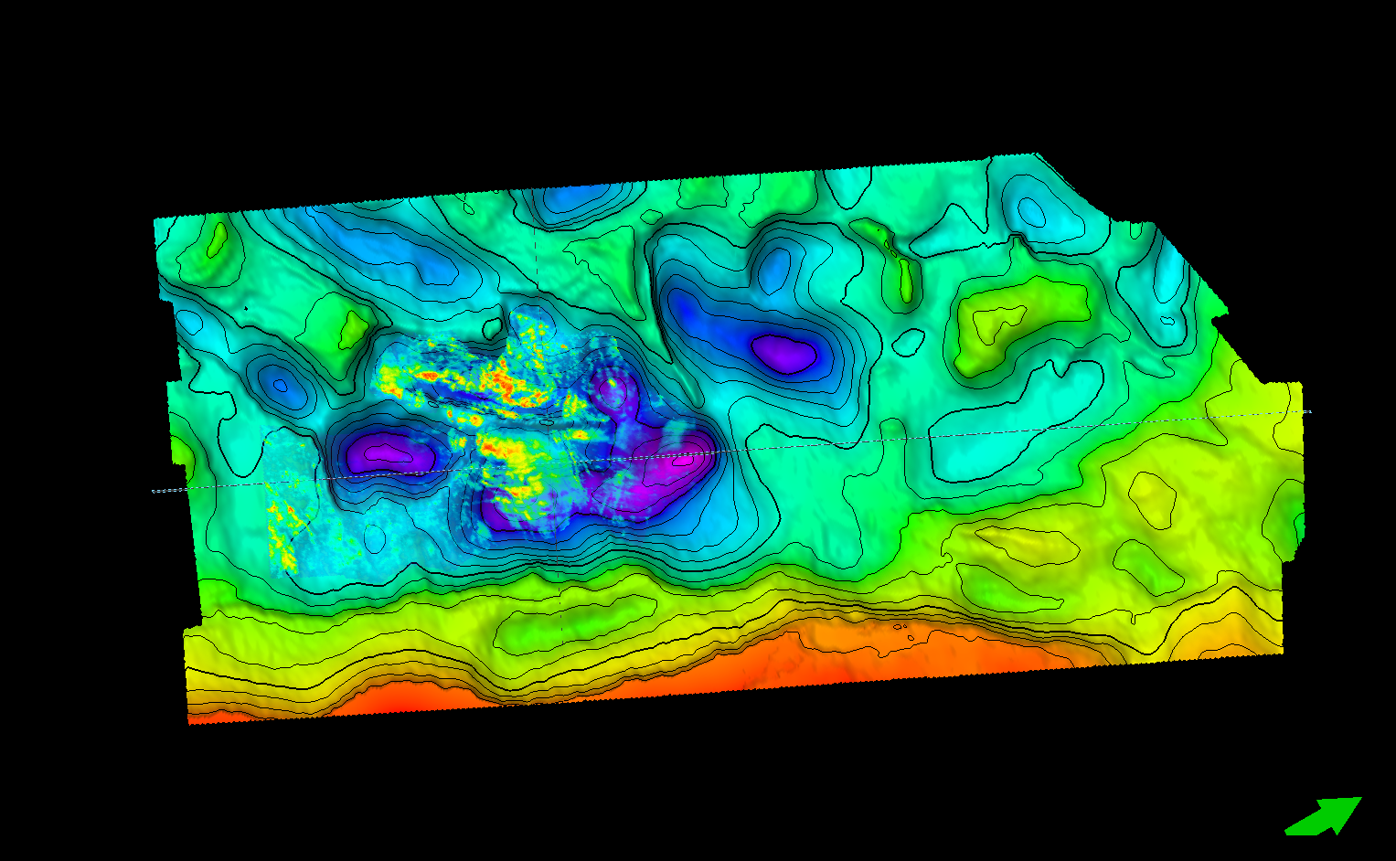
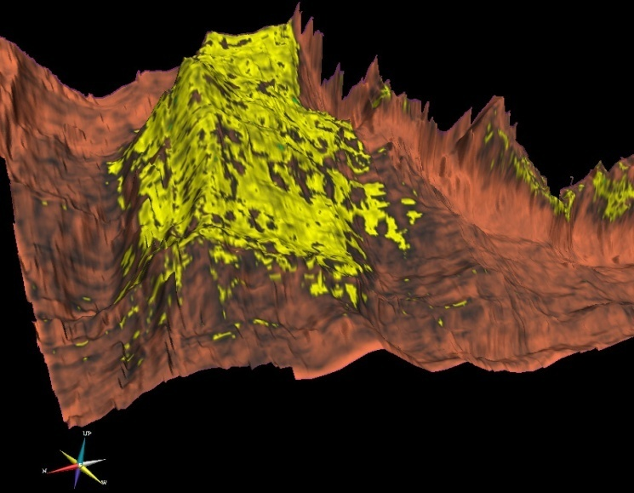
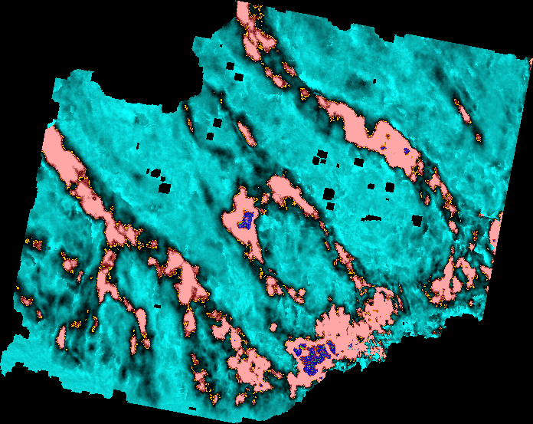
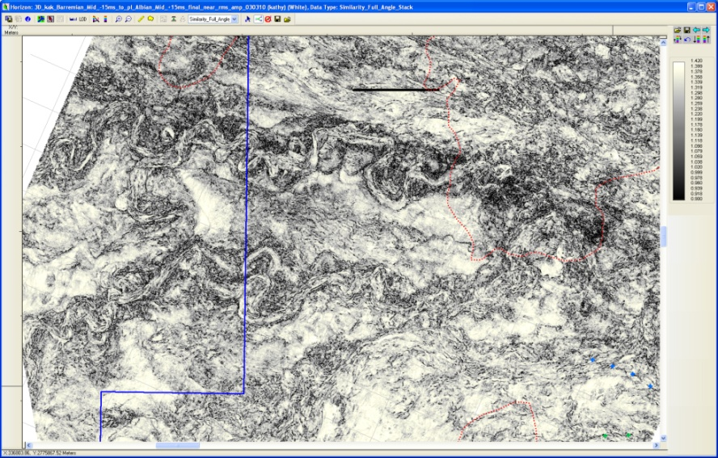
Exemples: Offshore 3D Seismic
Safi: Lower Cretaceous submarine fan
Essaouira:Middle Jurassic RMS Amplitudes
Agadir:Lower Cretaceous RMS Amplitudes
Boujdour:Lower Cretaceous channel systems
Base Cretaceous Slope Channels-Not Tested

Slide 14
NON CONVENTIONAL HYDROCARBON
OIL SHALE POTENTIAL IN MOROCCO
Notes:
l‘historique des activités de l’Exploration Pétrolière a été subdivisé en Quatre phases principales. Celles-ci sont définies

Slide 15
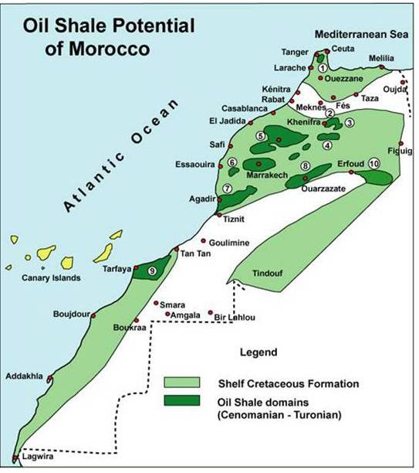
Non conventional hydrocarbon
Oil Shale Potential in Morocco
Morocco has important oil reserves contained in the oil shale (approximately 50 billions barrels) (Timahdit+Tarfaya)
The efforts of research started during the Eighties are reactivated with national and foreign partners within the framework of our global strategy
Notes:
l‘historique des activités de l’Exploration Pétrolière a été subdivisé en Quatre phases principales. Celles-ci sont définies

Slide 16
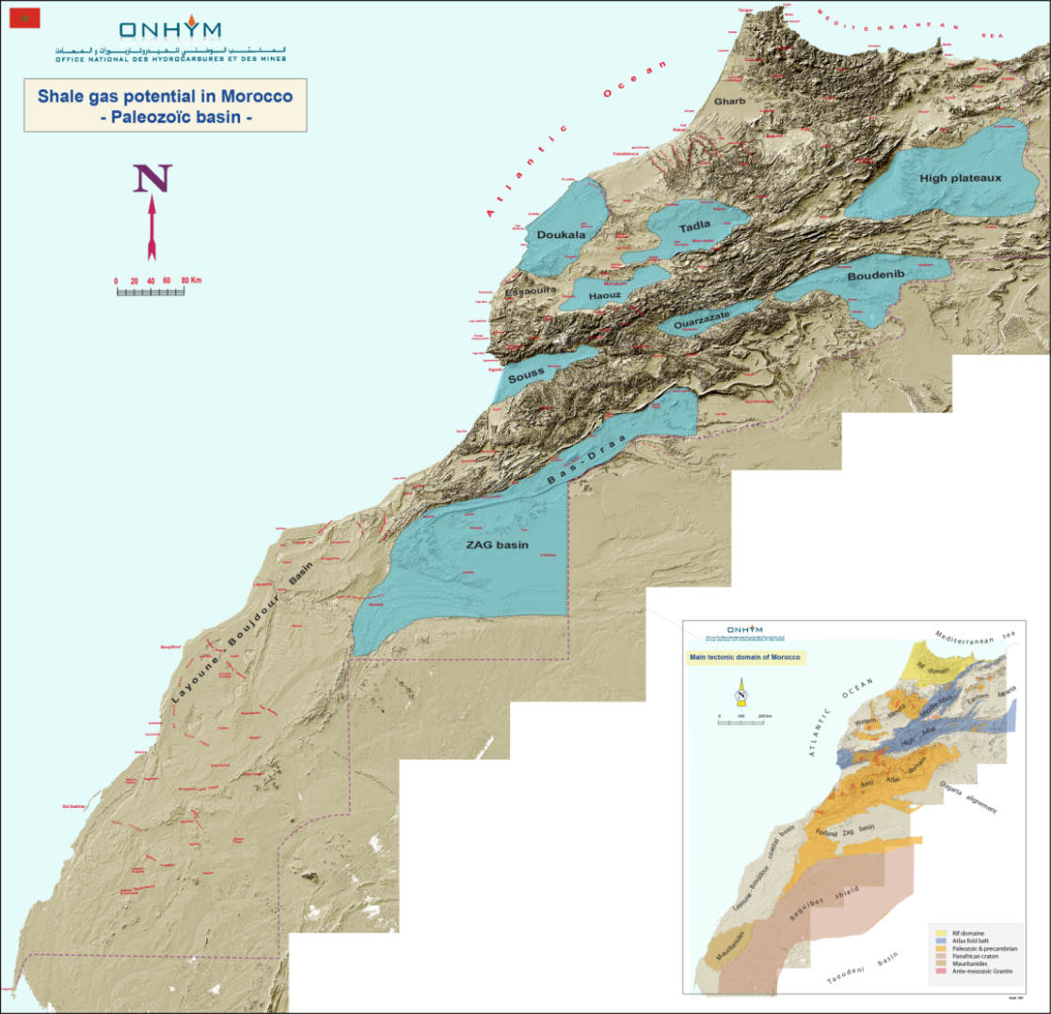
Non conventional hydrocarbon
Shale Gas Potential in Morocco
First Geological Appraisal
of Paleozoic Depositional
System
Other basins worth a deep exploration work.
The Mesozoic and Tertiary sediments have a good potential and we are looking at them closely.

Slide 17

Carboniferous
Area : 10000 Km²
Age : Carboniferous
TOC : 1 – 2 %
Area : 8000 Km²
Age : Carboniferous
TOC : 1 – 2 %
Area : 11000Km²
Age : Carboniferous
TOC : 1 – 1.6 %
Area : 6500 Km²
Age : Carboniferous
TOC : 1 – 1.45 %

Slide 18
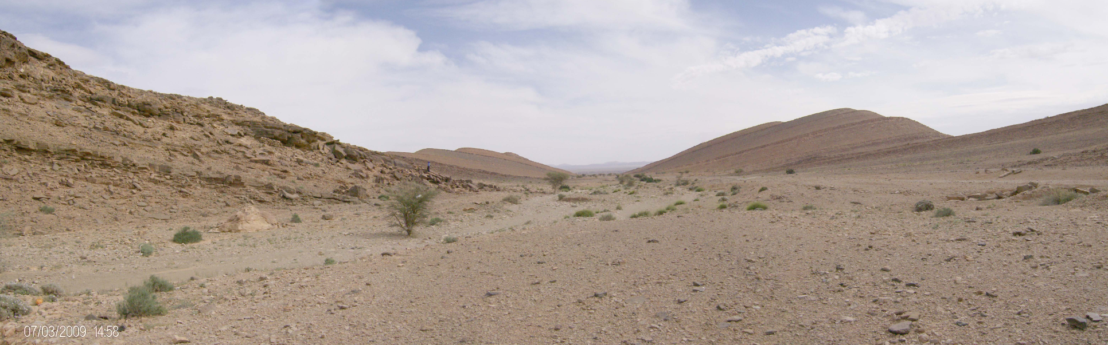
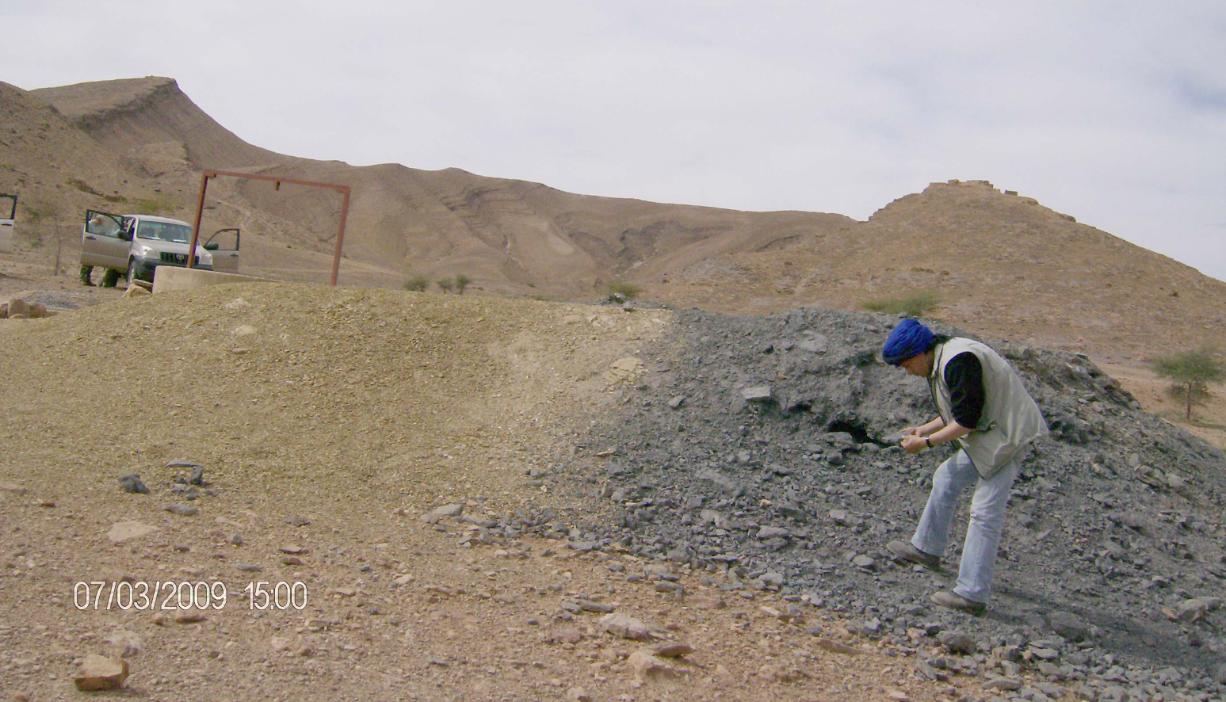
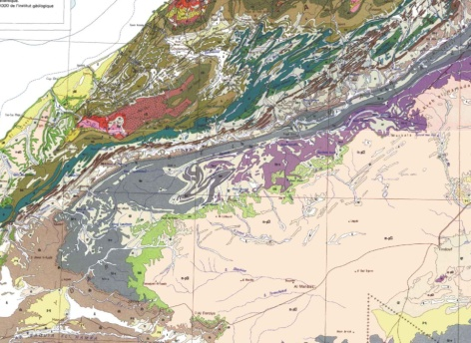
Tournaisian black shale from a water well (Jebel Ouarkziz, northern Zag – Bas Draa)

Slide 19
Devonian
Area : 10000 Km²
Age : Devonian
TOC : 1 – 5.30 %
Area : 8000 Km²
Age : Devonian
TOC : 1 – 2.48 %
Area : 65000 Km²
Age : Devonian
TOC : 1 – 2 %
Area : 6500 Km²
Age : Devonian
TOC : 1 – 1.30 %

Slide 20
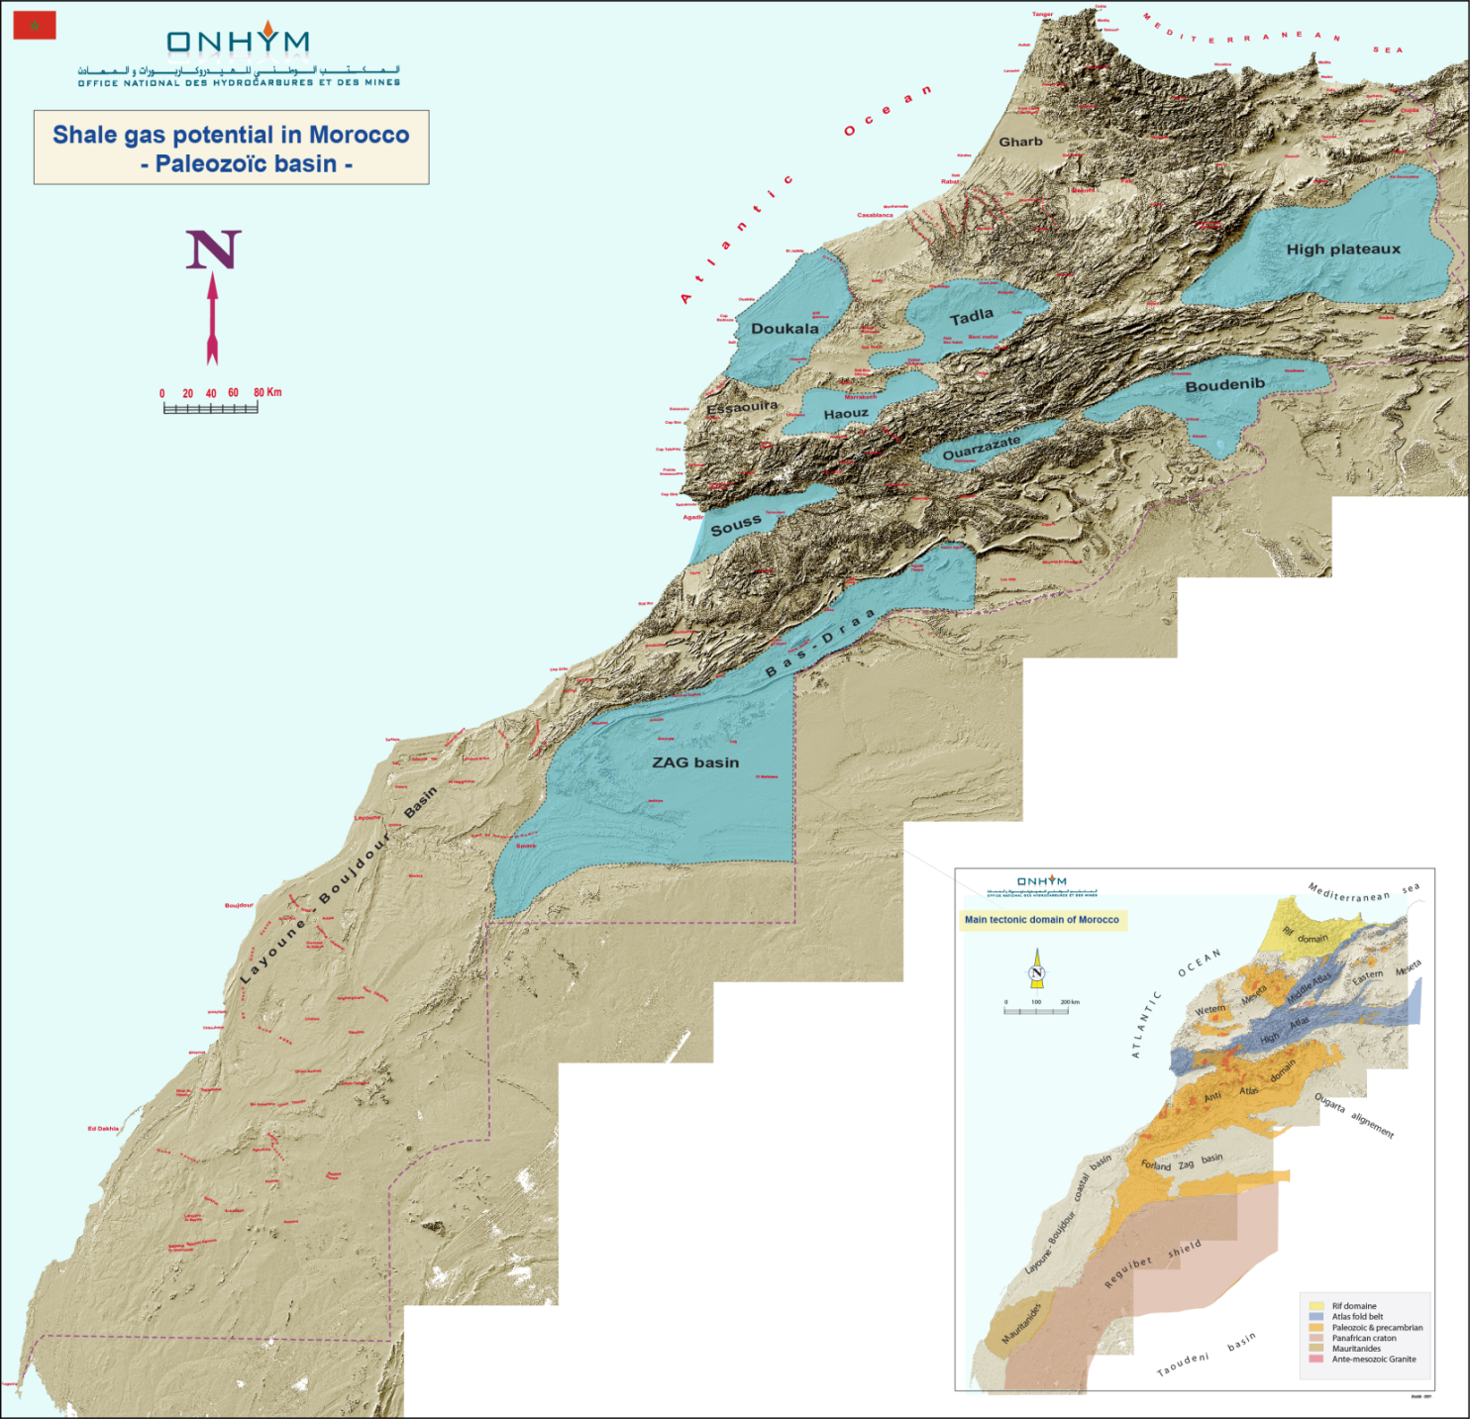
Silurian
Area : 10000 Km²
Age : Silurian
TOC : 1 - 12 %
Area : 8000 Km²
Age : Silurian
TOC : 1 – 2.10 %
Area : 6500 Km²
Age : Silurian
TOC : 1 – 3 %
Area : 65000 Km²
Age : Silurian
TOC : 1 – 2 %

Slide 21
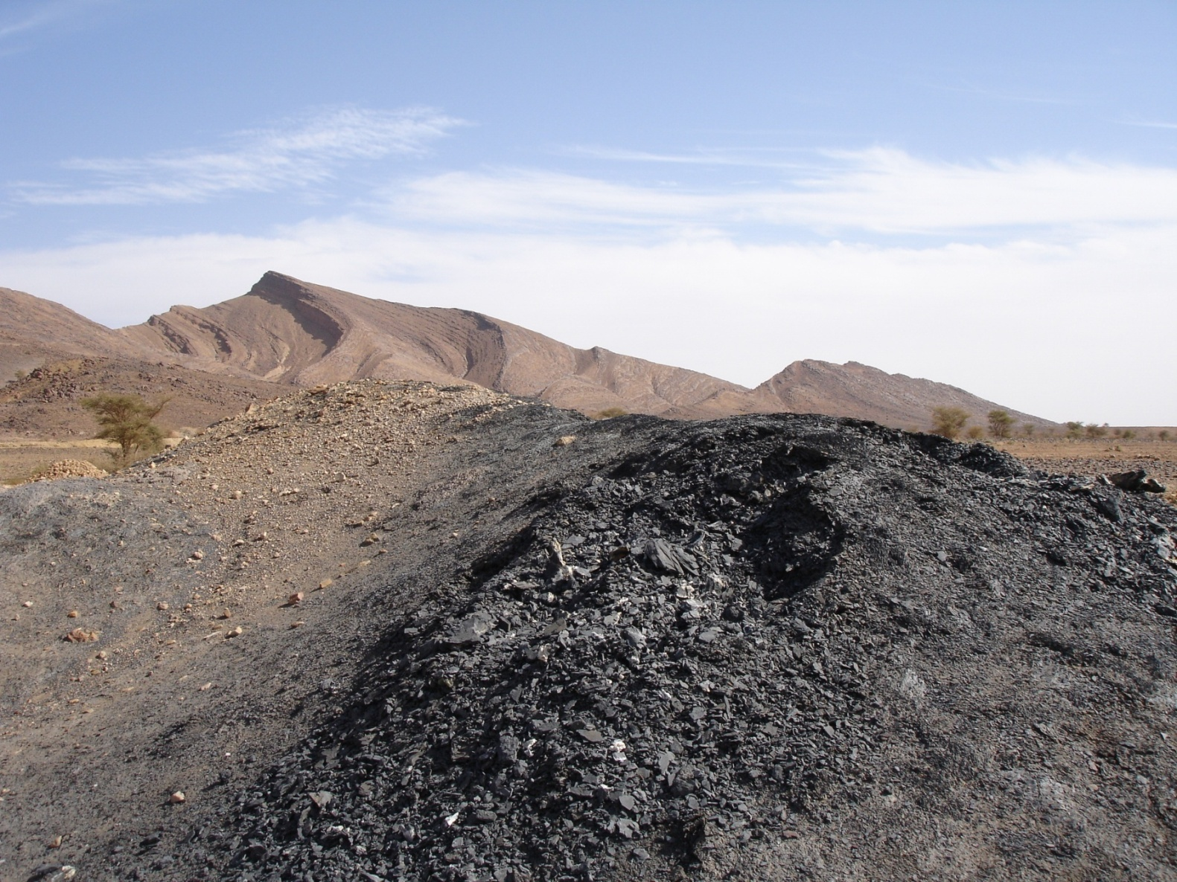
Silurian shale
(Eastern Anti-Atlas)
Ordovician Sandstone
Silurian shales

Slide 22

Ordovician
Area : 10000 Km²
Age : Ordovician
Area : 8000 Km²
Age : Ordovician
Area : 65000 Km²
Age : Ordovician
Area : 6500 Km²
Age : Ordovician

Slide 23
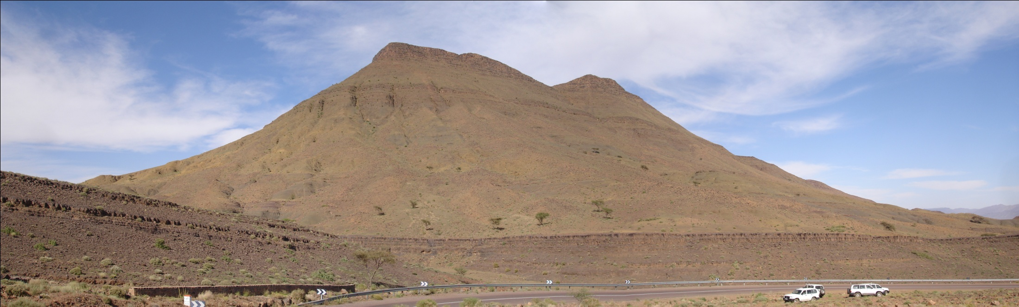
Middle Cambrian shales
(Central Anti-Atlas, South of Ouarzazate)
Tabanit Sandstone
P a r a d o x i d e s s h a l e

Slide 24
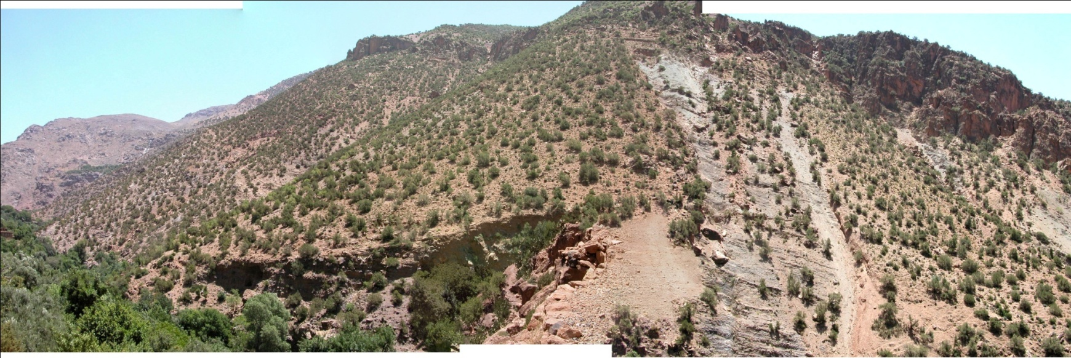
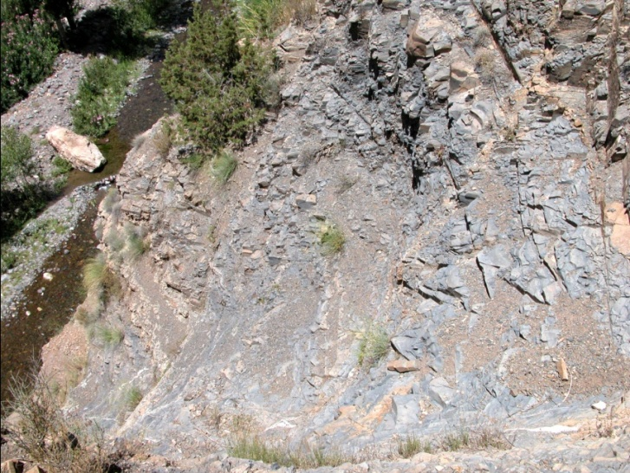
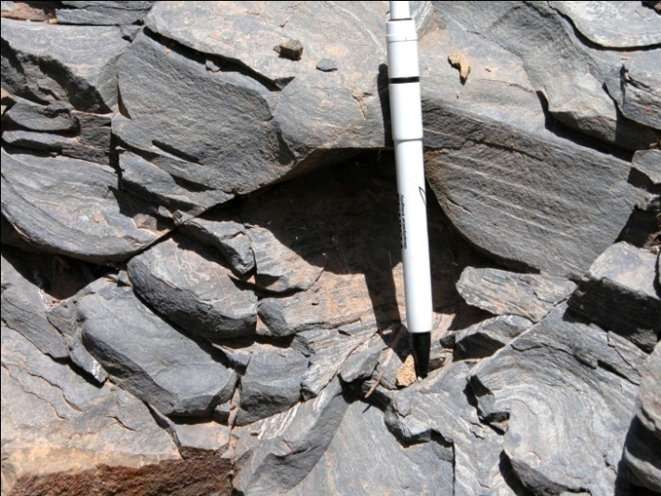
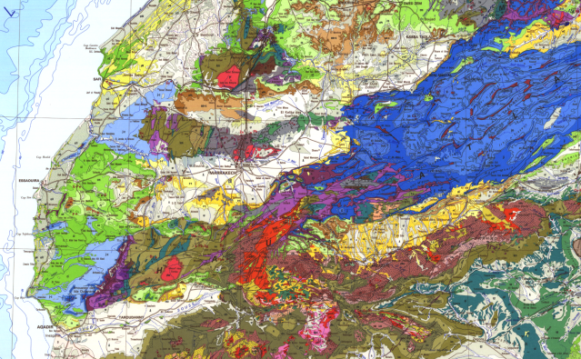
Precambrian shale
(Western High Atlas, South of Marrakech)

Slide 25
Perspectives & conclusions:
Future orientations and choices
ONHYM will continue the impulse the consolidation
of this new dynamics to :
Intensify petroleum exploration in our country
Attract maximum international investors
Realize in partnership with its partners,
commercial discoveries.
Notes:
ONHYM will continue the impulse and the consolidation of this new
dynamics to:
Intensify the petroleum exploration in our country
Attract maximum Oil & Gas players
Realize in partnership with its partners, commercial discoveries.

Slide 26
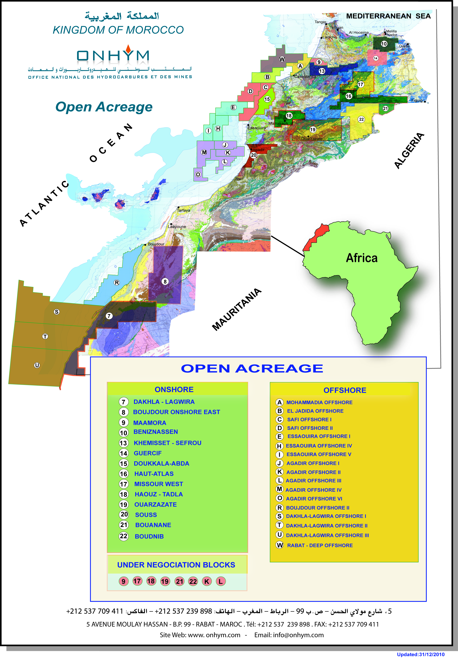
Perspectives & conclusions:
What Morocco has to offer?
Growing local energy demand
Developing infrastructure
Favourable and attractive terms
Acreage with good prospectivity
An easy place to operate.
Freely Accessible rich data base
An exciting future…
Notes:
I would like to conclude by this note:
As long as our launched strategy is pursued, it is possible for us
to affirm, with force and in resasonable terms, that our chances
to make discoveries, both onshore and offshore, remain intact.

Slide 27
A copy of this presentation and other materials
at booth International Pavilion
Please stop by
Thank you

