Slide 1
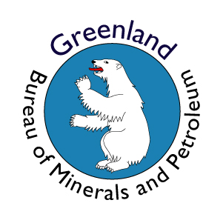
Henrik Stendal
Bureau of Minerals and Petroleum – BMP
Government of Greenland

Slide 2
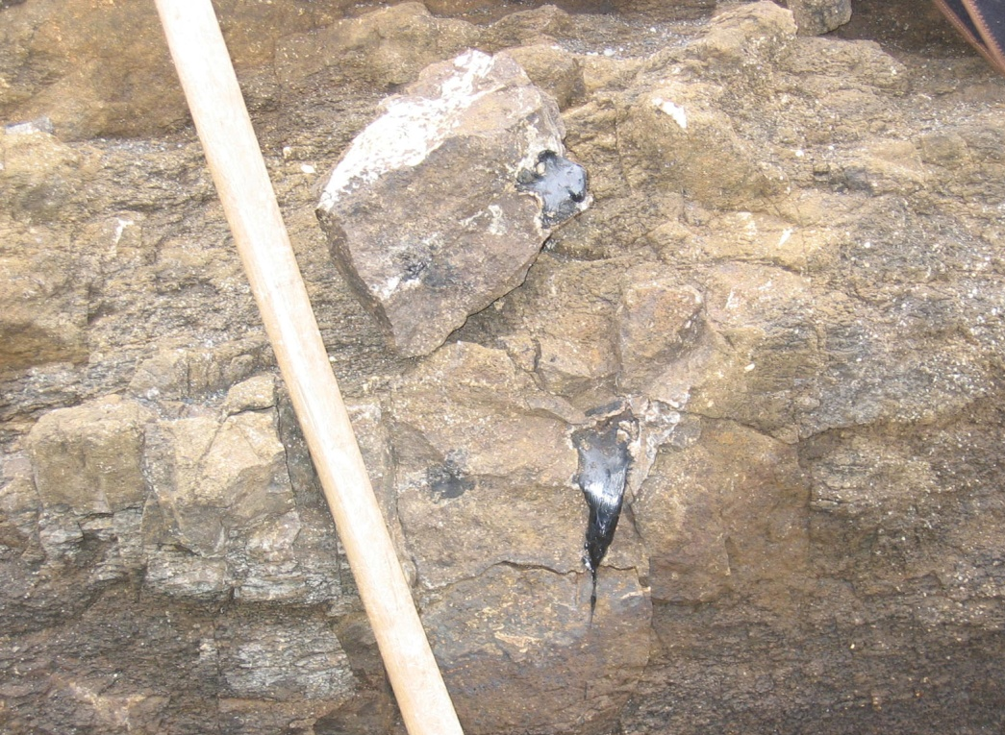
Greenland update
What has happened
in the last year?
Notes:
2

Slide 3
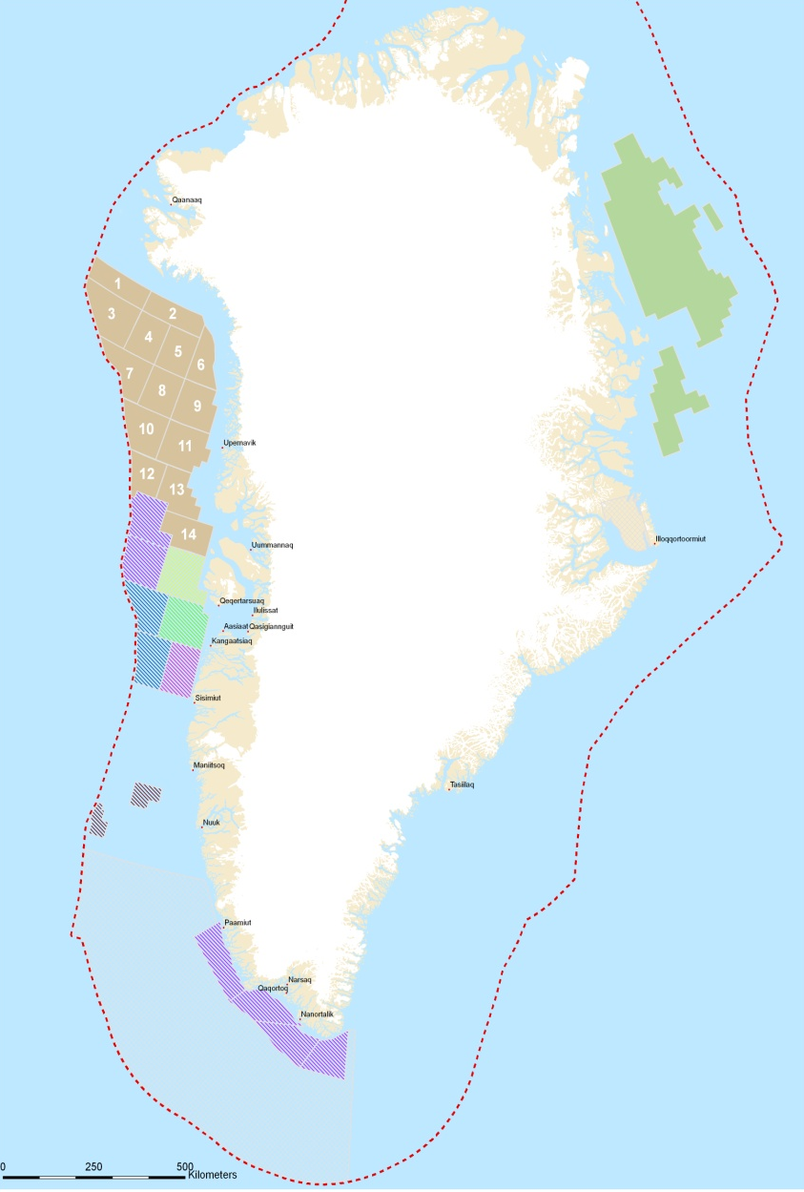
The licensing policy
Greenland Licensing Round 2012
Licensing rounds approximately every 2nd year: 2002, 2004, 2006, 2007, 2008 and 2010 have resulted in a boom in oil exploration in the last couple of years
More than 200.000 km² offshore West Greenland are now covered by exploration and exploitation licences
2010
and 2013
2006 and 2007
2002 and 2004
2007 and 2008

Slide 4
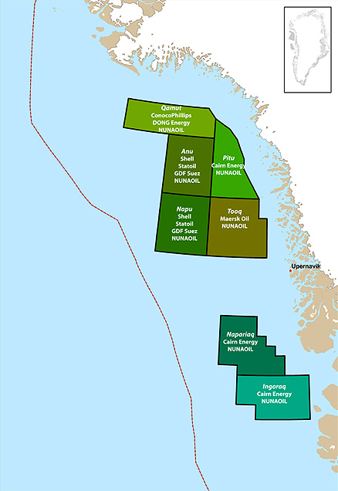
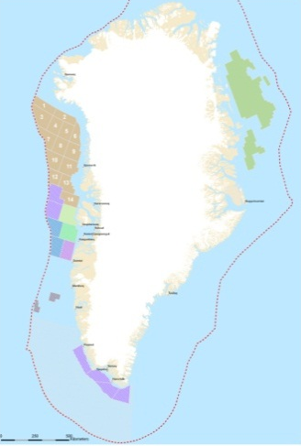
The result of the 2010 Baffin Bay licensing round
Seven licences have been awarded to the following groups of companies:
ConocoPhillips, DONG Energy and
NUNAOIL (“Qamut”)
Shell, Statoil, GDF Suez and NUNAOIL
(“Anu” og “Napu”)
Cairn Energy and NUNAOIL (“Pitu”,
“Napariaq” og “Ingoraq”)
Maersk Oil and NUNAOIL (“Tooq”)
With the addition of the new licensees, the list of companies with exclusive licences for oil/gas exploration in Greenland now comprises:
Exxon, Chevron, Husky, PA Resources, Cairn Energy, PETRONAS, ConocoPhillips, Shell, Statoil, GDF Suez, Maersk Oil, DONG Energy and NUNAOIL.

Slide 5
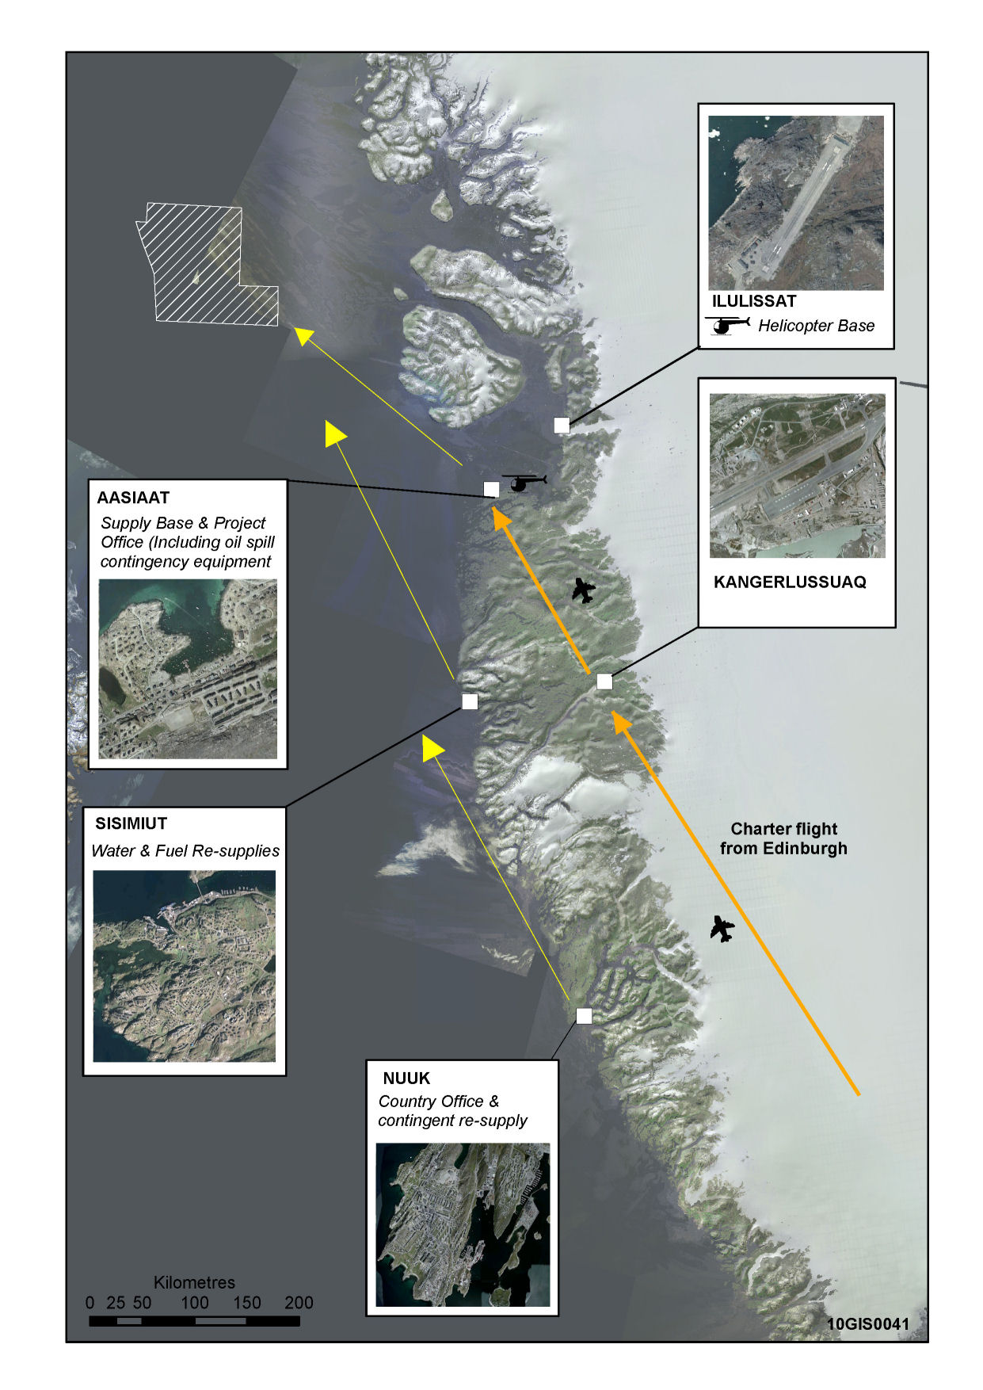
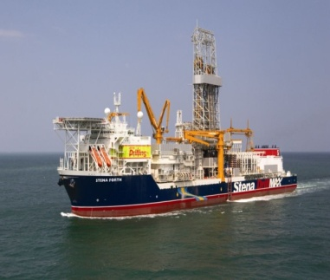
Drilling results 2010
Sigguk Exclusive Licence 2008/10
Cairn Energy has released the following geological results from the company’s offshore drilling program west of Disko-Nuussuaq in Greenland waters.
Cairn Energy announces that they have found hydrocarbons (oil) in the Alpha well. The oil is observed in a 460 m thick section in a sequence of volcanic rocks.
Laboratory analyses of different oil-bearing samples from the well confirm the presence of two oil types with different provenance and grade of maturity.
Cairn Energy reported in the middle of August this year, the existence of gas in the T8 well in the same area, thus hydrocarbons have been recorded in the first two wells in the region.
Stena - Forth
16 hours
23 hours
Stena - Don
36 hours
Notes:
Based on a maximum likely drilling programme of 150 days from entering Greenland territory to demobilising from Greenland waters (124 days for the
Stena Forth MODU and 95 days for the Stena Don MODU),
2 Rig Strategy – Drilling Program
The 2 rigs for the Greenland project are both dynamically positioned (DP), no anchors and kept in position by thrusters and GPS.
The drillship is the Stena Forth and the semi sub is the Stena Don, both are two of the most modern state of the art vessels in their class
Stena Forth DP Drillship, operates in broken ice
Stena Don Semi- Submersible both harsh environment rig
Detailed rig inspections and audits to ensure Arctic level environmental, safety and operations compliance
Helicopter Logistics – Helicopter Main Base - Hanger and maintenance facilities – Flight and maintenance crews based in Ilulissat, and
Personnel and Freight operates out of Aasiaat
2 x S-92 Crew change helicopter - S92 air frames for extended range and payload
1 x S-61 SAR and Oil Spill Response service - 24/7 Search and Rescue Capability
Helicopter iceberg reconnaissance and AIS beacon deployment
Logistics Vessels -
Ware-ship; Flotel (fog contingency) and storage of drilling equipment
1 x accommodation vessel / warship;
2x icebreaker vessels;
1 multi role icebreaker and Ice Management (IM) vessel;
1 multi role Emergency Response and Rescue Vessel (ERRV), Oil Recovery
and Ice Management Vessel;
2 x ERRV Standby vessels;
1 x Platform Supply Vessel (PSV); and
1 x Anchor Handling / ice breaker / ice management.

Slide 6
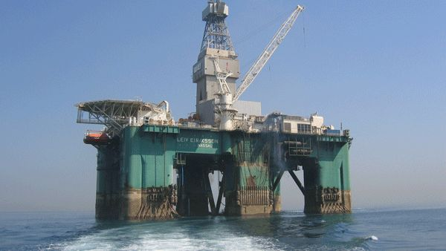
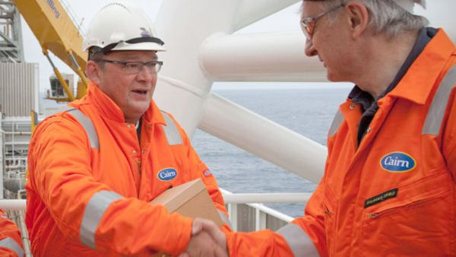
Cairn Energy plans to continue the drilling campaign in Greenland in 2011
Cairn Energy Plc. plans to conduct an oil exploration drilling campaign with up to 4 wells offshore Greenland during the 2011 season, subject to approval from the Greenland Government.
Cairn informs that the company plans to use 2 drilling vessels for the exploration drilling; a drilling ship and a semi-submersible drilling rig, a combination also used in the 2010 drilling campaign.
In 2011 Cairn plans to use the ”Leiv Eiriksson” (semi-submersible drilling rig) and the ”Corcovado” (drilling ship), both vessels owned and operated by Ocean Rig, whose operation locations includes the North Sea
Notes:
Based on a maximum likely drilling programme of 150 days from entering Greenland territory to demobilising from Greenland waters (124 days for the
Stena Forth MODU and 95 days for the Stena Don MODU),
2 Rig Strategy – Drilling Program
The 2 rigs for the Greenland project are both dynamically positioned (DP), no anchors and kept in position by thrusters and GPS.
The drillship is the Stena Forth and the semi sub is the Stena Don, both are two of the most modern state of the art vessels in their class
Stena Forth DP Drillship, operates in broken ice
Stena Don Semi- Submersible both harsh environment rig
Detailed rig inspections and audits to ensure Arctic level environmental, safety and operations compliance
Helicopter Logistics – Helicopter Main Base - Hanger and maintenance facilities – Flight and maintenance crews based in Ilulissat, and
Personnel and Freight operates out of Aasiaat
2 x S-92 Crew change helicopter - S92 air frames for extended range and payload
1 x S-61 SAR and Oil Spill Response service - 24/7 Search and Rescue Capability
Helicopter iceberg reconnaissance and AIS beacon deployment
Logistics Vessels -
Ware-ship; Flotel (fog contingency) and storage of drilling equipment
1 x accommodation vessel / warship;
2x icebreaker vessels;
1 multi role icebreaker and Ice Management (IM) vessel;
1 multi role Emergency Response and Rescue Vessel (ERRV), Oil Recovery
and Ice Management Vessel;
2 x ERRV Standby vessels;
1 x Platform Supply Vessel (PSV); and
1 x Anchor Handling / ice breaker / ice management.

Slide 7
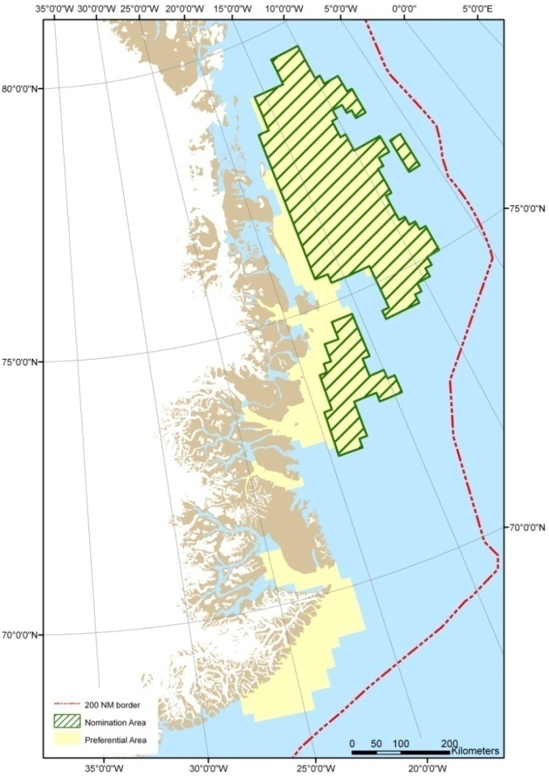
Greenland Licensing Rounds 2012 and 2013
Announcement of the licence area
50,000 km²
Terms and conditions

Slide 8
The North East Greenland Licensing Rounds 2012 and 2013
The area
The area designated for licensing in NE Greenland is shown to the right.
In all 50,000 km² will be included in the pre-licensing round and the ordinary licence rounds. 30,000 km² of those will be in the pre-round

Slide 9
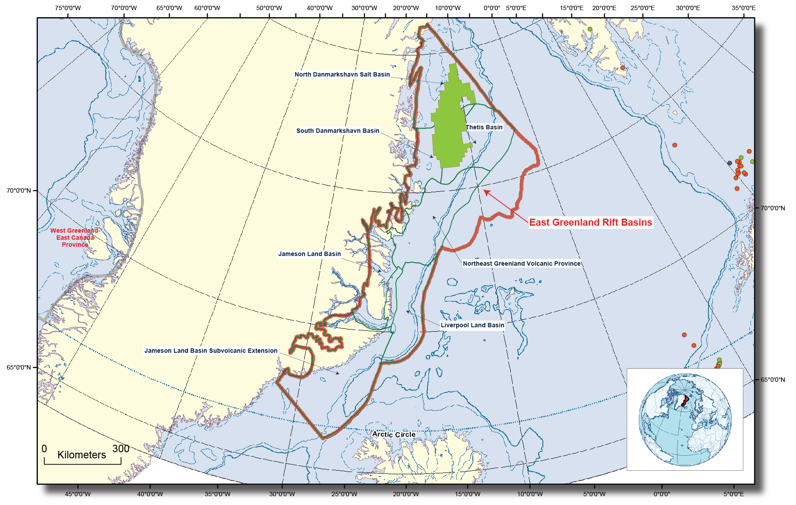
The North East Greenland
Licensing Rounds 2012 and 2013
Assessment
The licensing area lies within the East Greenland Rift Basins Province covered by the USGS assessment.
Estimating the mean undiscovered, pretroleum resources to be 31,400 MMBOE of oil and gas and natural gas liquids (USGS fact sheet 2007-3077)

Slide 10
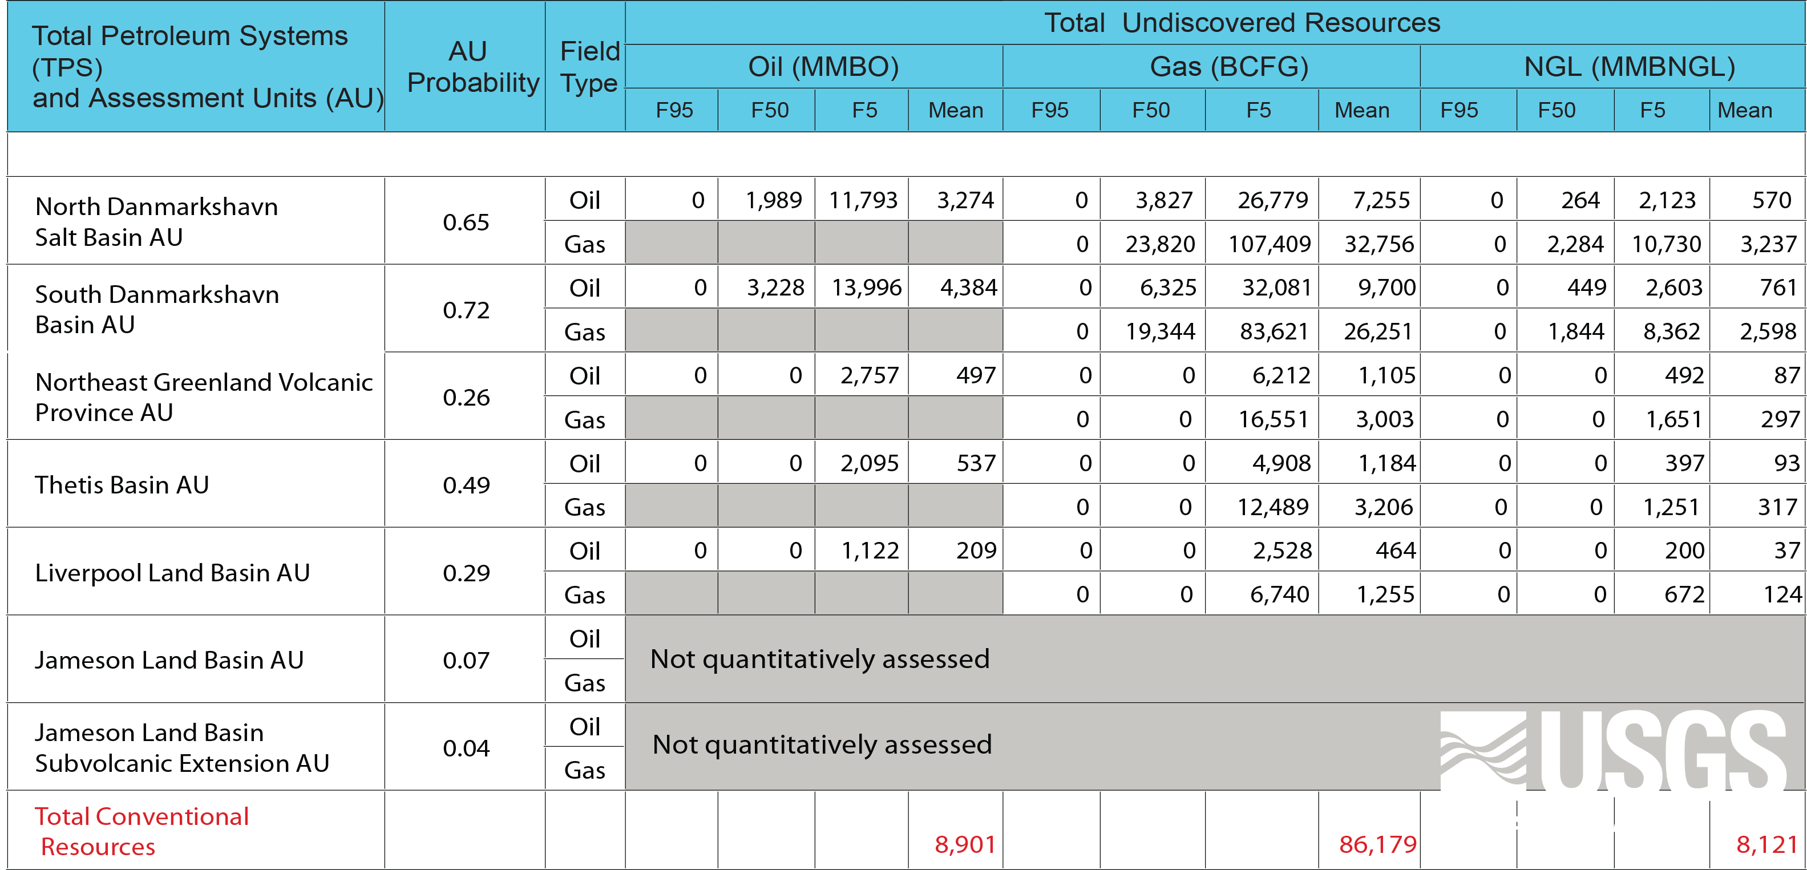
The North East Greenland
Licensing Rounds 2012 and 2013
Assessment
Of the five assessed units:
the North Danmarkshavn Basin and
the South Danmarkshavn Basin
are estimated to contain the most of the undiscovered petroleum resources

Slide 11
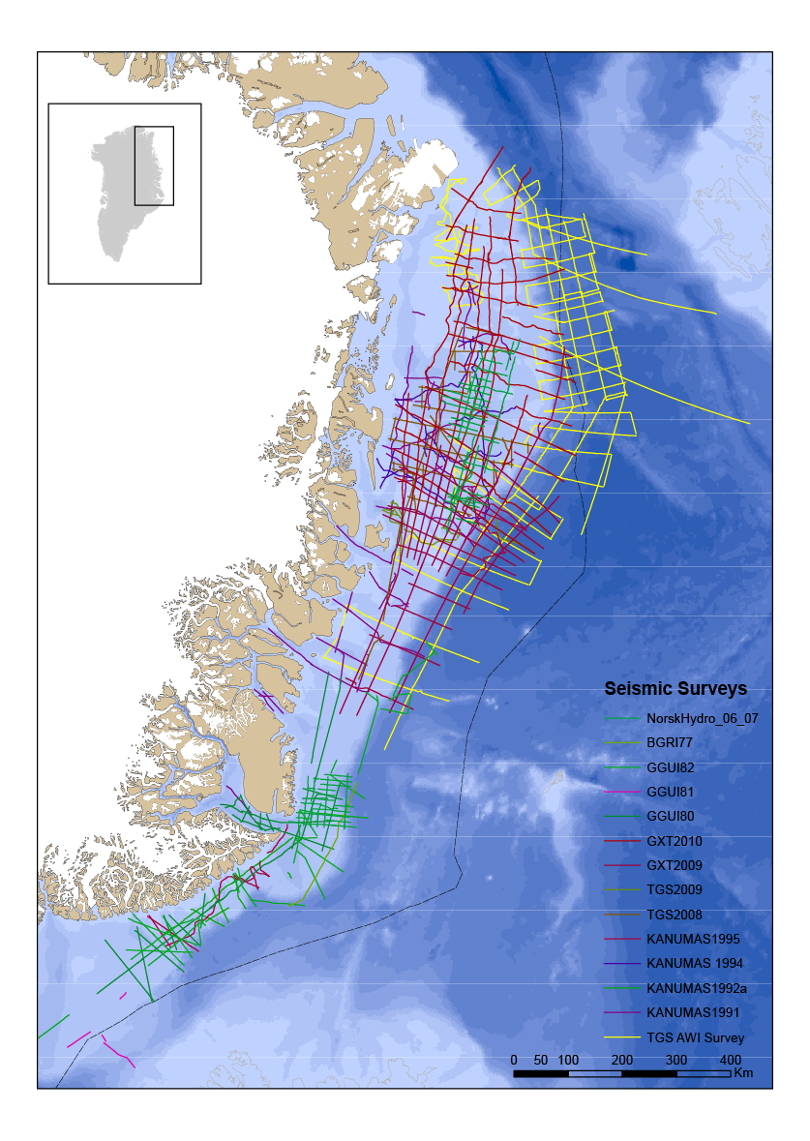
The North East Greenland
Licensing Rounds 2012 and 2013
Data
In the 90’s the KANUMAS group acquired 6,839 line km seismic data offshore Northeast Greenland
TGS-Nopec and GXT/ION has recently completed a seismic aquisition programme off the coast of Northeast Greenland
2,850 line km of seismic data were acquired in 2008 and 507 km in 2009 by TGS-Nopec
GXT/ION acquired 5283 km in 2009 and additional 6535 km in 2010
Additional seismic acquisitions are planned in 2011 – talk to the companies – they are here at the AAPG exhibition

Slide 12
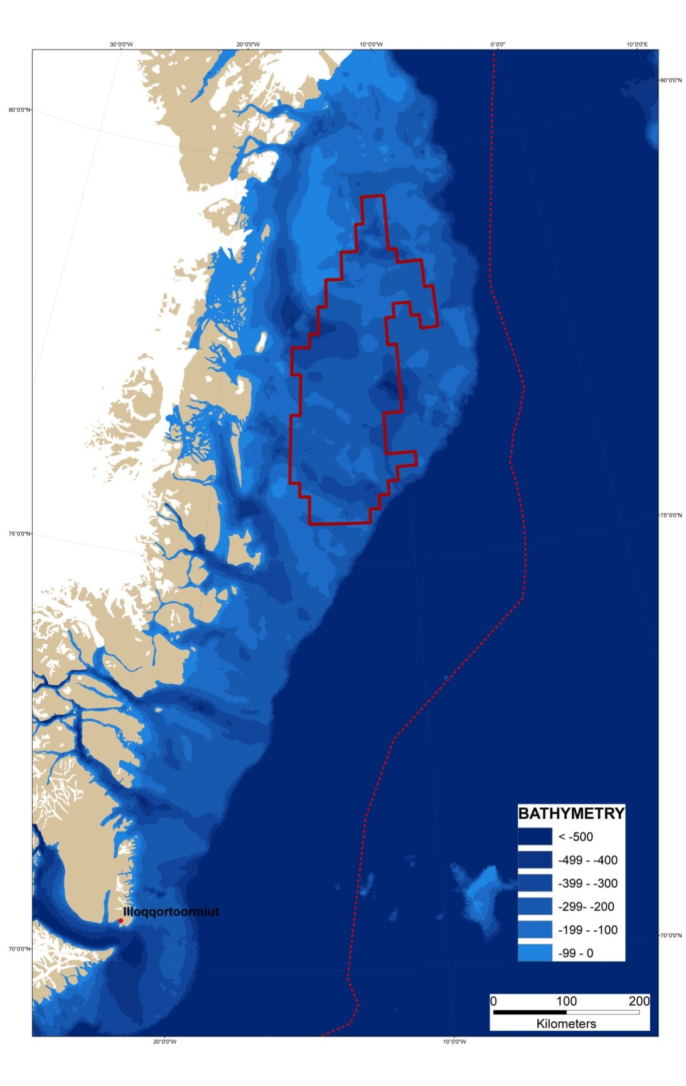
The North East Greenland
Licensing Rounds 2012 and 2013
Bathymetry
Shallow water depths in the licensing area
+500

Slide 13
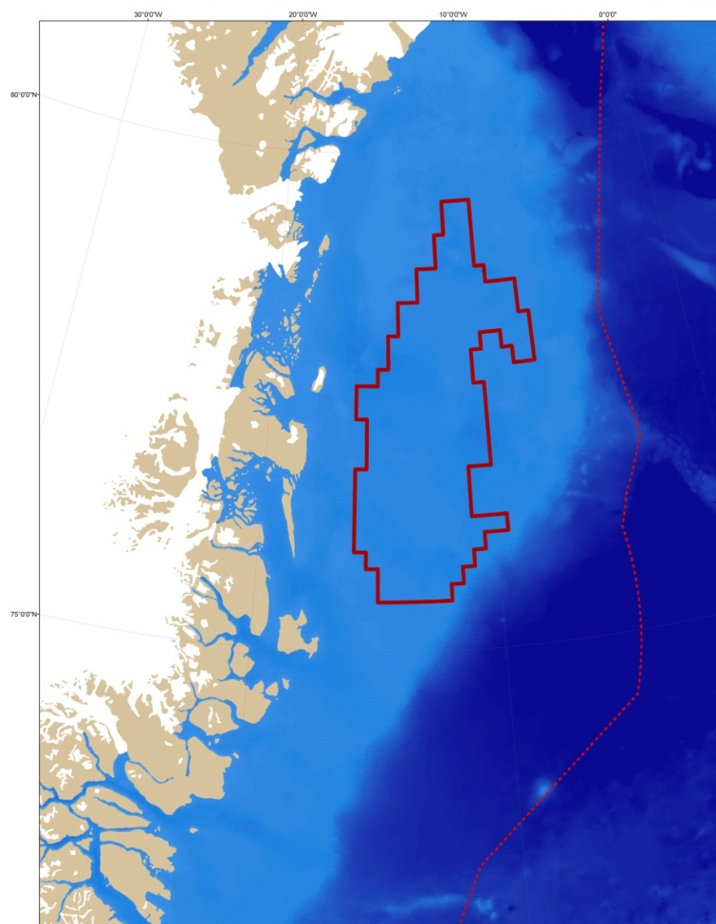
The North East Greenland
Licensing Rounds 2012 and 2013
Outline of licence terms
Licences will be granted for an exploration period of up to 16 years with a right to a 30-year extension for areas where exploitation is intended.
The exploration period of 16 years can be divided into a number of sub periods. Work programme is to be agreed upon for each sub period before the Licence is granted.
At the end of each sub period 30 % of the original area of each Licence Block shall be relinquished.

Slide 14
The North East Greenland
Licensing Rounds 2012 and 2013
Outline of licence terms
Maximum 3 plus NUNAOIL A/S
  The NE Greenland Licence Call 2010 is for companies or groups of companies (maximum 3 plus NUNAOIL A/S). Companies or groups of companies applying shall include an approved Operator.
The licensee may before the end of each sub period choose either to surrender the Licence, or accept the work programme for the next sub period
  Drill or drop

Slide 15
The North East Greenland
Licensing Rounds 2012 and 2013
Possible work commitments
1st subperiod
The licensee shall acquire an adequate up-to-date seismic coverage to evaluate the Licence area. This corresponds to shooting xxxx line kilometres of new seismic data
Studies of ice and other operational Conditions (e.g. as joint study)
Before entering 2nd subperiod licensee shall decide to drill or drop
Exploratory Well(s) shall be drilled through/to ……(stratigraphic formation)….. or a total depth of .…metres, whichever is reached first
Before entering 3rd subperiod licensee shall decide to drill or drop
Delineation or exploratory wells drilled through/to ……(stratigraphic formation)….. or a total depth of .…metres, whichever is reached first
1st + 2nd + 3rd subperiods comprise 16 years in all
2nd subperiod
3rd subperiod
Notes:
Field operations:
April 24 – JD 114: Laser flights of northern lines (V5-V8), aircraft has to return to Kangerlussuaq base due to other commitments
April 26 – JD116: Twin-Otter reflight of part of line V7-V8 with helicopter validation – weather finally ok
Medivac at T12 on Greenland ice sheet
April 21 – JD111: Twin-Otter flight to Qaarsut, awaiting weather for helicopter operations, lidar scanning of two southern lines (V1-V4) – no helicopter ops possible due to weather
Field operations:
April 24 – JD 114: Laser flights of northern lines (V5-V8), aircraft has to return to Kangerlussuaq base due to other commitments
April 26 – JD116: Twin-Otter reflight of part of line V7-V8 with helicopter validation – weather finally ok
Medivac at T12 on Greenland ice sheet
April 21 – JD111: Twin-Otter flight to Qaarsut, awaiting weather for helicopter operations, lidar scanning of two southern lines (V1-V4) – no helicopter ops possible due to weather
Field operations:
April 24 – JD 114: Laser flights of northern lines (V5-V8), aircraft has to return to Kangerlussuaq base due to other commitments
April 26 – JD116: Twin-Otter reflight of part of line V7-V8 with helicopter validation – weather finally ok
Medivac at T12 on Greenland ice sheet
April 21 – JD111: Twin-Otter flight to Qaarsut, awaiting weather for helicopter operations, lidar scanning of two southern lines (V1-V4) – no helicopter ops possible due to weather
Field operations:
April 24 – JD 114: Laser flights of northern lines (V5-V8), aircraft has to return to Kangerlussuaq base due to other commitments
April 26 – JD116: Twin-Otter reflight of part of line V7-V8 with helicopter validation – weather finally ok
Medivac at T12 on Greenland ice sheet
April 21 – JD111: Twin-Otter flight to Qaarsut, awaiting weather for helicopter operations, lidar scanning of two southern lines (V1-V4) – no helicopter ops possible due to weather
Field operations:
April 24 – JD 114: Laser flights of northern lines (V5-V8), aircraft has to return to Kangerlussuaq base due to other commitments
April 26 – JD116: Twin-Otter reflight of part of line V7-V8 with helicopter validation – weather finally ok
Medivac at T12 on Greenland ice sheet
April 21 – JD111: Twin-Otter flight to Qaarsut, awaiting weather for helicopter operations, lidar scanning of two southern lines (V1-V4) – no helicopter ops possible due to weather

Slide 16
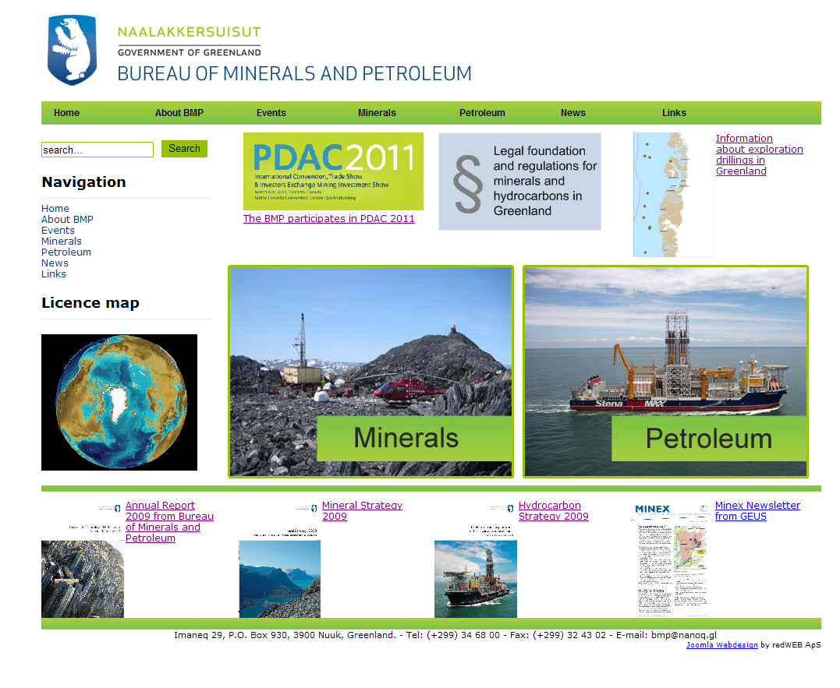
www.bmp.gl
New website – old link

Slide 17
Uulex
Greenland Oil Exploration Newsletter
Uulex is a newsletter to the international oil and gas exploration industry with updates of geo-scientific and legislative information about hydrocarbons in Greenland.
The name ‘Uulex’ is an abbreviation of ‘uulia’ (Greenlandic for oil) and ‘ex’ for exploration.
The newsletter is web based information news, which will be published two to three times a year by the Bureau of Minerals and Petroleum, Greenland Government at the webpage - www.bmp.gl.

Slide 18
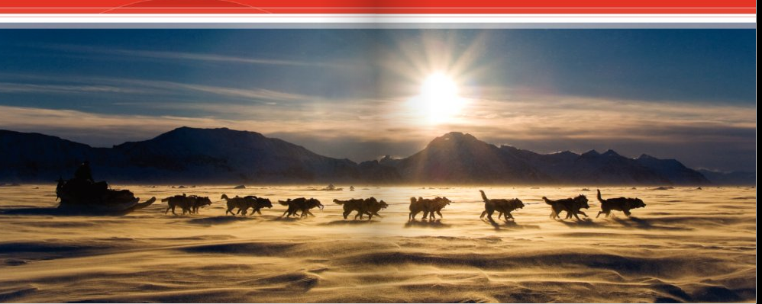

Thank you for the attention
Any questions…
Bureau of Minerals and Petroleum
Government of Greenland

